Slide 1
TRANSLATIONAL MEDICINE
taking discoveries for patients benefits
An overview of clinical trials:
the lay of the land
Noémi Zádori
Clinical Trial Course
Pécs, 2019.09.02.

Slide 2
TRANSLATIONAL MEDICINE
taking discoveries for patients benefits
We will cover:
1.descriptive studies – Benedek Tinusz
2. Analytical studies: cohort studies, case-control studies - Dániel Pécsi
3. Bias in observational studies – Zsolt Szakács

Slide 3
TRANSLATIONAL MEDICINE
taking discoveries for patients benefits
Aims for today
to provide basic knowledge of observational clinical studies
Lecture
to learn how to check, interpret and
critically appraise observational clinical studies
Practice

Slide 4
TRANSLATIONAL MEDICINE
taking discoveries for patients benefits
What does „clinical trial” mean?
experiments or observations done in clinical research
are performed on human participants
clinical trials are not limited to pharmaceutical 'phase studies'
Aim: to improve the healthcare system
Their goal is to anwer a specific scientific question.

Slide 5
TRANSLATIONAL MEDICINE
taking discoveries for patients benefits
Questions of clinical trials
Is it appropriate?
„So what?”
Hulley S, Cummings S, Browner W, et al. Designing clinical research. 3rd ed. Philadelphia (PA): Lippincott Williams and Wilkins; 2007.

Slide 6
TRANSLATIONAL MEDICINE
taking discoveries for patients benefits
Questions of clinical trials
Derived from the clinical problems to solve
Patient and/or Problem
Intervention
Comparison intervention (”gold standard”)
Outcome

Slide 7
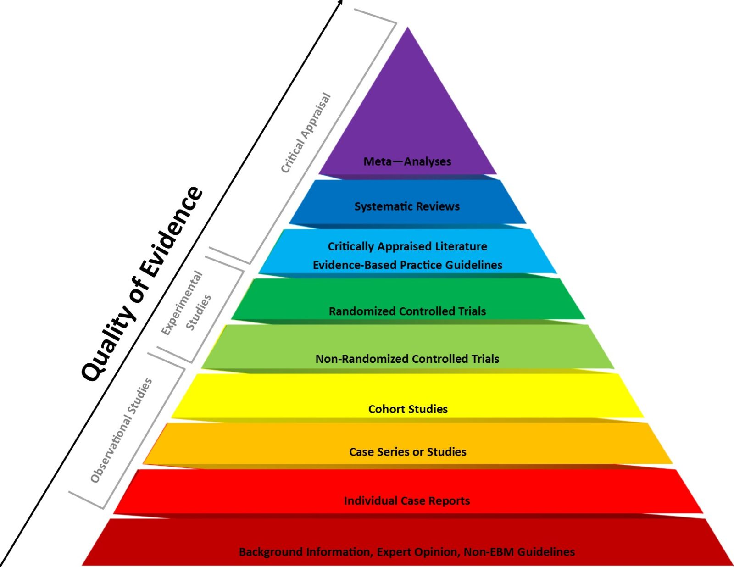
TRANSLATIONAL MEDICINE
taking discoveries for patients benefits
0. We should know the types of trials
1. Choose the right type for the question
Lancet, Epidemiology Series, 2002

Slide 8
TRANSLATIONAL MEDICINE
taking discoveries for patients benefits
1.
1. Is the intervention necessary because of the trial?
2.
3.
2. Is is randomized?
3. Is it controlled?
4.
4.How does the exposure and endpoint related to time?
Grimes DA, Schulz KF. Lancet. 2002

Slide 9
TRANSLATIONAL MEDICINE
taking discoveries for patients benefits
End of the study
Final analysis
Follow up
Interim analysis, Safety analysis
Data collecting
‘Must have’data
Ethical approval
Expected adverse events
Reg., Pre-pub protocol
It is neccesary for high-quality evidence
Sample size calculation
Hypothesis, expected effectivity
Protocol
According to preliminary search/knowledge

Slide 10
TRANSLATIONAL MEDICINE
taking discoveries for patients benefits
How many patients are needed?
Sample size calculation
What do we have to know?
How big is the difference we do expect between the groups?
Literature search done systematically
If there is no such data available: the own trial or own hypothesis might be used

Slide 11
TRANSLATIONAL MEDICINE
taking discoveries for patients benefits
Hypothesis
Might be derived from the scientific qestion we ask
Provides the justification for the clinical trial
It can be answered handling the methods used in the trial
Usually based on the primary endpoint
It is antecedent to the trial and establishes the trial's direction
The most widely employed method of determining whether the outcome of clinical trials is positive or negative
Should be tested at the end of the study (can be 1-sided or 2-sided)

Slide 12
TRANSLATIONAL MEDICINE
taking discoveries for patients benefits
How can I choose the right endpoint?
Primary
vs.
Secundary
There is usually only one primer endpoint
There is more than one
The hardest one' wins
Not so 'hard'
The most relevant above all
More like an additional information
Sample size calculation is based on this one
Less 'power'

Slide 13
TRANSLATIONAL MEDICINE
taking discoveries for patients benefits
What kind of endpoint should I choose?
Hard
vs.
Soft
Objective
Can be subjective
Can be measured accurately
Uncertanity of measurement
Mortality
Length of hospitalization
Pain
QoL
Cause-specific
mortality
Need for surgery
CRP level

Slide 14
TRANSLATIONAL MEDICINE
taking discoveries for patients benefits
COMMON MISTAKES
The clinical qestion is inappropriate
Choosing not the right type of trial for the question
Not relevant study design – sample size calculation, endpoint

Slide 15
TRANSLATIONAL MEDICINE
taking discoveries for patients benefits
'TAKE HOME MESSAGE'
The importance of preliminary knowledge of the relevant data in literature
Search in the literature for getting the methods known – decision for the appropriate processes
Clear questions, hypothesis and goals (PICO)

Slide 16
TRANSLATIONAL MEDICINE
taking discoveries for patients benefits
Analytical studies:
Cohort, case-control and
cross-sectional
. Dániel Pécsi
Clinical Trial Course
Pécs, 2019.09.02.

Slide 17
DOI:
10.1016/S0140-6736(02)07283-5
TRANSLATIONAL MEDICINE
taking discoveries for patients benefits
Introduction to observational studies
Observational studies dominate the literature
Is the study design appropriate to answer the research question?
E.g. descriptive studies cannot assess associations
Analytical vs. Descriptive studies

Slide 18
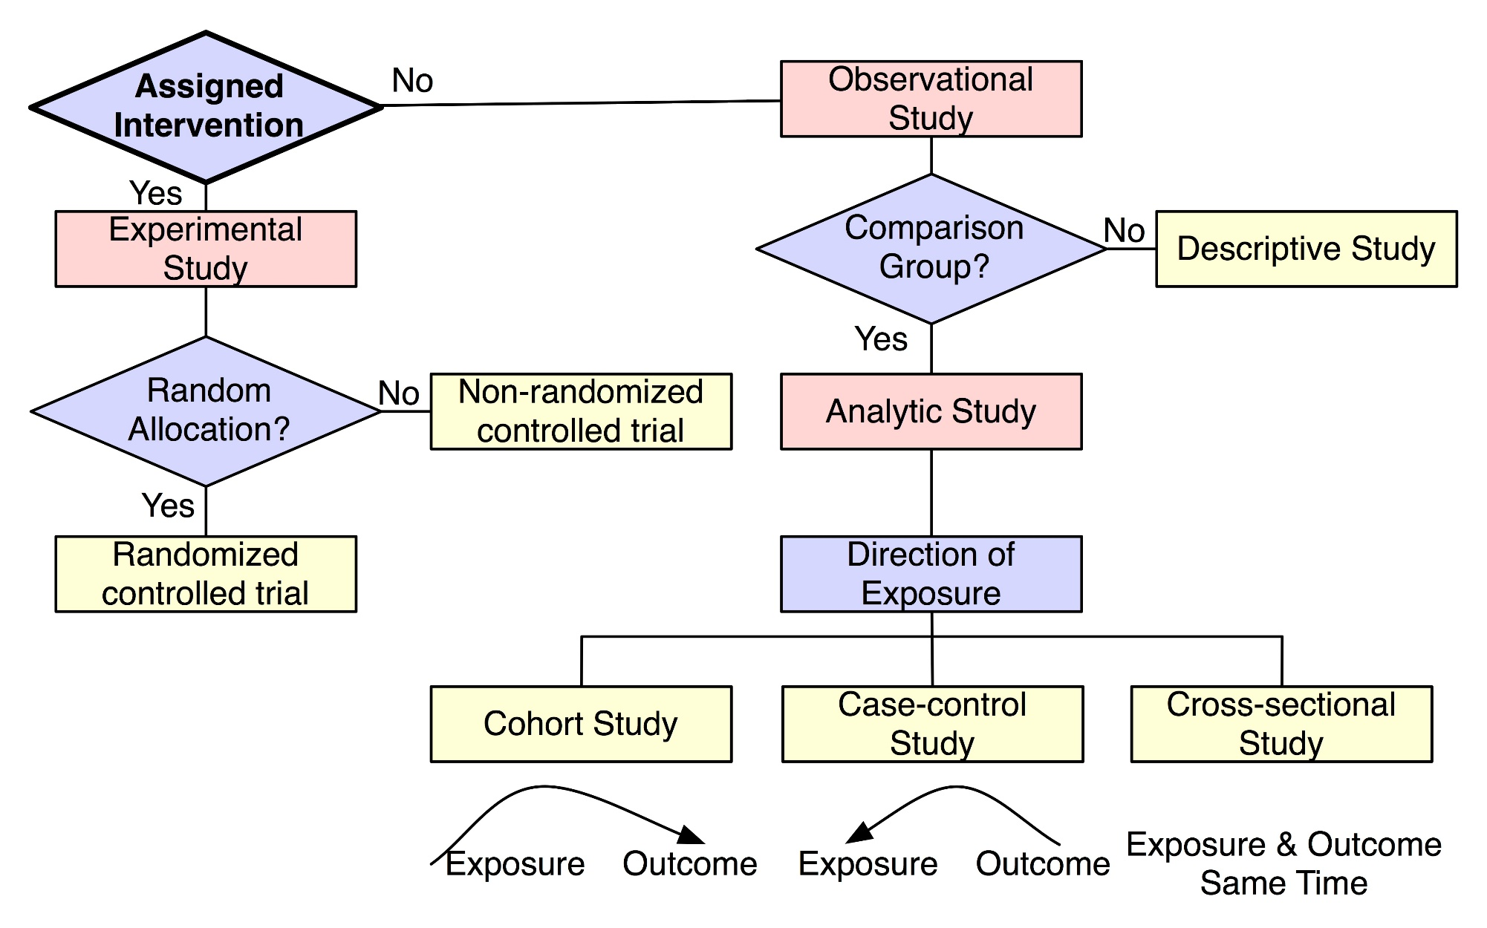
DOI:
10.1016/S0140-6736(02)07283-5
TRANSLATIONAL MEDICINE
taking discoveries for patients benefits
Population level
Individual level
Ecological study
Case study
Case series
Cross-sectional
Survaillance
https://irb.research.chop.edu/study-design

Slide 19
DOI:
10.1016/S0140-6736(02)07283-5
TRANSLATIONAL MEDICINE
taking discoveries for patients benefits
Cohort studies
General characterisctics:
Synonim: follow-up studies
Exposed and unexposed groups
Track people forward in time from exposure to outcome
May be mandatory as RCTs are unethical in certain settings (e.g. risk factors)
The term cohort has military, not medical, roots. A cohort
was a 300–600-man unit in the Roman army; ten cohorts
formed a legion

Slide 20
DOI:
10.1016/S0140-6736(02)07283-5
TRANSLATIONAL MEDICINE
taking discoveries for patients benefits
Cohort studies
IVF vs. Non-IVF
Multiple birth
Follows-up two or more groups from exposure to outcome
Cohort study moves in the same direction, although gathering data might not:
1. prospective / concurrent cohort
2. retrospective cohort
3. ambidirectional
IVF vs. Non-IVF
Multiple birth
IVF vs. Non-IVF
Ovarian carcinoma
Multiple birth

Slide 21
DOI:
10.1016/S0140-6736(02)07283-5
TRANSLATIONAL MEDICINE
taking discoveries for patients benefits
Cohort studies
Advantages:
best way to ascertain both the incidence and natural history of a disorder
useful in investigation of multiple outcomes
useful in the study of rare exposures
- more accurate data collection
can strongly suggest causality

Slide 22
TRANSLATIONAL MEDICINE
taking discoveries for patients benefits
Cohort studies
Disadvantages:
Selection bias
is not optimal for rare diseases (outcomes)
Loss to follow-up (non-differential!)
Expensive (follow-up)
Time-consuming (follow-up)
https://catalogofbias.org/biases/selection-bias/

Slide 23
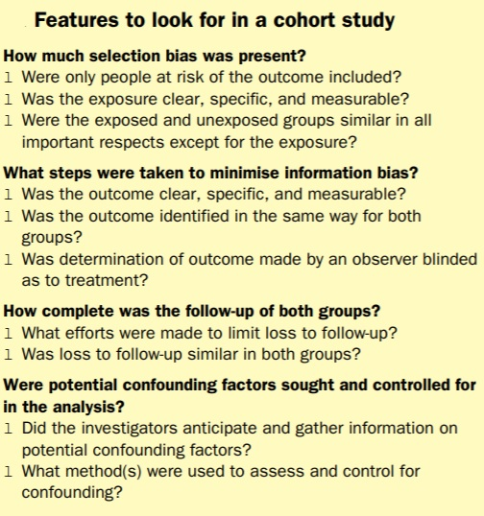
Minimum exposure might
have to be 14 cigarettes per day or less,18. Definition of exposure levels in this
way can result in more than two groups—eg, nonsmokers,
light smokers, and heavy smokers
Women who have had a tubal sterilisation
operation have almost no risk of salpingitis, e.g. they should
not be included in cohort studies of pelvic inflammatory
disease.
Features to look for in a cohort study
Lung-cancer
death rates among workers in the factory with rates of
persons of the same age and sex in the population.
Healthy-worker effect

Slide 24
Features to look for in a cohort study
Outcomes must be defined in advance! Failure to define
objective outcomes leads to uninterpretable results.
In endometritis:
Just how tender must a uterus be?
Important for subjective outcomes, such as tenderness or erythema.
By contrast, with objective outcome measures, such as
fever or death, blinding the exposure status is less
important.

Slide 25
Features to look for in a cohort study
For example, some participants
given a new antibiotic might have such poor outcomes
that they are unable to complete questionnaires or to
return for examination.
E.g. Obtaining the names of several
family members or friends who do not live with the
respondent is often helpful at the start of such studies.
The participant’s family doctor might also be helpful.
Death Registries!

Slide 26
Features to look for in a cohort study
Careful planning with a –preferably published - study protocol
Restriction
Matching
Stratification
Multivariate techniques

Slide 27
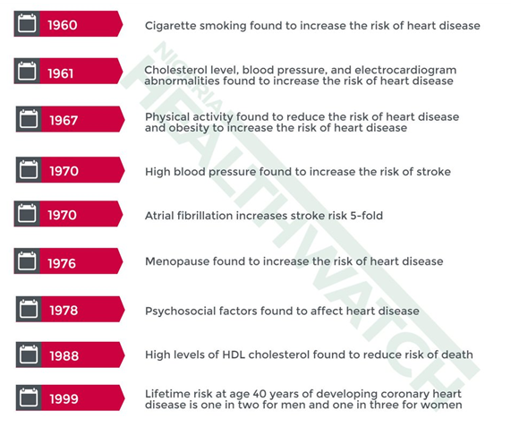
DOI:
10.1016/S0140-6736(02)07283-5
TRANSLATIONAL MEDICINE
taking discoveries for patients benefits
Commenced in 1948
5209 participants
Identify the risk factors that contributes to cardiovascuar diseases
Thousands of publications

Slide 28
DOI:
10.1016/S0140-6736(02)07283-5
TRANSLATIONAL MEDICINE
taking discoveries for patients benefits
Case-control studies
General characteristics:
One of the most common study type
Relatively simple to organize
Can yield important scientific findings with relatively little time, money, and effort
Aims to identify predictors of an outcome
Permit assessment of the influence of predictors on outcome via calculation of an odds ratio
Useful for hypothesis generation
Can only look at one outcome
Bias is a major problem
Runs backwards in time

Slide 29
DOI:
10.1016/S0140-6736(02)07283-5
TRANSLATIONAL MEDICINE
taking discoveries for patients benefits
Case-control studies

Slide 30
TRANSLATIONAL MEDICINE
taking discoveries for patients benefits
Selection of case and control groups
1. Case group:
All cases from a population could be included
Investigators should state how the sample was selected: providing a clear definition of the outcome being studied
Researchers should detail eligibility criteria used for selection (such as age range and location)
They should gather data preferably from incident (new) rather than prevalent (both old and new) cases → diagnostic patterns change over time, recent diagnoses are likely to be more consistent than those obtained from different periods

Slide 31
TRANSLATIONAL MEDICINE
taking discoveries for patients benefits
Selection of case and control groups
E.g. NSAID exposure for CRC prevention
- Random sampling from the general population
2. Control group
provides the background proportion of exposure expected in the case group
should be free of the disease (outcome) being studied
should be representative
population at risk of becoming cases. Selection of controls must be independent of the exposure being investigated

Slide 32
DOI:
10.1016/S0140-6736(02)07283-5
TRANSLATIONAL MEDICINE
taking discoveries for patients benefits
Case-control studies
Advantages:
the most efficient design in terms of time, money, and effort
efficient in the investigation of diseases that have a long latency period
good for investigation of rare diseases
Disadvantages:
„selection bias”
difficulty with the selection of the control group
difficulties with the rare exposures
casuality could be suggested

Slide 33
DOI:
10.1016/S0140-6736(02)07283-5
TRANSLATIONAL MEDICINE
taking discoveries for patients benefits
3 groups
HIV+
HIV- from STD clinic (OR 2.9)
HIV- from the general population (OR: 52)
Outcome: risk of HIV infection
Aim: to reduce selection bias

Slide 34
DOI:
10.1016/S0140-6736(02)07283-5
TRANSLATIONAL MEDICINE
taking discoveries for patients benefits
2 groups
Women with breast cancer
Healthy controls
Exposure: oral contraceptives
Aim: to reduce recall bias

Slide 35
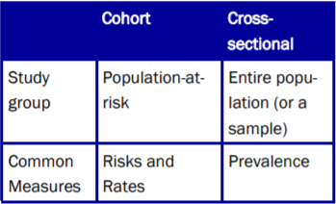
TRANSLATIONAL MEDICINE
taking discoveries for patients benefits
Cross-sectional studies
General characteristics:
Conceptually begin with a population based
We do not follow individuals over time
Only look at the prevalence of disease and/or exposure at one moment in time
Take „snapshot” of the proportion of individuals (diseased vs. non diseased at one point in time)
Two types: 1. descriptive (no control group); 2. analytical (control group)
Cross sectional studies are the best way to determine prevalence
Are relatively quick – no follow up – less resources needed
Can study multiple outcomes
Do not themselves differentiate between cause and effect or the sequence of events
Emerg Med J 2003;20:54–60

Slide 36
TRANSLATIONAL MEDICINE
taking discoveries for patients benefits
- data on the prevalence of both exposure and a health outcome are obtained for the purpose of comparing health outcome differences between exposed and unexposed.
- attempt to describe the prevalence, for example, of a disease by first beginning with a population-based sample
- differ from descriptive cross-sectional studies in that they have a control group
Emerg Med J 2003;20:54–60

Slide 37
TRANSLATIONAL MEDICINE
taking discoveries for patients benefits
Cohort | Case-control | Cross-sectional
Runs foward in time | Runs backward in time | Take a snapshot in time
Multiple outcomes | Rare diseases | Prevelence of the diseases
Rare exposures | Diseases with long latency period | Not able to assess temporal relations
„expensive” | „cheap” | „cheap”
Strongly suggest causality Hypothesis generation | Could suggest causality Hypothesis generation | Hypothesis generation

Slide 38
TRANSLATIONAL MEDICINE
taking discoveries for patients benefits
'TAKE HOME MESSAGE'
Obsevational studies are essential part of clinical research
Finding the optimal study type for your question is the most important
Think ahead! – publish a protocol before starting the study
Detailed statisctical planning is esential

Slide 39
TRANSLATIONAL MEDICINE
taking discoveries for patients benefits
COMMON MISTAKES
Do not overinterpret your results, know the limitations of your research

Slide 40
TRANSLATIONAL MEDICINE
taking discoveries for patients benefits
tm-centre.org
Thank you for your attention!

Slide 41
TRANSLATIONAL MEDICINE
taking discoveries for patients benefits
For cohort studies
Does it have a control group?
Were the exposed and unexposed groups similar in all important respects except for the exposure?
Were only people at risk of the outcume included?
What kind of outcomes are reported? Was the outcome clear, specific and measurable?
What efforts were made to limit loss to follow up?

Slide 42
For case-control studies
TRANSLATIONAL MEDICINE
taking discoveries for patients benefits
How was the sample selected?
Is there a clear definition of the outcome studied?
Are there enough details in the eligibility criteria?
Did they include only incident or prevalent cases too?
Are the groups representative of the population?
How did they choose a control group?

Slide 43
TRANSLATIONAL MEDICINE
taking discoveries for patients benefits
Descriptive studies,
the ’first toe in the water’
Benedek Tinusz
Clinical Trial Course
Pécs, 2019.09.02.

Slide 44
TRANSLATIONAL MEDICINE
taking discoveries for patients benefits
Introduction
Analogy - ’first toe in the water’^{[1]}:
Generally low quality of evidence (if any)
Why do we still use them?
New areas of inquiry
Generate hypotheses
Can be followed up by other investigations
[1] Hulley et al. (Baltimore, 2001), Designing clinical reasearch: an epidemiologic approach
Notes:
Bottom of the „quality of evidence hierarchy”
Still, why is it important to have them?

Slide 45
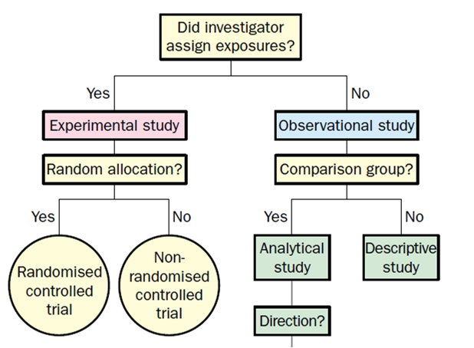
TRANSLATIONAL MEDICINE
taking discoveries for patients benefits
Descriptive studies: Definition^{[2]}
Individual level
Case study
Case series
Cross-sectional
Surveillance
Population level
Ecological study
[2] Grimes et al. (Lancet, 2002), Descriptive studies: what they can and canniot do
Notes:
Bottom of the „quality of evidence hierarchy”
Still, why is it important to have them?

Slide 46
Characteristics of descriptive studies
The descriptive pentad: five basic „W” questions
1.) Who?
2.) What?
3.) Why?
4.) When?
5.) Where?
6.) So what?

Slide 47
Characteristics of descriptive studies
The descriptive pentad: five basic „W” questions
1.) Who has the disease in question?
Characterization (e.g.: age, gender, race)
2.) What is the condition or disease being studied?
Exact definition
3.) Why did the condition or disease arise?
Clues and assumptions about causes and NOT associations
4.) When is the condition common or rare?
Assuming temporal relationships
5.) Where does or does not the disease or condition arise?
Assuming localizational relationships
+1.) So what?
Impact / implications

Slide 48
TRANSLATIONAL MEDICINE
taking discoveries for patients benefits
1-2.) Case report & Case-series
Reports an unusual disease or association
Least publishable – lowest quality of evidence
Can prompt further investigation

Slide 49
TRANSLATIONAL MEDICINE
taking discoveries for patients benefits
Case-series example

Slide 50
TRANSLATIONAL MEDICINE
taking discoveries for patients benefits
3.) Descriptive cross-sectional studies
Provides a snapshot of the population at a particular time
No control group! (compared to analytical cross-sectional studies)
Similar to the census
Both exposure and outcome are ascertained at the same time
Temporal sequence is often impossible to work out
Relatively cheap to organize

Slide 51
TRANSLATIONAL MEDICINE
taking discoveries for patients benefits
4.) Surveillance
„Watchfulness over a community”
Continuous data collection, analysis, interpretation
Active – Searching for cases
Passive – Death certificates, diagnosis codes
Examples:
Mortality registries
Birth registries
Tumor registries

Slide 52
TRANSLATIONAL MEDICINE
taking discoveries for patients benefits
Surveillance example

Slide 53
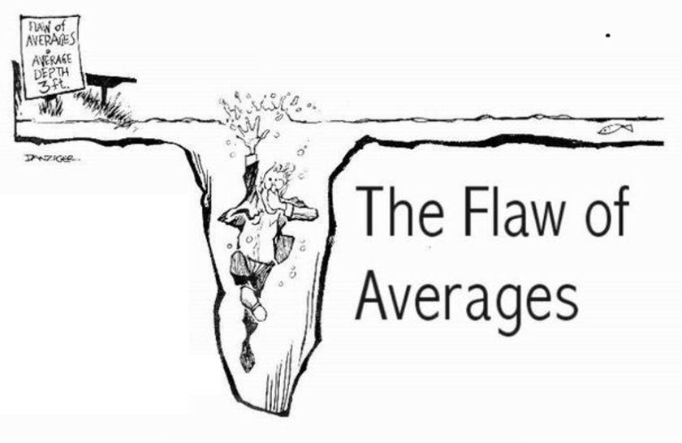
TRANSLATIONAL MEDICINE
taking discoveries for patients benefits
Ecological correlational studies
Looks for associations between exposures and outcomes in populations rather than in individuals
Cigarette smoking and CHD mortality
Color televisions and CHD mortality

Slide 54
TRANSLATIONAL MEDICINE
taking discoveries for patients benefits
Uses of descriptive studies
1.) Trend analysis
2.) Healthcare planning
3.) Hypothesis development

Slide 55
TRANSLATIONAL MEDICINE
taking discoveries for patients benefits
Advantages and drawbacks
Advantages:
Inexpensive - data are already available
Few ethical difficulties
Drawbacks:
Temporal associations might be unclear
Mistakenly drawn causal conclusions

Slide 56
TRANSLATIONAL MEDICINE
taking discoveries for patients benefits
'TAKE HOME MESSAGE'
Descriptive studies are…
Often the first approach to a new event or condition
Useful for trend analysis, healthcare planning and hypothesis development
Often followed up by other studies on the same topic

Slide 57
TRANSLATIONAL MEDICINE
taking discoveries for patients benefits
COMMON MISTAKES
Misidentifying the study
Lack of precise definitions
Drawing definitive conclusions about the cause!

