Slide 1
TRANSLATIONAL MEDICINE
taking discoveries for patients benefits
Descriptive statistics
Dávid Németh
Clinical Trial Course
Pécs, 2019.09.02.

Slide 2
TRANSLATIONAL MEDICINE
taking discoveries for patients benefits
Nominal
Categorical
Ordinal
Variable
Discrete
Numerical
Continuous
Notes:
The variables are everything, what we are exame. Practically, all the collected data.There are two main types of variables. One is the categorical, which are not numbers. This can be the types of diabetes which is an example for the nominal, that can not be given in orders. Or a categorical variable can be a stage of an illness as well, which have a rank, or some kind of order. Variables like this, called ordinal variable.
The other main type is the numerical variables. They are numbers, so we are able to calculate with them. The difference is that the discretes are can take only finite numbers, like heart rate, which normaly can be just an integer. The continuous variable can take any kind of number. Continuous variable can be for example the blood pressure.

Slide 3
TRANSLATIONAL MEDICINE
taking discoveries for patients benefits
Continuous
Dichotome
Huge amount of information
Perfect null hypothesis
Cheaper
Can be transform to dichotome
Information loss
Not possible to transform
Expensive
Notes:
Blood pressure can be measured with continuous variables like I mentioned before, for instance in inches of mercury. Or it can be separated to two groups, for example hypertonic and normal pressure. That is call dichotomization. In the second case, so in case of dichotomization, there are some information loss. That is why it is impossible for example to make three groups of this two later, like hypotonic, hypertonic, and normal. In case of dichotomization, the interpretation is also different, because we can just say, that there is a normal and a not normal group.
Although, it can be a mistake to measure everything, even if we won’t need it. To measure a variable it means more time, more human resources, and of course more money. So that’s shows us, how important to ascertain a proper null hypothesis, which is tell us exactly, what we want to know, or what is the purpose of the research. A good null hypothesis is a sentence, which can clarify us the revelance of the research. This is what the statistician group need the most, and a proper data base of course. The null hypothesis can be like, „A” medicine makes a higher reduce in blood pressure, than the „B” one. That simple is the null hypothesis.
In case of multicenter researches, it is also important to clarify which measurements was used in the different centers. Even more, if they are from different countries. Those can use another methods, or maybe another scale.

Slide 4
Numerical data collection
TRANSLATIONAL MEDICINE
taking discoveries for patients benefits
Central tendency
Mean
Median
Spread
SD
Range
(Standard deviation)
(Min, max)
SE
Quartiles
(Standard error)
(Q1, Q3, IQR)
Notes:
A numerical data in most of the cases are shown in a central tendency, and a spread, which are connected. Both are tell us, how our data looks like. Normally it is impossible to publish a huge amount of data, because no one would understand it. And of course, nobody would read an article which is full of raw data. So we have to reduce our data, to some numerical variables. But it is really important, to keep all the important information in this numbers.
That is why, the central tendency tells us something about the middle of the data, and the spread can show how far the others are from this middle value. Most of the time, the central tendency is mean, or median. The mean, also called average, is the result you get by adding two or more amounts together, and dividing the total by the number of amounts.
The median is the middle value, which separates the higher half from the lower half of the data sample, after ordering it. So the fifty percent of the data are below the median, and the fifty percent are upper it.
Usually the mean is used with standard deviation, or with standard error. Standard deviation is a measure that is used to quantify the amount of variation of a set of data values. A low standard deviation indicates that the data points tend to be close to the mean, while a high standard deviation indicates that the data points are spread out over a wider range of values. Standard error can be calculated from the standard deviation. The median is appears with range, or quartiles. The range is the minimum and the maximum value of the sample, and the quartiles are similar to the median. Below the first quartile, there are the twenty five percent of the data, and below the third quartile, there are the seventy five percent of the data.

Slide 5
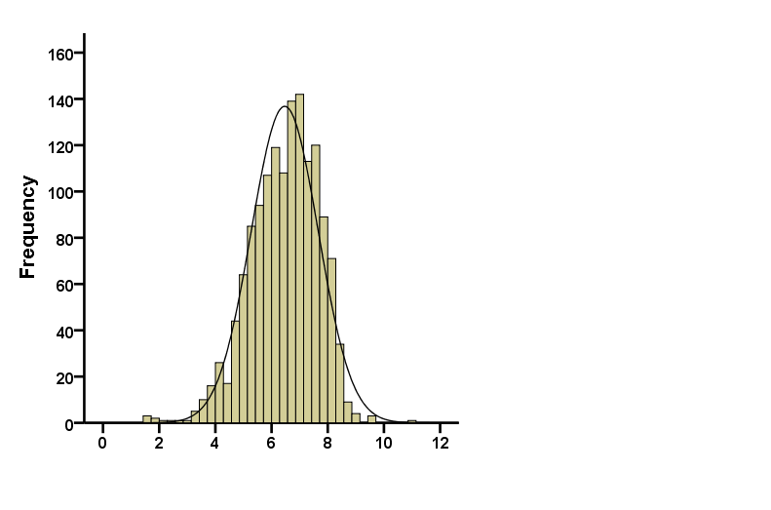
TRANSLATIONAL MEDICINE
taking discoveries for patients benefits
Probability density function
Notes:
We can represent our data in probability density function, which is a function whose value at any given sample in the sample space can be interpreted as providing a relative likelihood that the value of the random variable would equal that sample.
So that means, how much more likely it is that the random variable would equal one sample compared to the other sample.
These density functions have a kind of distribution, and the shape of this distribution is important in case of the statistical analysis.

Slide 6
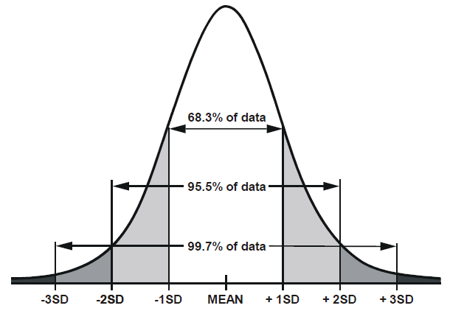
TRANSLATIONAL MEDICINE
taking discoveries for patients benefits
Normal distribution
Mean
Median
Notes:
Normal distribution is called symmetrical distribution as well.
Symmetry means that one half of the distribution is a mirror image of the other half. So normal distribution has no skew. The tails are exactly the same. In the case of normal distribution the mean is equal to the median. And the 95.5% of the sample are within two standard deviations from the mean. In case of laboratory diagnostics, the reference province is within this two standard deviations.

Slide 7
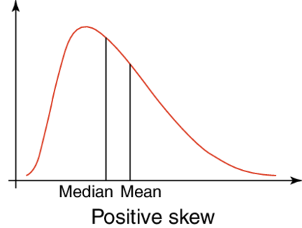
TRANSLATIONAL MEDICINE
taking discoveries for patients benefits
Skew distribution
Mean
Median
Notes:
If one tail is longer than the other, the distribution is skewed. These distributions are sometimes called asymmetric or asymmetrical distributions as they don’t show any kind of symmetry. As you can see, in case of skew distribution, the mean is not equal to the median, that is why, the mean is not really informative. We say that positively skew the distribution, when the mean is higher than the median. And inversely the negative skew means the mean is lower than the median.
Sometimes it is important to transform skew distribution to normal distribution, beacause some statistical trials has premise for the normal one. It is a possibility to make for example a logarithmical transform, but in some cases, it is imposible to transform. When we make a logarithmical transformation, we have to deal with the difficulty of interpretation. Later we will see some trials for the asymmetrical distribution as well.

Slide 8
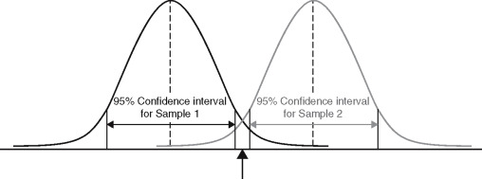
TRANSLATIONAL MEDICINE
taking discoveries for patients benefits
Confidence interval
No overlap of confidence 95% confidence intervals. Therefore, samples are significantly different.
Notes:
The intervall estimation is a value range, which containes the estimate parameter with the pre-fixed reliability, which is usually 95 or 90 percent. It is possible to calculate it for a lot of variables, but most of the time, it is calculated for the mean. In this case, the mean is a fixed value, while the end points of the intervall are come from the sample. The 95 percent raliability means, that if we take a huge amount of sample, than the confidence intervalls of these samples, will contain the estimate parameter, in this case the mean, in the 95 percent of the cases. Here you can see, there is no overlap of the two confidence intervals, so the two sample are certainly different. The wildth of the confidence intervall shows, how precise the sample. So how strong does the sample represent the population. We can make statistical decision based on the confidence intervall.

Slide 9
TRANSLATIONAL MEDICINE
taking discoveries for patients benefits
Huge sample size
Small confidence interval
Huge sample size
Money, other resources
Golden middle way
Perfect sample size
Notes:
It is important to know, that if smaller the confidence interval, than it is more accurate. The interval will decrease if we increase the sample size. But working with a too high amount of sample is wasting. The sample size has to be as big, as we can just reach the required accurate. I will speak later about the sample size estimation as well.

Slide 10
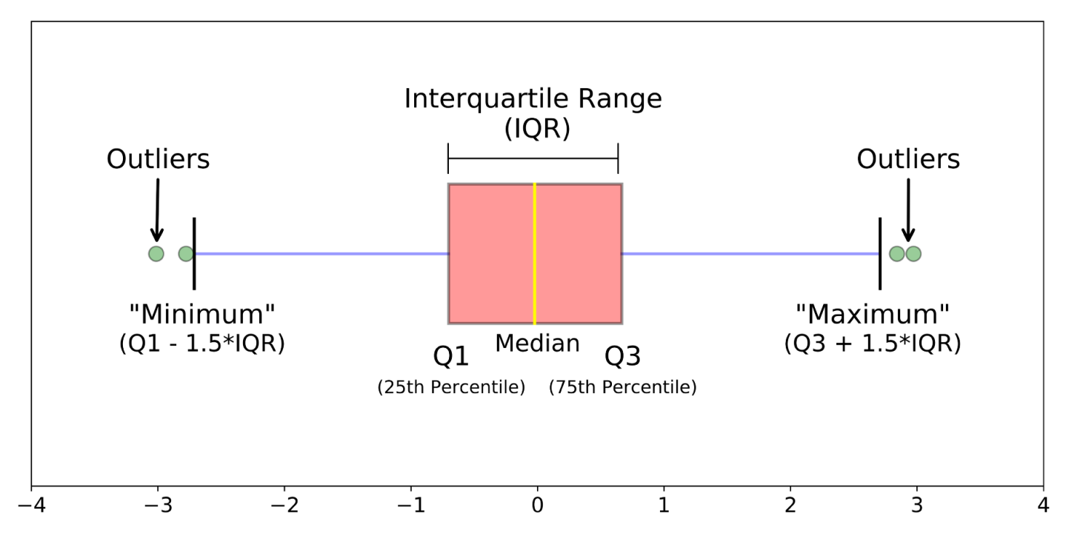
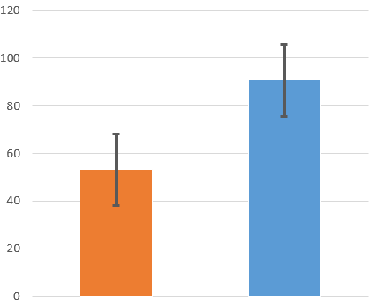
TRANSLATIONAL MEDICINE
taking discoveries for patients benefits
Boxplot
Mean - bar chart
Notes:
The distribution of our available data, can be presented with boxplot for example. This is usually appears with median and interquartile range. It can be seen, that the yellow line is the median, and the right and left side of the pink box are the first and third quartile. That means, the pink box is contained the interquartile range. The blue lines are IQR multiplicate with 1.5 far from the first and from the third quartile. So the values, which are out of this margin, called outliers. They have to be treated somehow, because normaly, they are not supposed to be exist. These are usually the results of some kind of mistake, like erratum, or counting mistake.

Slide 11
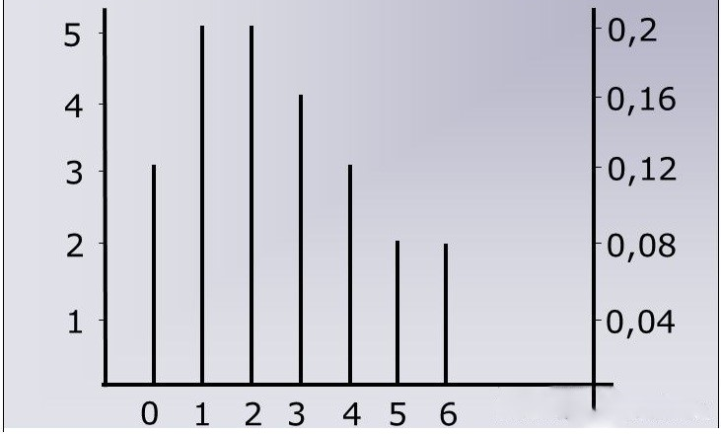
TRANSLATIONAL MEDICINE
taking discoveries for patients benefits
Stick diagram
Notes:
The boxpolt is proper for continuous variable, while for the discrete variable, we can use the stick diagram.

Slide 12
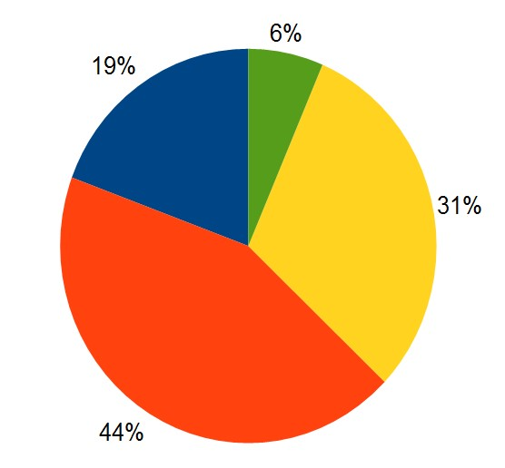
TRANSLATIONAL MEDICINE
taking discoveries for patients benefits
Notes:
And at last, but not at least, the bar charts are used for present the percentage distribution. So we can easily recognise the difference in percentages. That is the purpose of the bar charts. The bar charts are used for ordinal variables, so we can see, their percentages of each other. Pie charts are used for nominal variables, so we can see their percentages of the hole.

Slide 13
TRANSLATIONAL MEDICINE
taking discoveries for patients benefits
tm-centre.org
Thank you for your attention!

Slide 14
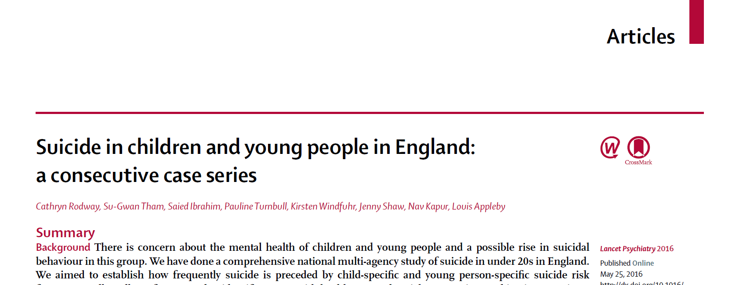
TRANSLATIONAL MEDICINE
taking discoveries for patients benefits
Descriptive studies – Group Practice

Slide 15
TRANSLATIONAL MEDICINE
taking discoveries for patients benefits
Descriptive studies – Group Practice
Why is the study described in the article descriptive and not analytical? What data would be required for the study to be analytical?
Precisely which type of descriptive study is this? What does that mean?
Identify the items of the descriptive pentad in the article (Who? What? Why? When? Where? So what?)!
Does the study make the common mistake of not providing precise definitions?
What conditions did the study prove as risk factors for commiting suicide in the study population?
Which type of bias is mentioned as being a major limitation of this study?

Slide 16
TRANSLATIONAL MEDICINE
taking discoveries for patients benefits
Bias in observational studies
Zsolt Szakács
Clinical Trial Course
Pécs, 2019.09.02.

Slide 17
TRANSLATIONAL MEDICINE
taking discoveries for patients benefits
Does smoking cause lung cancer?

Slide 18
TRANSLATIONAL MEDICINE
taking discoveries for patients benefits
Selection bias
Chance for a bomber to make it: 50-50%

Slide 19
TRANSLATIONAL MEDICINE
taking discoveries for patients benefits
Chance for a bomber to make it: 50-50%
(Ábrahám Wald)

Slide 20
TRANSLATIONAL MEDICINE
taking discoveries for patients benefits
Chance for a bomber to make it: 50-50%
(Ábrahám Wald)

Slide 21
TRANSLATIONAL MEDICINE
taking discoveries for patients benefits
=Neyman bias
Case-control
Cross-sectional
Cohort studies

Slide 22
TRANSLATIONAL MEDICINE
taking discoveries for patients benefits
Is the sample representative to the entire population?
All aircrafts
Random samples
vs.
Convenience samples
Who made it home
Eligiblity criteria
=non-responsen bias in questionnaires

Slide 23
TRANSLATIONAL MEDICINE
taking discoveries for patients benefits
Is the sample representative to the entire population?
Are the study-arms equal in all properties except for the exposure?
B
A
A1
A2
Properties of A = Properties of B
Properties of A1 = Properties of A2
Representativeness
Confounding

Slide 24
DOI:
10.1016/S0140-6736(02)07283-5
TRANSLATIONAL MEDICINE
taking discoveries for patients benefits
Hypothesis: aspirin reuduces CV deaths in the elderly
Design: two-arm prospective study (500-500 patients)
 | Aspirin | No aspirin
Male:female ratio | 1:1.01 | 1:1.04 | P=NS
Age (mean±SD) | 71±10 y | 64±9 y | P<0.001
10-y CV death | 12% | 4% | P<0.001
10-y bleeding | 16% | 11% | P<0.001
The hypothesis should be rejected because aspirin increases CV deaths

Slide 25
TRANSLATIONAL MEDICINE
taking discoveries for patients benefits
Aspirin
CV deaths
Age (Comorbidities)

Slide 26
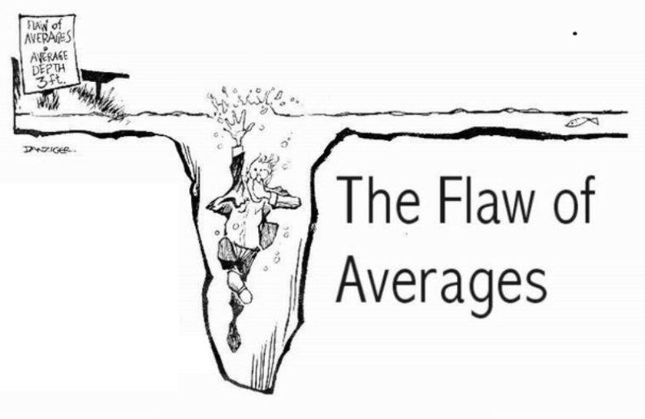
DOI:
10.1016/S0140-6736(02)07283-5
TRANSLATIONAL MEDICINE
taking discoveries for patients benefits
Ecological studies (The mean of A correlates with the mean of B.)
De a színestévé eladásokkal is korrelál….
Ecological error

Slide 27
DOI:
10.1016/S0140-6736(02)07283-5
TRANSLATIONAL MEDICINE
taking discoveries for patients benefits
The choice of control group in case-case control studies (Berkson-bias)
Group of interest
HIV+ homosexual men
Reference groups:
STD clinics (70%)
Neighborhood (41%)
Sexual behaviour?

Slide 28
DOI:
10.1016/S0140-6736(02)07283-5
TRANSLATIONAL MEDICINE
taking discoveries for patients benefits
How to deal with confounding in observational studies?
With math…
Stratification
Matching
Standardization
Multivariate analysis

Slide 29
DOI:
10.1016/S0140-6736(02)07283-5
Confounding
How to deal with confounding in observational studies?
With math…

Slide 30
TRANSLATIONAL MEDICINE
taking discoveries for patients benefits
Recall bias
Oral contraceptives and BC
Case-control
Cross sectional
Retrospecitve cohort Prospective cohort

Slide 31
TRANSLATIONAL MEDICINE
taking discoveries for patients benefits
Observer bias (performance/detection bias)
Smoking and lung cancer
Case-control
Cross sectional
Retrospecitve cohort Prospective cohort

Slide 32
TRANSLATIONAL MEDICINE
taking discoveries for patients benefits
Errors in epidemiological studies
Bias
Imprecision
Valid?
Precise?

Slide 33
TRANSLATIONAL MEDICINE
taking discoveries for patients benefits
Errors in epidemiological studies
Bias
Imprecision
Systematic error
Random error
Sample size
Risk
Sample size
Risk

Slide 34
DOI:
10.1016/S0140-6736(02)07283-5
TRANSLATIONAL MEDICINE
taking discoveries for patients benefits
Inherent in observational studies…
Bias
Causality

Slide 35
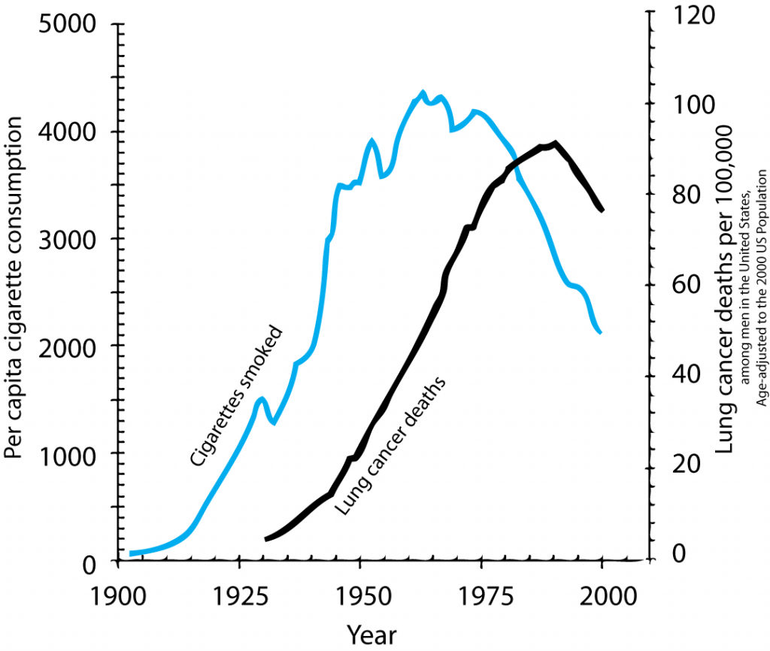
TRANSLATIONAL MEDICINE
taking discoveries for patients benefits
Cause-effect relationship
Does smoking cause lung cancer?

Slide 36
TRANSLATIONAL MEDICINE
taking discoveries for patients benefits
Does smoking cause lung cancer?

Slide 37
TRANSLATIONAL MEDICINE
taking discoveries for patients benefits
COMMON MISTAKE
NOT understanding the concept of bias
NOT seeking for potential bias in studies
Stating a cause-effect relationship based on biased results

Slide 38
TRANSLATIONAL MEDICINE
taking discoveries for patients benefits
TAKE HOME MESSAGE
Always question the validity of the results.
Selection bias, information bias, and confounding.
Pay close attention to cause-effect relationships.

Slide 39
TRANSLATIONAL MEDICINE
taking discoveries for patients benefits
tm-centre.org
Thank you for your attention!

