Slide 1
TRANSLATIONAL MEDICINE
taking discoveries for patients benefits
Experimental and observational studies:
a comparative lecture
Noémi Zádori
Clinical Trial Course
Pécs, 2019.09.03.

Slide 2
TRANSLATIONAL MEDICINE
taking discoveries for patients benefits
1.
1. Is the intervention necessary because of the trial?
2.
3.
2. Is is randomized?
3. Is it controlled?
4.
4.How does the exposure and endpoint related to time?
Grimes DA, Schulz KF. Lancet. 2002

Slide 3
TRANSLATIONAL MEDICINE
taking discoveries for patients benefits
We will cover:
1.Randomization and masking – Bálint Erőss
2. Interventions and outcomes - Andrea Párniczky
3. Statistics in clinical trials – Dávid Németh
4. Bias in clinical trials – Zsolt Szakács
5. The role of a clinicical trial coordinator in desining clinical trials – Judit Antal
6. Publication strategy, closing remarks – Péter Hegyi

Slide 4
TRANSLATIONAL MEDICINE
taking discoveries for patients benefits
 | RCT | Observational
 | Treatment assigned | Observe only, no treatment assigned
Control group | yes | Yes/no
Study population | Highly selected population, highly controlled environement | Diverse population
Directionality | Exposure is assigned before outcome is ascertained | Depends on the type of the study
Primary use | Reports a cause and effect | Reports an association
Sample | Randomization of sample group | May (or not) use random sample sets
Representativity | Generalize to poulation | May (or not) generalize to population

Slide 5
TRANSLATIONAL MEDICINE
taking discoveries for patients benefits
Why are randomised controlled trials gold standard?
Only study design, in which causality can be proved (act of randomization balances participant characteristics between the groups)
measure the effectiveness of a new intervention or treatment
reduces bias
provides a rigorous tool to examine cause-effect relationships between an intervention and outcome

Slide 6
TRANSLATIONAL MEDICINE
taking discoveries for patients benefits
What are the limitations of RCTs?
Their use is limited by ethical and practical concerns
failure to perform trials may result in harmful treatments being used
may be ethical but infeasible-for example, because of difficulties with randomisation or recruitment
Strong patient preferences may also limit recruitment and bias outcomes
are generally more costly and time consuming than other studies

Slide 7
TRANSLATIONAL MEDICINE
taking discoveries for patients benefits
tm-centre.org
Thank you for your attention!

Slide 8
TRANSLATIONAL MEDICINE
taking discoveries for patients benefits
Randomization and masking
Bálint Erőss
Clinical Trial Course
Pécs, 2019.09.03.

Slide 9
Hallmarks of an RCT
Standardized treatment
Prospective plan
Adverse event reporting
Regulatory requirements
RANDOMIZATION +/- MASKING
Important to note:
Different study designs paralell, crossover, factorial, cluster, adaptive

Slide 10
Definition of randomization
Wikipedia:
‚In the statistical theory of design of experiments, randomization involves randomly allocating the experimental units across the treatment groups.’
Lancet epidemiology series:
‚The hallmark of randomised controlled trials is assignment of participants to exposures purely by the play of chance.’

Slide 11
Aims of randomization
Wikipedia:
‚To reduce certain sources of bias when testing the effectiveness of new treatments.’
Lancet epidemiology series:
‚The randomised controlled trial is the only known way to avoid SELECTION and CONFOUNDING BIASES in clinical research. Randomised controlled trials reduce the likelihood of bias in determination of outcomes.’

Slide 12
Aims of randomization
Avoids selection bias
Prognostic factors related to treatment assignment
Confounding by indication
Can influence outcomes as strogly as or more strongly than treatments
Tends to produce comparable treatment groups
Known and unknown confounders
Assures statistical tests (e.g. t-test, chi-square) will have statistical valid significance levels (e.g. p = 0.03)
Defined time point for trial entry

Slide 13
DOI:
10.1016/S0140-6736(02)07283-5
Confounding
Hypothesis: aspirin reuduces CV deaths in the elderly
Design: two-arm prospective study (500-500 patients)
 | Aspirin | No aspirin
Male:female ratio | 1:1.01 | 1:1.04 | P=NS
Age (mean±SD) | 71±10 y | 64±9 y | P<0.001
10-y CV death | 12% | 4% | P<0.001
10-y bleeding | 16% | 11% | P<0.001
The hypothesis should be rejected because aspirin increases CV deaths

Slide 14
Types of randomization schemes
Simple randomization
Restrictive randomization
Adaptive randomization

Slide 15
Practice 1.
Simple radomization, we would like to have 1:1 allocation ration
Toss of the coin
Sample with 2 confounding factors (M: male, F: female, O: obese, N: normal, non-obese)
1. M/O, 2. F/N, 3. F/N, 4. M/O, 5. M/N, 6. M/N, 7. F/O, 8. F/N, 9. M/O 10. F/O
How many patients have been allocated to A and B? What is the allocation ratio?
What is the distribution of major confounders (M:F ratio, O:N ratio) in the two arms?

Slide 16
Practice 2.
Simple radomization, we would like to have 1:1 allocation ration
Toss of the coin
1. M/O, 2. F/N, 3. F/N, 4. M/N, 5. M/O, 6. M/N, 7. F/N, 8. F/N, 9. F/N, 10. F/N, 11. F/O, 12. M/O, 13. F/O 14. M/N, 15. M/N, 16. F/O, 17. M/O, 18. M/N, 19. M/N, 20. F/N, 21. M/N, 22. F/O, 23. M/O 24. F/N 25. F/O, 26. F/N, 27. M/O 28. F/N, 29. M/O, 30. M/N, 31. M/N, 32. F/N
How many patients have been allocated to A and B? What is the allocation ratio?
What is the distribution of major confounders (M:F ratio, O:N ratio) in the two arms?

Slide 17
Simple randomization: advantages
Complete randomization, e.g., coin toss
Each assignment is independent
Advantages:
Each assignment is completely unpredictable
In the long run, number of patients assigned to each group should be about equal

Slide 18
Simple randomization: risks
Imbalances
Number of patients assigned to treatment and control groups
Confounding factor by treatment goup
May diminish credibility of results
Risks are inversely associated with number of participants
Each assignment is completely unpredictable
In the long run, number of patients assigned to each group should be about equal

Slide 19
Restrictive randomization
Scheme with constrains to produce expected assignment ratio according to time and/or specified covariate(s)
Two main types of restrictive randomization:
Blocking
Stratification

Slide 20
Restrictive randomization: blocking
Block is a list of treatment assignments that achieves the treatment allocation ratio, e.g., A:B = 1:1
block of size 4: 2As and 2Bs
list of all possible pernutatations: AABB, ABAB, BABA, ABBA, BAAB, BBAA
Size of the smallest possible block is the sum of the integers defined in treatment allocation ratio
2 for 1:1, 3 for 2:1
larger block sizes are multiples of smallest one
All possible block sequences are randomly permuted (to arrange in all possible ways)
randomly choses 1 of X permuted blocks
Ensures balance of treatments over time

Slide 21
Blocking implementation
Fixed allocation ratio throughout the study
It is a secret!
Block size(s) are on a need to know basis
Use more than one block size
Overall sequence appears more random
Protects against discovery
Especially in unmasked (open label) studies

Slide 22
Practice 3.
Block radomization, we would like to have 1:1 allocation ration
1. M/O, 2. F/N, 3. F/N, 4. M/N, 5. M/O, 6. M/N, 7. F/N, 8. F/N, 9. F/N, 10. F/N, 11. F/O, 12. M/O, 13. F/O 14. M/N, 15. M/N, 16. F/O, 17. M/O, 18. M/N, 19. M/N, 20. F/N, 21. M/N, 22. F/O, 23. M/O 24. F/N 25. F/O, 26. F/N, 27. M/O 28. F/N, 29. M/O, 30. M/N, 31. M/N, 32. F/N
Use the following randomly generated and permuted blocks:
AB
ABBA
BABA
BA
AB
BBAA
AB
BAAB
ABAB
AABB
How many patients have been allocated to A and B? What is the allocation ratio?
What is the distribution of major confounders (M:F ratio, O:N ratio) in the two arms?

Slide 23
Blocking pros and cons
Advantages
Overall balance, especially in smaller trials
Protects against time related changes
In the composition of study population
Data collection procedures
External forces being difeferential across treatment groups, i.e., secular trends, chronological bias
If the trial is stopped early, have balanced groups
Analyses are more powerful
Disavantages
Can facilitate prediction of future assignments
More problematic for unmasked trials or poorly masked trials

Slide 24
Restricted randomization: stratification
Ensure balance in treatment assignments within subgroups defined before randomization
Clinic, gender, risk level
Subgroup should be related to outcome – strong confounder or effect modifier
Requires a separate set of treatment assignment schedules for each category of each stratum

Slide 25
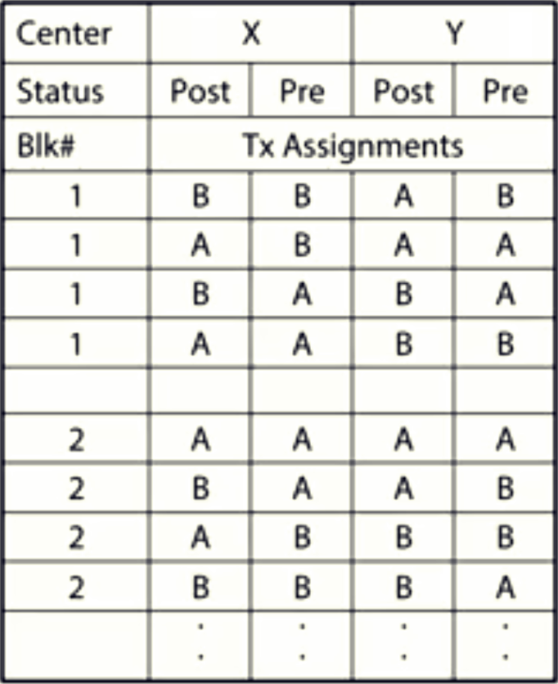
Stratification and Blocking Example
Breast cancer treatment, 1:1 treatment allocation
A and B
Stratification
-Center
-X or Y
-Postmenopausal status
-Post or pre
Block size 4

Slide 26
Practice 4.
Block radomization, we would like to have 1:1 allocation ration
1. M/O, 2. F/N, 3. F/N, 4. M/N, 5. M/O, 6. M/N, 7. F/N, 8. F/N, 9. F/N, 10. F/N, 11. F/O, 12. M/O, 13. F/O 14. M/N, 15. M/N, 16. F/O, 17. M/O, 18. M/N, 19. M/N, 20. F/N, 21. M/N, 22. F/O, 23. M/O 24. F/N 25. F/O, 26. F/N, 27. M/O 28. F/N, 29. M/O, 30. M/N, 31. M/N, 32. F/N
Let’s assume gender is the major confounding factor
Therefore, use the following randomly generated and permuted blocks for
Females: BAAB, ABAB, ABBA, AB, AB
Males: BABA, BA, AB, BBAA, AABB
How many patients have been allocated to A and B? What is the allocation ratio?
Have we managed to allocate equal number of Fs and Ms to A and B?

Slide 27
Practical aspects of stratification
Limit to a few (1-2) variables
Highly related to outcome
Logistical
Typical ones
Clinic in mulicentric trial
Surgeon
Stage of disease
Demographic charcteristics (gender, age)
Too many strata may lead to imbalances in overall treatment group allocation!

Slide 28
Definition of masking (blinding)
Wikipedia:
‚In a blind or blinded experiment, information which may influence the participants of the experiment is withheld (masked or blinded) until after the experiment is complete. .’
Coursera Design and Interpretation of Clinical Trials:
‚Treatment assignment is not known after randomization.’

Slide 29
Aims of masking (blinding)
Wikipedia:
‚Good blinding can reduce or eliminate experimental biases that arise from the placebo effect, the observer effect, confirmation bias, and other sources.’
Lancet epidemiology series:
‚Blinding usually reduces differential assessment of outcomes (information bias), but can also improve compliance and retention of trial participants while reducing biased supplemental care or treatment (sometimes called co-intervention).’

Slide 30
Information bias
Observer bias (performance/detection bias)
Smoking and lung cancer
Case-control
Cross sectional
Retrospecitve cohort Prospective cohort

Slide 31
Aims of masking (blinding)
What happens if we don’t mask (blind) particiants?
Effects of experimental treatment on the outcome measures will be:
Underestimated
Overestimated

Slide 32
Practice 5.
Masking
Choose the outcomes for which masking/blinding is necessary:
Length of hospital stay; mortality; pain on VAS; hip fracture; myocardial infarction (2 out of 3: ECG, enzymes, chest pain); QoL by questionnaire, reccurance of cancer

Slide 33
Most common masking (blinding) in RCTs

Slide 34
Potential benefits accruing dependent on those individuals successfully blinded
Participants:
Less likely to have biased psychological or physical responses to intervention
More likely to comply with trial regimens
Less likely to seek additional adjunct interventions
Less likely to leave trial without providing outcome data, leading to lost to follow-up
Trial investigators:
Less likely to transfer their inclinations or attitudes to participants
Less likely to differentially administer co-interventions
Less likely to differentially adjust dose
Less likely to differentially withdraw participants
Less likely to differentially encourage or discourage participants to continue trial
Assessors:
Less likely to have biases affect their outcome assessments, especially with subjective outcomes of interest’

Slide 35
Randomization and masking
COMMON MISTAKE
Randomization is not properly done (predictable)
Subjective outcome measures assessed without masking/blinding

Slide 36
Randomization and masking
TAKE HOME MESSAGE
Choose the most appropriate randomization scheme
Use a proper random generation system (computers)
Mask/blind when the outcome measures are subjective

Slide 37
Practice 6.
Compare the two studies
How were the random allocation sequence generated?
Were the random allocation concealed from patients and investigators?
Were the randomization schemes restrictive?
Were intervention and control groups comparable at baseline?
Were participants and study personnel blinded?

Slide 38
TRANSLATIONAL MEDICINE
taking discoveries for patients benefits
Interventions and outcomes
Andrea Párniczky
Clinical Trial Course
Pécs, 2019.09.03.

Slide 39
TRANSLATIONAL MEDICINE
taking discoveries for patients benefits
Interventions
Design to affect clinical phenomenon
Must be:
Reproducible
Standardized
Clearly defined

Slide 40
TRANSLATIONAL MEDICINE
taking discoveries for patients benefits
Interventions
Design to affect clinical phenomenon
Must be:
Reproducible
Standardized
Clearly defined
Can be:
Invasive/non-invasive
Preventive/therapeutic
Acute/chronic

Slide 41
TRANSLATIONAL MEDICINE
taking discoveries for patients benefits
Outcome/endpoint
Quantitative measure(s)
Reflects the objectives of the trial
Efficacy/effectiveness
Safety
Process
Costs
Usually determined in each study participant
Objectives are met by the aggragate of outcomes

Slide 42
TRANSLATIONAL MEDICINE
taking discoveries for patients benefits
Hierarchy of outcomes
Primary outcome
Reflects objectives and primary hypothesis
Design variable (sample size calculation)
Related to stage/type of research
Secondary outcomes
Other important potential effects (defined safety outcomes, mechanism effect)
Allow more complete evaluation (risk-benefit)

Slide 43
TRANSLATIONAL MEDICINE
taking discoveries for patients benefits
Hierarchy of outcomes
Other outcomes
Other data on patient’s health or participation (compliance)
Exploratory

Slide 44
TRANSLATIONAL MEDICINE
taking discoveries for patients benefits
Primary outcome
A priori
Relevant and likely to be influenced by treatment
Accurate and reliable measurement
Evaluate in all participants
Assessment independent of treatment assignment (no bias)
Power considerations
Variability, freqency, anticipated differences

Slide 45
TRANSLATIONAL MEDICINE
taking discoveries for patients benefits
Metrics for events as outcomes
Dichotomus
Presence/absence, yes/no, normal/abnormal
Clinical state or cut-off value
Typically at a specified time point
Time-to-event
Add dimension of time to dichotomous outcome
Allow for censoring
More powerful than dichotomous

Slide 46
TRANSLATIONAL MEDICINE
taking discoveries for patients benefits
Metrics for events as outcomes
Rates
1/0 but allows for „repeats”
Need follow-up time
Analyze count or rate
Composite measures
Two or more events related to disease process
Could be considered dichotomous or time-to-event or rate

Slide 47
TRANSLATIONAL MEDICINE
taking discoveries for patients benefits
Metrics for events as outcomes
Continuous variables
Outcomes are value or change from baseline
Standard units, e.g: lab values
Need to define an important difference
Repeated measures possible
Typically more powerful than discrete outcomes
Distributional assumptions more important

Slide 48
TRANSLATIONAL MEDICINE
taking discoveries for patients benefits
Metrics for events as outcomes
Ordinal scale
Ranked categories, eg. 1-5, A-D
Difference between categories is usually qualitative
Adverse event severity

Slide 49
TRANSLATIONAL MEDICINE
taking discoveries for patients benefits
Objective-subjective
Objective-clinical events or measurements that are definitive, require little or no subjective judgements
Rigorous defintions to limit interpretion
May include test results for confirmation
Subjective-assessments that rely on judgement
Patient’s reported outcomes
Observer reported outcomes

Slide 50
TRANSLATIONAL MEDICINE
taking discoveries for patients benefits
Influence on design
Effectiveness vs. Efficacy
Asthma
Effectiveness: hospitalizations/steroid courses
Efficacy: FEV1
Vaccine trial
Effectiveness: clinical case of influenza
Efficacy: clinical case with laboratory confirmation

Slide 51
TRANSLATIONAL MEDICINE
taking discoveries for patients benefits
Example
HIV treatment outcomes measured
1. survival (death, AIDS status)
2. Immunologic response
3. Virologic response
4. Change in patients’ status (QoL, etc)
5. Specified toxicity
6. Other side effects
LONG-TERM EFFECTIVENESS
LONG-TERM EFFICACY
SORT-TERM EFFICACY
SAFETY

Slide 52
TRANSLATIONAL MEDICINE
taking discoveries for patients benefits
„Protection of outcome”
randomization
masking
Intetion-to-treat

Slide 53
TRANSLATIONAL MEDICINE
taking discoveries for patients benefits
COMMON MISTAKE
Primary outcome is not objective enough
Primary outcome is not suitable for answering the hypothesis
Intervention is poorly defined

Slide 54
TRANSLATIONAL MEDICINE
taking discoveries for patients benefits
TAKE HOME MESSAGE
Choose the best primary outcome („hardest one”)
Define your intervention as detailed as possible
Primary outcome as outlined in the protocol must be assessed

Slide 55
TRANSLATIONAL MEDICINE
taking discoveries for patients benefits
tm-centre.org
Thank you for your attention!

Slide 56
Practice
Compare the two studies
Were the interventions defined clearly?
Were the interventions administered correctly and appropriately?
Were there primary, secondary, or composite outcome(s) in the studies?
Were outcome measures suitable and valid?

Slide 57
TRANSLATIONAL MEDICINE
taking discoveries for patients benefits
Sample size estimation
Dávid Németh
Centre for Translational Medicine
Biostatistics@tm-centre.org
3. September, 2019
University of Pécs
Pécs

Slide 58
TRANSLATIONAL MEDICINE
taking discoveries for patients benefits
Huge sample size
Small confidence interval
Huge sample size
Money, other resources
Golden middle way
Perfect sample size
Notes:
It is important to know, that if smaller the confidence interval is, than it is more accurate. The length of the interval will decrease if we increase the sample size. But working with a too high amount of sample is wasting. The sample size has to be as big, as we can just reach the required accuracy.

Slide 59
Sample size estimation
Sample size estimation
Null hypothesis
Worth?!
Benefit
Notes:
As you could see in my first presentation yesterday, the size of the sample is really important. That is why we have to calculate the estimated required sample size, before the research. At this time, we need to know the null hypothesis. We want to verify or reject the null hypothesis, and we are curious about the primary outcome. For that, we can perform a sample size estimation, to know how many subject do we need to envince the difference. So calculating the sample size is essential to reduce the cost of a study and to prove the hypothesis effectively.
It is important to know, how many patiant do we need, so we could compare the benefit with it, and we will be able to decide if it worth or not.

Slide 60
Find previous researches
Previous publication
No other researches
Accurate estimation
Uncertain estimation
Notes:
For the best sample size estimation, we need the results of the previous researches, because the estimation is more accurate, if we know, what was the outcome for other researches. If we can not find any previous publications about the topic, than we just groping in the dark, so it is more difficult to estimate. That is why, our estimation will be uncertain. In this case, we prepare pilot studies, which are small-scale, preliminary studies which aim to investigate whether crucial components of a main study will be feasible.

Slide 61
Data we need
Continuous variable
Mean
SD
Event
Non-event
Dichotome variable
Percentage of
Control
Non-event control
Notes:
For a sample size estimation, we need the mean and the standard deviation, if it is a continuous variable. In case of dichotome variable, we need the percentage distribution. That means, we need for example the percentage of the patients who have take a medicine and died which can be the event, and who take it and survived which can be the non-event. And of course we need to know the percentage of the patients who died without the medicine, control, and who survived, non-event control. The event and non-event can be changed based on the hypothesis.

Slide 62
Type I error
Our decision
Type I error
Null hypothesis
Type II error
Notes:
It is also necessary to know about the type I error. This is also called false positive, which is the rejection of the true null hypothesis. In most of the cases, this would be a more serious mistake, than the type II error. And if we decrease one of them, the other will increase. We can imagine, what would be more serious mistake, if we would say for a medicine, which doesn’t have any effect, that it is effective, this would be the type I error. Or if we would say for a medicine, which is effective, that it is ineffective. This would be the type II error. In general, the null hypothesis is that something does not have an effect, or is not different from the another group. So the biggest mistake, what we can commit, that we reject the true null hypothesis, and we beleive in something, which is not true. That is why, we usually set the type I error at 1, 5 or 10 percent. In this case, we will more likely to commit the type II error, which means, we won’t believe in something, which is true. But we can still work on new researches, to find a convince, to reject the null hypothesis.

Slide 63
TRANSLATIONAL MEDICINE
taking discoveries for patients benefits
Statistical methods
Dávid Németh
Centre for Translational Medicine
Biostatistics@tm-centre.org
3. September, 2019
University of Pécs
Pécs

Slide 64
P-value
P-values, where the null-hypothesis would reject
P-values, where the null-hypothesis would accept
Alpha
Notes:
The p-value is the level of marginal significance within a statistical hypothesis test representing the probability of the occurrence of a given event. The p-value is used as an alternative to rejection points to provide the smallest level of significance at which the null hypothesis would be rejected. A smaller p-value means that there is stronger evidence in favor of the alternative hypothesis.
So p-value is a measure which shows us, how srtong the evidence of the observed sample is against the null hypothesis, for the benefit of the alternative hypothesis. If the p-value is under the margin of type I error, which is also called alpha, we will reject the null hypothesis, and in this case, there is a significant difference or effect. Inversely, if the p-value is above the alpha, then the evidence of our sample is not strong enough against the null hypothesis. For example, if a p-value 0.33 is calculated from a sample, than the evidence of this sample, is not strong enough against the null hypothesis, because our p value is higher than the alpha value which is 0.05. To this extent every third sample would contradict the null hypothesis, even if it is true. But if the p-value is 0.001 for instance, then the null hypothesis is not true, because if it would be true, than just every thousandth sample would contradict as much against the null hypothesis as this.

Slide 65
Statistical methods I
- Independent - Dependent
T-test
Normal distributon
ANOVA
Post hoc-test
Mann-Whitney
Kruskal-Wallis
Not normal distribution
Wilcoxon
Notes:
We distinguish 2 groups when talking about statistical methods depending on the distribution of our data. Here you can see the methods according to normal distribution. The independent t-test, also called the two sample t-test or student's t-test, is a statistical test that determines whether there is a statistically significant difference between the means in two unrelated groups. So independent sample means, that the selection of the two sample, was independent from each other.
The dependent t-test, also called the paired t-test, compares the means of two related groups to determine whether there is a statistically significant difference between these means. So in this case, we want to compare two expected value with each other, which are selected from two population, based on paired sample. In both cases, the null hypothesis is that the two means are equal.
We can use analysis of variance, which also called ANOVA, when we want to examine one variable in more than two groups.. In this case, if we would compare the groups separately, in pairs, the chance of type I error would extreamly increase. That is why, in this case we usualy use the ANOVA. If the result of ANOVA is significant, only one question remains: where is the significant difference exactly. For that, we can use post hoc tests to compare them to each other, but with using some kind of correction. The type of the post hoc test depends on a lot of things, every test have some adventiges, and disadvantiges as well. Post hoc test can be for example the Dunnet test, or Tukey-test.
If the distribution of our data is not normal, than we can use some alternative methodes. For example the mann-whitney test, which is a nonparametric test of the null hypothesis that it is equally likely that a randomly selected value from one sample will be less than or greater than a randomly selected value from a second sample. The Mann-Whitney test is an alternative for the independent samples t-test when the assumptions required by the latter aren't met by the data and we have two groups. If we have more than 2 groups, we can use Kruskal-Wallis test.
When we have two groups with dependent samples without normal distribution, we can use Wilcoxon test. It is an alternative for paired t-test.

Slide 66
Statistical methods II
Relative risk
Discrete variables
Odds ratio
Notes:
When we have discrete varables we can calculate relative risk and odds ratio, which are really similar.
The difference between relative risk and odds ratio, is that the odds ratio is calculate with odds, instead of probability. For case control studies and for cohort studies we can calculate relative risk as well as odds ration, but when we have RCTs, we use odds ratio.
Both of relative risk and odds ratio, have skew distribution even with high amount of sample, but they can be transformed with logarithmical transformation. In this case, both will have nearly normal distribution, with a mild sample size. The mild sample size means like more than thirty.

Slide 67
Higher statistical approaches
Notes:
For those who are still awake after this statistical session, I will talk about higher statistical approaches.

Slide 68
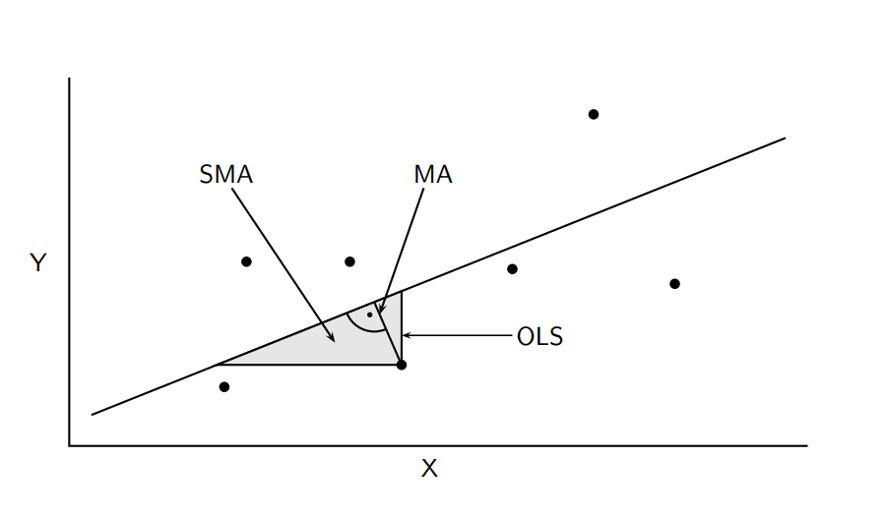
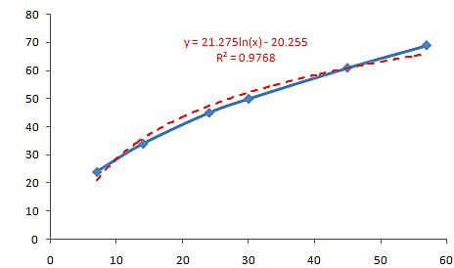
Regression
Linear regression
Logistic regression
Notes:
We use regression for examining the relationship between two conzinuous variables. Linear regression consists of finding the best-fitting straight line through the points. There are some kind of possibilities to measure the distence of the points from the line. On the first picture, you can see one of them. The linear regression is not suitable for classification problem. The output from the hypothesis is the estimated probability.
The logistic regression is used when there is a relationship, but it is not linear. Logistic regression measures the relationship between the categorical dependent variable and one or more independent variables by estimating probabilities using a logistic function, which is the cumulative distribution function of logistic distribution. We can use regression for example, when we want to know, wether the tumor is malignant or not.

Slide 69
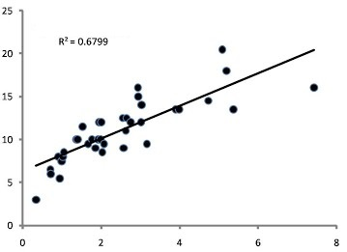
Correlation
Correlation coefficient
R
Prediction strength
R^2
Notes:
Correlation is a statistical technique that can show whether pairs of variables are related and how strongly. For example, height and weight are related; taller people tend to be heavier than shorter people. The relationship isn't perfect. People of the same height vary in weight, and you can easily think of two people you know where the shorter one is heavier than the taller one. Correlation can tell you just how much of the variation in peoples' weights is related to their heights. A correlation coefficient is a numerical measure of some type of correlation, meaning a statistical relationship between two variables. Several types of correlation coefficient exist, each with their own definition and own range of usability and characteristics. They all assume values in the range from −1 to +1, where ±1 indicates the strongest possible agreement and 0 the strongest possible disagreement.
Correlation quantifies the degree to which two variables are related. You simply are computing a correlation coefficient (r) that tells you how much one variable tends to change when the other one does. Linear regression finds the best line that predicts Y from X (Y is for the dependent variable, and X is for the independent one). Correlation does not fit a line.
With correlation, you don't have to think about cause and effect. It doesn't matter which of the two variables you call "X" and which you call "Y„. So it does not matter, which is the dependent, and which is the independent variable. You'll get the same correlation coefficient if you swap the two.
The decision of which variable you call "X" and which you call "Y" matters in regression, as you'll get a different best-fit line if you swap the two. The line that best predicts Y from X is not the same as the line that predicts X from Y.

Slide 70
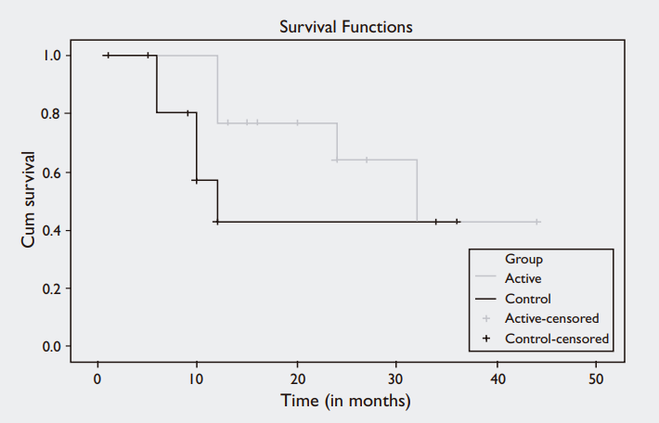
Survival analysis
Can not compare directly
Not normal distribution
Survival analysis
Notes:
The analysis of survival needs special methods, because the survival time does not have normal distribution, and we can not compare directly the means of the two group. We can use the Kaplan-Meier estimation for the analysis. For this, we will need the time of the investigation, the number of events at the end of the investigation, which means, the number of the patients who died during this time, and the number of the patients, who survived this period. Kaplan-meier can be used to compare two treatment groups on their survival times. Here you can see a survival plot for comparison of two groups. Active, and control groups. The reason, why we have to perform a survival analysis, is that since all the subjects died, (for example of lung cancer) we have no extra information to require us to perform survival analysis. But most of the cases, there are some censored observations, which can exist because, the critical event has not yet occurred, or lost to follow-up, or other interventions offered.

Slide 71
Cox-regression
Cox-regression
Status variable: Dependent
Covariates: independent
Time variable
Continuous or discrete
Categorical or continuous
Binary
Notes:
The Kaplan Meier technique is the univariate version of survival analysis, which means comparing using only one variable. To take confounders into the analysis, we have to use cox regression. For the previous lung cancer example, we have collected information on race, age and gender, and want to look at a confounder model to determine whether the two groups differ after adjusting for demographics. For this analysis we can use the Cox-regression. It is similar to logistic regression. The cox regression procedure is useful for modeling the time to a specified event, based upon the values of given covariates. The central statistical output is the hazard ratio.
The dependent factor in cox-regression should be a binary variable. This is the status variable. The time variable measures duration to the event defined by the status variable. (continuous, or discrete) The covariates are independent or predictor variables. They can be categorical, or continuous.

Slide 72
TRANSLATIONAL MEDICINE
taking discoveries for patients benefits
tm-centre.org
Thank you for your attention!

Slide 73
TRANSLATIONAL MEDICINE
taking discoveries for patients benefits
PRACTICE

Slide 74
TRANSLATIONAL MEDICINE
taking discoveries for patients benefits
Bias in randomized controlled trials
Szakács Zsolt
Clinical Trial Course
Pécs, 2019.09.03.

Slide 75
TRANSLATIONAL MEDICINE
taking discoveries for patients benefits
Does aspirin reduce mortality in the elderly?

Slide 76
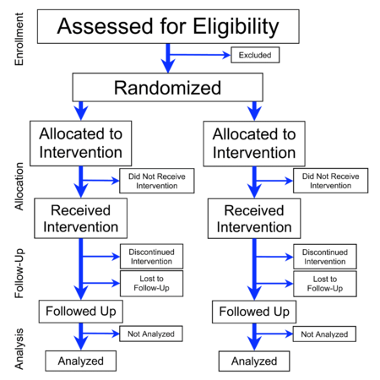
TRANSLATIONAL MEDICINE
taking discoveries for patients benefits
An ideal setting: pure cause-effect relationship
Only the exposure is different
Difference in outcomes is caused by the exposure

Slide 77
An ideal setting: pure cause-effect relationship
NOT only the exposure is different
Biased
Difference in outcomes is caused by the exposure and/or something else

Slide 78
Selection bias/confounding
Is the sample representative to the entire population?
Are the study-arms equal in all properties except for the exposure?
B
A
A1
A2
Properties of A = Properties of B
Properties of A1 = Properties of A2
Representativeness
Confounding

Slide 79
TRANSLATIONAL MEDICINE
taking discoveries for patients benefits
Selection bias
Definition: differences between baseline characteristics of groups compared
How can you prevent it from occurring?
Randomization
A1
A2

Slide 80
TRANSLATIONAL MEDICINE
taking discoveries for patients benefits

Slide 81
TRANSLATIONAL MEDICINE
taking discoveries for patients benefits
…a quart of cyder (2)
…sea-water (2)
…elixir vitriol (2)
…orange and lemon (2)
…electuary (2)
…vinegar (2)

Slide 82
TRANSLATIONAL MEDICINE
taking discoveries for patients benefits
Pitfall 1
How was the random sequence generated?
Pitfall 2
How was the random sequence implemented?

Slide 83
DOI:
10.1016/S0140-6736(02)07283-5
Confounding
Hypothesis: aspirin reuduces CV deaths in the elderly
Design: two-arm prospective study (500-500 patients)
 | Aspirin | No aspirin
Male:female ratio | 1:1.01 | 1:1.04 | P=NS
Age (mean±SD) | 71±10 y | 64±9 y | P<0.001
10-y CV death | 12% | 4% | P<0.001
10-y bleeding | 16% | 11% | P<0.001
The hypothesis should be rejected because aspirin increases CV deaths

Slide 84
DOI:
10.1016/S0140-6736(02)07283-5
Selection bias
Hypothesis: aspirin reuduces CV deaths in the elderly
Design: two-arm randomized study
The hypothesis should be rejected because aspirin does not change CV deaths but increases bleeding risk

Slide 85
Examples for performance bias
Let’s compare a new drug to the old one…
Design: experimental, parallel (2 arms), randomized, open-label.
The new drug reduces thrombosis rate by 20% (95% CI: 15-25%).
But doctors do not trust the new drug…
20% of patient (old drug) and 85% of patients (new drug) were prescribed additional leg ultasound exa
An ancillary exposure distrubuting unequally between groups

Slide 86
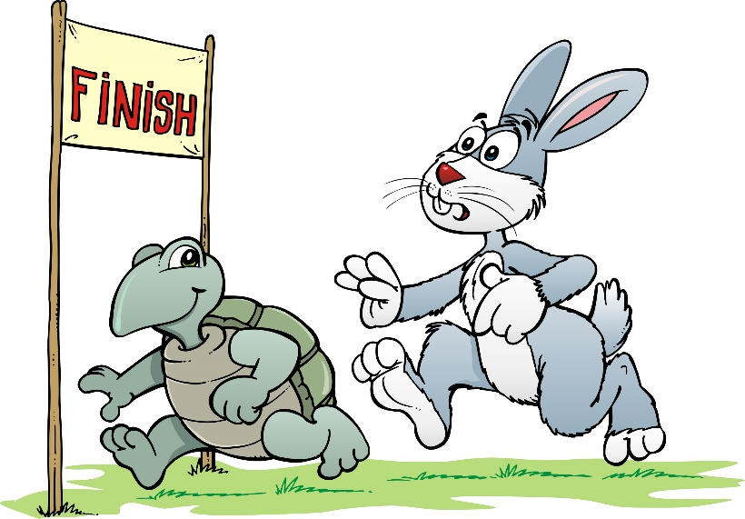
Types of bias
Performance bias
Definition: differences in care or exposure to factors (other than the intervention) between groups
How can you prevent it from occurring?
Blinding

Slide 87
Examples for detection bias
Let’s compare a new drug to the old one…
Design: experimental, parallel (2 arms), randomized, open-label.
The new drug reduces pneumonia rate by 20% (95% CI: 15-25%).
But doctors do not trust the new drug…
20% of patient (old drug) and 85% of patients (new drug) were ordered chest X-ray (p<0.001)
Any detecting modality distrubuting unequally between groups

Slide 88
Types of bias
Detection bias
Definition: differences in how outcomes were determined between groups
How can you prevent it from occurring?
Blinding

Slide 89
Selection bias/Attrition bias
Chance for a bomber to make it: 50-50%
(Ábrahám Wald)

Slide 90
Types of bias
Attrition bias or follow-up bias (drop-outs)
Definition: differences in withdrawals between groups
How can you minimize it?
Intention-to-treat vs. per-protcol analysis

Slide 91
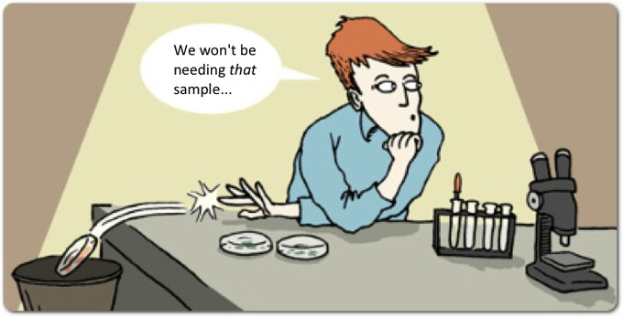
Types of bias
Reporting bias
Definition: differences between reported and unreported findings
Odds ratios for reporting significant results: efficacy: OR=2.4 (95%CI: 1.4-4.0) harms: OR=4.7 (95%CI: 1.8-12.0)
Chan AW, Hróbjartsson A, Haahr MT, Gøtzsche PC, Altman DG. Empirical evidence for selective reporting of outcomes in randomized trials: comparison of protocols to published articles. JAMA2004; 291: 2457-2465.

Slide 92
Examples for detection bias
Let’s compare a new drug to the old one…
Design: experimental, parallel (2 arms), randomized, double-blind
Results:
mortality reduced by 2% (95% CI: 1.5-2.5%)
organ failure rate reduced by 1.0% (95% CI: 0.8-1.2%)
short-term (1-month) neurological deficit did not change
Picking of the desired results

Slide 93
Examples for detection bias
Let’s compare a new drug to the old one…
Design: experimental, parallel (2 arms), randomized, double-blind
Results:
mortality reduced by 2% (95% CI: 1.5-2.5%)
organ failure rate reduced by 1.0% (95% CI: 0.8-1.2%)
short-term (1-month) neurological deficit did not change
long-term (1-year) neurological deficit increased by 40% (95% CI: 34-60%)
Picking of the desired results

Slide 94
Types of bias
Reporting bias
Definition: differences between reported and unreported findings
How can you prevent it from occurring?
Pre-study protocols…

Slide 95
Types of bias
Sponsorship bias
Definition: deviation from true results due to financial conflict of interest
How can you prevent it from occurring?
No sponsor (?)
Declare the role of the sponsor (?)

Slide 96
TRANSLATIONAL MEDICINE
taking discoveries for patients benefits
Does aspirin reduce mortality in the elderly?

Slide 97
TRANSLATIONAL MEDICINE
taking discoveries for patients benefits
COMMON MISTAKE
NOT understanding the concept of bias
NOT seeking for potential bias in studies
Stating a cause-effect relationship based on biased results

Slide 98
TRANSLATIONAL MEDICINE
taking discoveries for patients benefits
TAKE HOME MESSAGE
Always question the validity of the results.
Selection bias, information bias, and confounding.
Pay close attention to cause-effect relationships.

Slide 99
TRANSLATIONAL MEDICINE
taking discoveries for patients benefits
tm-centre.org
Thank you for your attention!

Slide 100
TRANSLATIONAL MEDICINE
taking discoveries for patients benefits
What types of bias can you find in the articles?
selection bias
performance bias
detection bias
attrition bias
reporting bias
sponsorship bias

Slide 101
TRANSLATIONAL MEDICINE
taking discoveries for patients benefits
What Kind of Role do
the Clinical Trial Coordinators Play
In Translational Medicine?
Judit Antal
Clinical Trial Course
Pécs, 2019.09.03.

Slide 102
TRANSLATIONAL MEDICINE
taking discoveries for patients benefits
Who the clinical trial coordinators are?

Slide 103
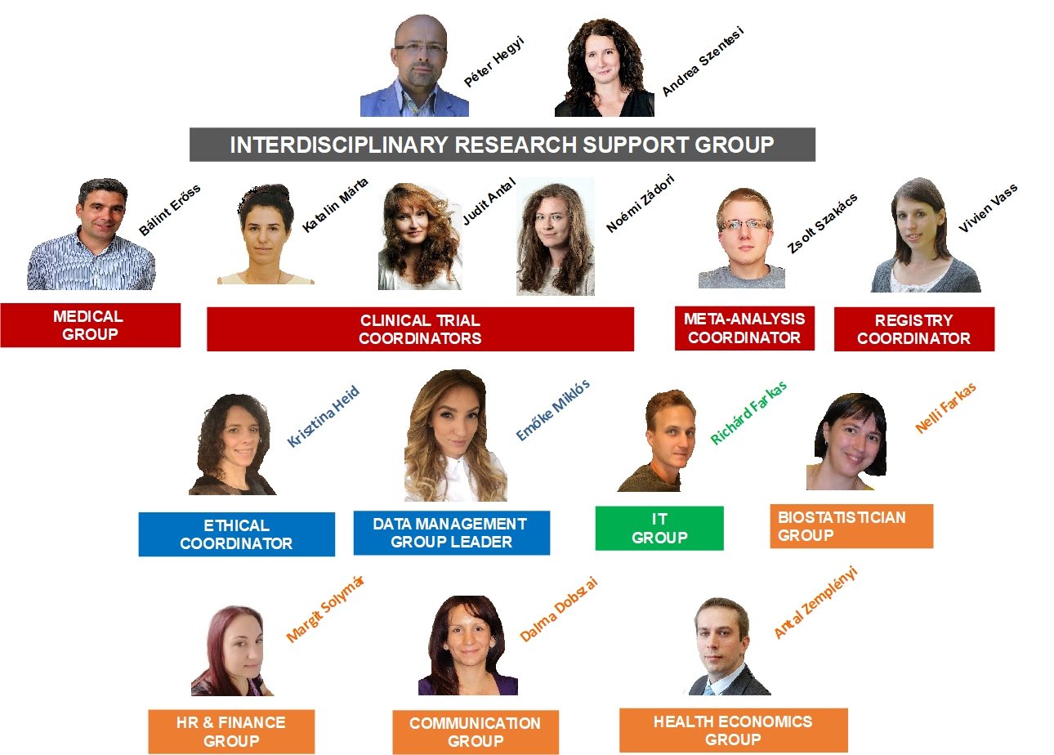

Slide 105
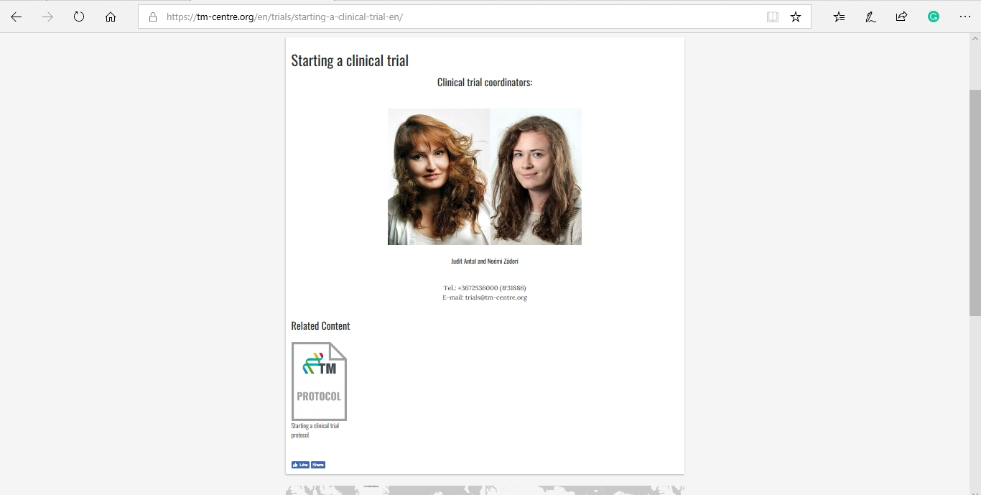
What do the trial coordinators do?
TRANSLATIONAL MEDICINE
taking discoveries for patients benefits
What do the trial coordinators do?

Slide 106
TRANSLATIONAL MEDICINE
taking discoveries for patients benefits
What do the trial coordinators do?

Slide 107
What do the trial coordinators do?
TRANSLATIONAL MEDICINE
taking discoveries for patients benefits
Theoretically:
„One of the main objectives of the Translational Medicine Center at the University of Pécs is to assist clinicians and/or basic scientists at the different phases of planning, launching, managing, evaluating, and publishing of the clinical trials. The guidance might covers the entire progression of the clinical trial…”
„Starting a Clinical Study Protocol”
https://tm-centre.org/download/article-realated/204/klinikai-vizsgalat-inditasa-protokoll-0627110954.pdf

Slide 108
What do the trial coordinators do?
TRANSLATIONAL MEDICINE
taking discoveries for patients benefits
Theoretically:
„One of the main objectives of the Translational Medicine Center at the University of Pécs is to assist clinicians and/or basic scientists at the different phases of planning, launching, managing, evaluating, and publishing of the clinical trials. The guidance might covers the entire progression of the clinical trial…”
„Starting a Clinical Study Protocol”
https://tm-centre.org/download/article-realated/204/klinikai-vizsgalat-inditasa-protokoll-0627110954.pdf

Slide 109
What do the trial coordinators do?
TRANSLATIONAL MEDICINE
taking discoveries for patients benefits
Theoretically:
„One of the main objectives of the Translational Medicine Center at the University of Pécs is to assist clinicians and/or basic scientists at the different phases of planning, launching, managing, evaluating, and publishing of the clinical trials. The guidance might covers the entire progression of the clinical trial…”
„Starting a Clinical Study Protocol”
https://tm-centre.org/download/article-realated/204/klinikai-vizsgalat-inditasa-protokoll-0627110954.pdf

Slide 110
What do the trial coordinators do?
TRANSLATIONAL MEDICINE
taking discoveries for patients benefits
Theoretically:
„One of the main objectives of the Translational Medicine Center at the University of Pécs is to assist clinicians and/or basic scientists at the different phases of planning, launching, managing, evaluating, and publishing of the clinical trials. The guidance might covers the entire progression of the clinical trial…”
„Starting a Clinical Study Protocol”
https://tm-centre.org/download/article-realated/204/klinikai-vizsgalat-inditasa-protokoll-0627110954.pdf

Slide 111
TRANSLATIONAL MEDICINE
taking discoveries for patients benefits
End of the study
Final analysis
Follow up
Interim analysis, Safety analysis
Data collecting
‘Must have’data
Ethical approval
Expected adverse events
Reg., Pre-pub protocol
It is neccesary for high-quality evidence
Sample size calculation
Hypothesis, expected effectivity
Protocol
According to preliminary search/knowledge

Slide 112
TRANSLATIONAL MEDICINE
taking discoveries for patients benefits
End of the study
Final analysis
‘Must have’data
Expected adverse events
Publication of the results
Hypothesis, expected effectivity

Slide 113
DOI:
10.1016/S0140-6736(02)07283-5
TRANSLATIONAL MEDICINE
taking discoveries for patients benefits
https://www.equator-network.org/

Slide 114
TRANSLATIONAL MEDICINE
taking discoveries for patients benefits
It is unavoidable in case of organizing RCT!
It can be an assistance for planning
Means less occurance of publication bias

Slide 115
TRANSLATIONAL MEDICINE
taking discoveries for patients benefits
Patient involvement strategy
Planning the study with the assistance of patients
Patients are also the part of publication strategies

Slide 116
TRANSLATIONAL MEDICINE
taking discoveries for patients benefits
COMMON MISTAKES
1. Carried out not according to the guidelines (SPIRIT, CONSORT)
2. Protocol registration of the study is missing, and/or not publishing the pre-study protocol

Slide 117
TRANSLATIONAL MEDICINE
taking discoveries for patients benefits
'TAKE HOME MESSAGE'
1. Planning the study according to the guidelines – Equator Network
2. International registration and, publication of the pre-study protocol

Slide 118
TRANSLATIONAL MEDICINE
taking discoveries for patients benefits
tm-centre.org
Thank you for your attention!

