Slide 1
Introduction of the Clinical Trial Coordinator Group
Lajos Szakó
Clinical Trial Coordinator Group

Slide 2
Overview
Relevance of a Clinical Trial Coordinator (CTC)
Responsibilities and job of CTC
Introduction of the Clinical Trials Coordinator Group

Slide 3
Relevance
Hungary: 10th in terms of number of trials, more than 4000 registered trials
Since 2010: 300 registered trials annually
Most of the trials are multicentric
International studies: 60% are related to US
Most of them: phase 3 and 4 trials: initiated by the pharmaceutical industry
Quality: organized work
A prezentáció alcíme

Slide 4
Proposed timeline of the initiation of a clinical trials
Interdisciplinary
discussion
1.STEP
hypothesis
START
OF THE TRIAL

Slide 5
Step 1: Interdisciplinary discussion
Hypothesis formation
Clinical trial coordinator, strategical consultant, chief investigator
Is clinical trial the appropriate tool?
Discussion about the study design,
feasibility, and endpoints
A prezentáció alcíme

Slide 6
Proposed timeline of the initiation of a clinical trials
Interdisciplinary
discussion
2. STEP
1.STEP
hypothesis
Preparation of
the protocol
START
OF THE TRIAL

Slide 7
Step 2: Preparation of the protocol
Background of the scientific question
Clinical equipoise
Objectives, expected results
Standard Protocol Items: Recommendations for Interventional Trials (SPIRIT) statement
A prezentáció alcíme
Chan A-W, Tetzlaff JM, Altman DG, Laupacis A, Gøtzsche PC, Krleža-Jerić K, Hróbjartsson A, Mann H, Dickersin K, Berlin J, Doré C, Parulekar W, Summerskill W, Groves T, Schulz K, Sox H, Rockhold FW, Rennie D, Moher D. SPIRIT 2013 Statement: Defining standard protocol items for clinical trials. Ann Intern Med 2013;158:200-207

Slide 8
Proposed timeline of the initiation of a clinical trials
Sample size calculation
Interdisciplinary
discussion
3. STEP
1.STEP
2. STEP
hypothesis
Preparation of
the protocol
START
OF THE TRIAL

Slide 9
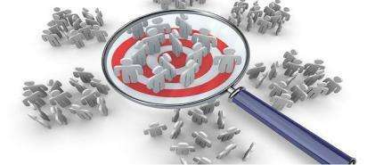
Step 3: Sample size calculation
Involvement of a biostatistician
The necessary number of participants
Decision on the statistical framework (non-inferiority, superiority, stc.)
Requested variables
(drop out rate,
expected effect)
A prezentáció alcíme

Slide 10
Proposed timeline of the initiation of a clinical trials
Interdisciplinary
discussion
Sample size calculation
4. STEP
1.STEP
2. STEP
3. STEP
hypothesis
Preparation of
the protocol
Final decision about
the starting of the
trial
START
OF THE TRIAL

Slide 11
Step 4: Final decision about the starting of the clinical trial
Finalization of the hypothesis
Estimation of the time required for the study to succeed
Timing of interim analyses
Potential participating centres
Funding
A prezentáció alcíme

Slide 12
Proposed timeline of the initiation of a clinical trials
Writing the pre-study protocol, compiling questionnaires
Interdisciplinary
discussion
Sample size calculation
5. STEP
1.STEP
2. STEP
3. STEP
4. STEP
hypothesis
Preparation of
the protocol
Final decision about
the starting of the
trial
START
OF THE TRIAL

Slide 13
Step 5: Writing of the pre-study protocol, compiling questionnaires
Finalization of the protocol
Data collection forms
A prezentáció alcíme

Slide 14
Proposed timeline of the initiation of a clinical trials
Writing the pre-study protocol, compiling questionnaires
Interdisciplinary
discussion
Sample size calculation
6.STEP
1.STEP
2. STEP
3. STEP
4. STEP
5. STEP
hypothesis
Preparation of
the protocol
Final decision about
the starting of the
trial
ITAB discussion
START
OF THE TRIAL

Slide 15
Step 6: ITAB discussion
International Trial Advisory Boards
Revision of the protocol by internationally recognized experts
A prezentáció alcíme

Slide 16
Proposed timeline of the initiation of a clinical trials
Writing the pre-study protocol, compiling questionnaires
IT development
Interdisciplinary
discussion
Sample size calculation
7. STEP
1.STEP
2. STEP
3. STEP
4. STEP
5. STEP
6.STEP
hypothesis
Preparation of
the protocol
Final decision about
the starting of the
trial
ITAB discussion
START
OF THE TRIAL

Slide 17
Step 7: IT development
Involvement of the IT specialist
Finalization of the case report forms and electronic case report forms
A prezentáció alcíme

Slide 18
Proposed timeline of the initiation of a clinical trials
Writing the pre-study protocol, compiling questionnaires
Interdisciplinary
discussion
Sample size calculation
IT development
1.STEP
2. STEP
3. STEP
4. STEP
5. STEP
6.STEP
7. STEP
hypothesis
Preparation of
the protocol
Final decision about
the starting of the
trial
ITAB discussion
8. STEP
Preparation of documents in Hungarian, translations
START
OF THE TRIAL

Slide 19
Step 8: Preparation of documents in hungarian, translations
Translation of all documentation into English, Hungarian and other required languages
User instructions
A prezentáció alcíme

Slide 20
Proposed timeline of the initiation of a clinical trials
Writing the pre-study protocol, compiling questionnaires
Interdisciplinary
discussion
Sample size calculation
IT development
1.STEP
2. STEP
3. STEP
4. STEP
5. STEP
6.STEP
7. STEP
hypothesis
Preparation of
the protocol
Final decision about
the starting of the
trial
ITAB discussion
Ethics approval
9. STEP
8. STEP
Preparation of documents in Hungarian, translations
START
OF THE TRIAL

Slide 21
Step 9: Ethics approval
Compiling the documentation with the help of the CTC and Ethich Coordinator
Submission of the papers to Medical Research Council
A prezentáció alcíme

Slide 22
Proposed timeline of the initiation of a clinical trials
Writing the pre-study protocol, compiling questionnaires
Interdisciplinary
discussion
Sample size calculation
IT development
1.STEP
2. STEP
3. STEP
4. STEP
5. STEP
6.STEP
7. STEP
hypothesis
Preparation of
the protocol
Final decision about
the starting of the
trial
ITAB discussion
Ethics approval
10. STEP
8. STEP
9. STEP
Preparation of documents in Hungarian, translations
International registration
START
OF THE TRIAL

Slide 23
Step 10: International registration
Not mandatory in Hungary
Visibility and high-quality evidence
Prevention of publication bias and selective reporting
A prezentáció alcíme

Slide 24
Proposed timeline of the initiation of a clinical trials
Writing the pre-study protocol, compiling questionnaires
Interdisciplinary
discussion
Sample size calculation
IT development
1.STEP
2. STEP
3. STEP
4. STEP
5. STEP
6.STEP
7. STEP
hypothesis
Preparation of
the protocol
Final decision about
the starting of the
trial
ITAB discussion
Pre-study publication
Ethics approval
11. STEP
8. STEP
9. STEP
10. STEP
Preparation of documents in Hungarian, translations
International registration
START
OF THE TRIAL

Slide 25
Step 11: Pre-study publication
Selection of the target journal: SC and CTC
A prezentáció alcíme

Slide 26
Proposed timeline of the initiation of a clinical trials
Writing the pre-study protocol, compiling questionnaires
Interdisciplinary
discussion
Sample size calculation
IT development
1.STEP
2. STEP
3. STEP
4. STEP
5. STEP
6.STEP
7. STEP
hypothesis
Preparation of
the protocol
Final decision about
the starting of the
trial
ITAB discussion
Ethics approval
Pre-study publication
12. STEP
8. STEP
9. STEP
10. STEP
11. STEP
Preparation of documents in Hungarian, translations
International registration
User manuals and practical aids
START
OF THE TRIAL

Slide 27
Step 12: User manuals and practical aids
Essential in the precise conduction
Guide for the participating investigators, nurses, administrators
A prezentáció alcíme

Slide 28
Proposed timeline of the initiation of a clinical trials
Writing the pre-study protocol, compiling questionnaires
Interdisciplinary
discussion
Sample size calculation
IT development
1.STEP
2. STEP
3. STEP
4. STEP
5. STEP
6.STEP
7. STEP
hypothesis
Preparation of
the protocol
Final decision about
the starting of the
trial
ITAB discussion
Test-phase of the clinical trial
Ethics approval
Pre-study publication
13. STEP
8. STEP
9. STEP
10. STEP
11. STEP
12. STEP
Preparation of documents in Hungarian, translations
International registration
User manuals and practical aids
START
OF THE TRIAL

Slide 29
Step 13: Test-phase if the clinical trial
Evaluation of the feasibility of the protocol, instructions for use, enrolment of participants, and data upload
A prezentáció alcíme

Slide 30
Proposed timeline of the initiation of a clinical trials
Writing the pre-study protocol, compiling questionnaires
Interdisciplinary
discussion
Sample size calculation
IT development
1.STEP
2. STEP
3. STEP
4. STEP
5. STEP
6.STEP
7. STEP
hypothesis
Preparation of
the protocol
Final decision about
the starting of the
trial
ITAB discussion
Ethics approval
Pre-study publication
Test-phase of the clinical trial
14. STEP
8. STEP
9. STEP
10. STEP
11. STEP
12. STEP
13. STEP
Preparation of documents in Hungarian, translations
International registration
User manuals and practical aids
Training for
all participating centre
START
OF THE TRIAL

Slide 31
Step 14: Training for all participating centre
Participating centres should recive a comprehensive lecture
A prezentáció alcíme

Slide 32
Clinical trial coordinator
Facilitation of each step
Guidance for the Chief Investigator
Communication between the members of the interdisciplinary study group
A prezentáció alcíme

Slide 33
Clinical Trial Coordinator group
Noémi Zádori
Lajos Szakó
A prezentáció alcíme
Bálint Erőss
Nóra Vörhendi
Szilárd Váncsa

Slide 34
An overview of clinical trials:
the lay of the land
Lajos Szakó
Clinical Trial Coordinator Group

Slide 35
AIMS FOR TODAY
to provide basic knowledge of observational clinical studies
to learn how to check, interpret and critically appraise observational clinical studies
An overview of clinical trials:
the lay of the land

Slide 36
What does „clinical trial” mean?
experiments or observations done in clinical research
are performed on human participants
Clinical trials are not limited to pharmaceutical 'phase studies'
Aim: to improve the healthcare system
Their goal is to answer a specific scientific question
A prezentáció alcíme

Slide 37
Questions of clinical trials
„So what?”
Is it appropriate?
Hulley S, Cummings S, Browner W, et al. Designing clinical research. 3rd ed. Philadelphia (PA): Lippincott Williams and Wilkins; 2007.

Slide 38
Questions of clinical trials
Derived from the clinical problems to solve
Patient and/or Problem
Intervention
A prezentáció alcíme
Comparison intervention (”gold standard”)
Outcome

Slide 39
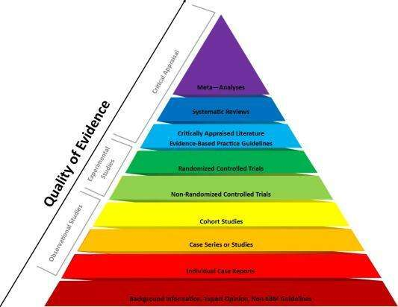
EB pyramid
0. We should know the types of trials
1. Choose the right type for the question
A prezentáció alcíme
Lancet, Epidemiology Series, 2002

Slide 40
Types of clinical trials
1. Is the intervention necessary because of the trial?
2. Is is randomized?
3. Is it controlled?
4.How does the exposure and endpoint related to time?
A prezentáció alcíme
Grimes DA, Schulz KF. Lancet. 2002

Slide 41
Sample size calculation
How many patients are needed?
What do we have to know?
How big is the difference we do expect between the groups?
Literature search done systematically
If there is no such data available: the own trial or own hypothesis might be used

Slide 42
Hypothesis
Might be derived from the scientific question we ask
Provides the justification for the clinical trial
It can be answered handling the methods used in the trial
Usually based on the primary endpoint
It is antecedent to the trial and establishes the trial's direction
The most widely employed method of determining whether the outcome of clinical trials is positive or negative
Should be tested at the end of the study (can be 1-sided or 2-sided)
A prezentáció alcíme

Slide 43
How can I choose the right endpoint?
Primary
vs.
Secundary
There is usually only one primer endpoint
There is more than one
The hardest one' wins
Not so 'hard'
The most relevant above all
More like an additional information
Sample size calculation is based on this one
Less 'power'

Slide 44
What kind of endpoint should I choose?
Hard
Soft
Objective
vs.
Can be subjective
Can be measured accurately
Uncertanity of measurement
Mortality
Length of hospitalization
Pain
QoL
A prezentáció alcíme
Cause-specific
mortality
Need for surgery
CRP level

Slide 45
'TAKE HOME MESSAGE'
The importance of preliminary knowledge of the relevant data in literature
Search in the literature for getting the methods known – decision for the appropriate processes
Clear questions, hypothesis and goals (PICO)
A prezentáció alcíme

Slide 46
Thank you for your attention!

Slide 47
DESCRIPTIVE STUDIES
the ’first toe in the water’
Nóra Vörhendi
Clinical Trials Coordinator Group
Notes:
Hi everyone, my name is Nóra Vörhendi, im a second year phd student, and i am the member of the clinical trial coordinator group.

Slide 48
TABLE OF CONTENTS
WHAT IS A DESCRIPTIVE STUDY?
TYPES OF STUDIES
Characteristics of descriptive studies
Advantages and drawbacks
DESCRIPTIVE STUDIES
the ’first toe in the water’
Notes:
The purpose of my presentation is to introduce genre of descriptive studies, so the types, characteristiscs, applications, advanteges and diasadvantages.

Slide 49
WHAT IS A DESCRIPTIVE STUDY?
A descriptive study is one that is designed to describe the distribution of one or more variables, without regard to any causal or other hypothesis.
Notes:
A descriptive study – as the name implies – describes the distributions of disease, injury or health in a population, outlining the burden of disease or the extent of exposure. without regard to any other hypothesis.

Slide 50
TYPES OF STUDIES
TYPES OF DESCRIPTIVE STUDIES
Individual level
A prezentáció alcíme
Case study
Case series
Cross-sectional
Population level
Ecological study
Notes:
Study designs are primarily of two types – observational and interventional, with the former being loosely divided into “descriptive” and “analytical.”
Analytic studies test hypotheses about exposure-outcome relationships, Measure the association between exposure and
Outcome, Include a comparison group.
But in this presentation, we discuss the descriptive study designs.
Descriptive studies can be of several types, namely, case reports, case series, cross-sectional studies, and ecological studies. In the first three of these, data are collected on individuals, whereas the last one uses aggregated data for groups.

Slide 51
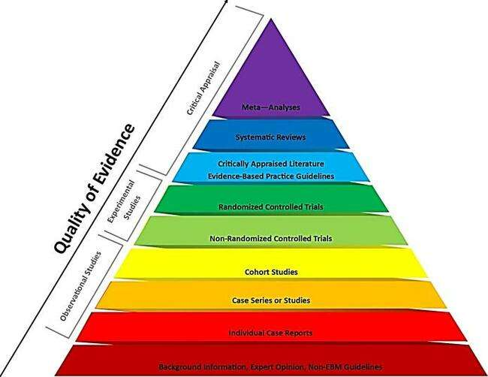
Generally low quality of evidence (if any)
Why do we still use them?
New areas of inquiry
Generate hypotheses
Can be followed up by other investigations
Notes:
Here you can see that the case reports and case series are in the second and third level of evidence based pyramid and they represent a low quality of evidence.
But why do we still use them? Because they help to generate a hypothesis and promotes other investigations.

Slide 52
Characteristics of descriptive studies
The descriptive pentad: five basic „W” questions
Who has the disease in question?
Characterization (e.g.: age, gender, race)
What is the condition or disease being studied?
Exact definition
Why did the condition or disease arise?
Clues and assumptions about causes and NOT associations
When is the condition common or rare?
Assuming temporal relationships
Where does or does not the disease or condition arise?
Assuming localizational relationships
A prezentáció alcíme
Notes:
Here you can see the descriptive pentad, so the “who, what, why, when, where” questions. Their function is to describe the study without regard to the hypothesis, highlighting patterns of disease and associated factors.
SO:: Who has the disease in question? The characteristics (age, sex, occupation) of the individuals affected by the Outcome
What is the condition or disease being studied?
Why did the condition or disease arise?
When is the condition common or rare? Or when events (diagnosis, reporting; testing) occurred
Where does or does not the disease or condition arise? Or the geography (residence, work, hospital) of the affected individuals

Slide 53
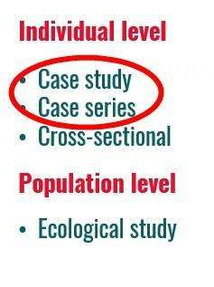
Case report & Case-series
reports an unusual disease or association
least publishable – lowest quality of evidence
can prompt further investigation
A prezentáció alcíme
Notes:
First, lets look at the Case reports and case series. They describe the experience of a single patient or a group of patients with a similar diagnosis.
They refer to the description of a patient with an unusual disease or with simultaneous occurrence of more than one condition.
They can represent the first clues in the identification of new diseases or adverse effects of exposure.
A case report can prompt further investigations with more rigorous study design.

Slide 54
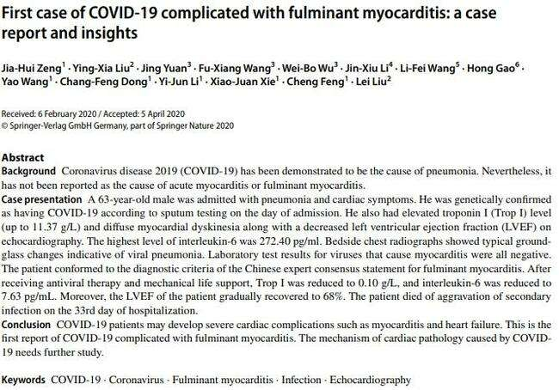
Case report: example
A prezentáció alcíme
Notes:
This study design has historical importance in epidemiology. It was often used as an early means to identify the begining or presence of an disease and play an important role in advancing medical science.
Here you can see the first case of covid 19 complicated with fulminant myocarditis.

Slide 55
Case-series: example
A prezentáció alcíme
Notes:
Here you can see the classic example of a case series. It is the first description of AIDS. In 1981 five formerly healthy homosexual young men form LosAngeles hospital diagnosed with pneumonia caused by Pneumocystis Carinii. These were surprising because so far this form of pneumonia was observed in elderly people
whose immune systems were suppressed. Under these unusual circumstances it indicated that it was a previously unknown disease acquired by immunodeficiency called Acquired Immunodeficiency Syndrome (AIDS).

Slide 56
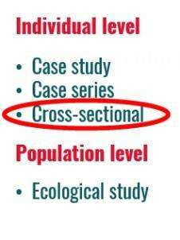
cross-sectional studies
snapshot of the population
measuring prevalence
both exposure and outcome are ascertained at the same time
no control group! (compared to analytical cross-sectional studies)
relatively cheap to organize
temporal sequence is often impossible to work out
A prezentáció alcíme
Notes:
Lets move on the characteristics of cross sectional studies. This is the observation of a defined population at a single point in time or time interval. So cross-sectional studes provide a snapshot of the population at a particular time.
These are very good for measuring the prevalence of a disease or of a risk factor in a population. Thus, these are very helpful in assessing the disease burden and healthcare needs.
Exposure and outcome are determined simultaneously. The cross-sectional study describes the presence and/or absence of various clinical features, so it provides a cross-sectional comparison. This means that costs are small and loss to follow up is not a problem. However, because exposure and outcome are measured at the same time point, the temporal sequence is often impossible to determine.

Slide 57
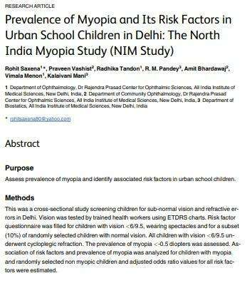
cross-sectional study: example
A prezentáció alcíme
Notes:
Let us look at a study that was aimed to assess the prevalence of myopia among Indian children. In this study, trained health workers visited schools in Delhi and tested visual acuity in all children. Of the 9884 children screened, 1297 (13.1%) had myopia. Furthermore, overall, 322 had mild, 247 had moderate, and 3 children had severe visual impairment. These parts of the study looked at the prevalence and degree of myopia or of visual impairment, and did not assess the relationship of one variable with another or test a causative hypothesis . These data would be helpful to a health planner to assess the need for a school eye health program, and to know the proportion of children who would need corrective glasses.

Slide 58
Ecological/ CORRELATIONAL studies
association between an exposure and an outcome
population level
quick, cheap, identify new risk factors
confounding factors
Notes:
Ecological (also sometimes called as correlational) study design look for association between an exposure and an outcome across populations rather than in individuals. They use data that has already been collected. An ecological study is quick and cheap to conduct.
It can generate new hypotheses.
It can identify new risk factors.
It is unable to control for confounding factors. Its units of study are populations not individuals. Therefore, the disease rates linked with population characteristics and the association observed at group level does not reflect association at individual level.

Slide 59
Ecological study: example
1960: USA, CHD-smoking-deaths
Notes:
One classic example of correlation studies in the 1960s in the United States conducted a survey in which 44 states examined the association with coronary heart disease
between deaths and cigarette consumption. This study is significantly contributed to the hypothesis that smoking causes lethal coronary heart disease.
This hypothesis was later used by a number of analytical epidemiologists study confirmed.

Slide 60
Uses of descriptive studies
1.) Healthcare planning
2.) Hypothesis development
3.) Trend analysis
Notes:
Here you can see the applications of descriptive studies.
Descriptive studies provide knowledge about which populations or subgroups are most or least affected by disease. This enables public health administrators to target particular segments of the population for education or prevention programmes and can help allocate resources more efficiently.
Descriptive studies identify descriptive characteristics which frequently constitutes an important first step in the search for determinants or risk factors that can be altered or eliminated to reduce or prevent disease. So they can help with the generation of a hypothesis.
This figure shows the relative incidence of esophageal adenocarcinoma over the years.
Time-trend analysis is a longitudinal descriptive study that can provide a dynamic view of a population's health status. Data is collected over time, place and person to look for trends and changes.

Slide 61
ADVANTAGES AND DRAWBACKS
Advantages:
Inexpensive - data are
already available
Very easy to conduct
Few ethical difficulties
Drawbacks:
Temporal associations
might be unclear
Mistakenly drawn
causal conclusions
Notes:
Here you can see the advantages and disadvantages of these studies.
Descriptive studies, irrespective of the subtype, are often very easy to conduct. For case reports, case series, and ecological studies, the data are already available. For cross-sectional studies, these can be easily collected (usually in one encounter). Thus, these study designs are often inexpensive, quick and do not need too much effort. Furthermore, these studies often do not face serious ethics scrutiny, except if the information sought to be collected is of confidential nature.
As with other study designs, descriptive studies have their own pitfalls. Case reports and case-series refer to a solitary patient or to only a few cases, who may represent a chance occurrence. Hence, conclusions based on these run the risk of being non-representative, and hence unreliable. In cross-sectional studies, the validity of results is highly dependent on whether the study sample is well representative of the population proposed to be studied, and whether all the individual measurements were made using an accurate and identical tool, or not. If the information on a variable cannot be obtained accurately, for instance in a study where the participants are asked about socially unacceptable (e.g., promiscuity) or illegal (e.g., substance use) behavior, the results are unlikely to be reliable.

Slide 62
'TAKE HOME MESSAGE'
Descriptive studies are…
Often the first approach to a new event or condition
Useful for trend analysis, healthcare planning and hypothesis development
Often followed up by other studies on the same topic
Notes:
Lets see our take home message. Descriptive studies are often the first approach to a new event or condition. They are useful for trend analysis, healthcare planning and hypothesis development. And Often followed up by other studies on the same topic

Slide 63
THANK YOU FOR THE ATTENTION!
Nóra Vörhendi
Clinical Trials Coordinator Group
Notes:
Thank you for your attention.
The next presentation you can learn about some statistical methods of these topic. Our next presenter is Dávid Németh. Dávid, can you give a lecture on the statistical methods of descitptive studies?

Slide 64
Statistics
Descriptive statistics
Dávid Németh

Slide 65
TABLE OF CONTENTS
Variable types
Numerical data collection
Probability density function
Confidence interval
Representation
Statistics
Descriptive statistics
Notes:
Here you can see, what are the main points, I would like to talk about.

Slide 66
Variable types
Nominal
Categorical
Ordinal
Variable
Discrete
Numerical
Continuous
Notes:
There are two main types of variables. One is the categorical ∆, which are not numbers. This can be the types of diabetes which is an example for the nominal ∆, that can not be given in orders. Or a categorical variable can be a stage of an illness as well, which have a rank, or some kind of order. Variables like this, called ordinal variable ∆.
The other main type is the numerical ∆ variables. They are numbers, so we are able to calculate with them. The difference is that the discretes ∆ are can take only finite numbers, like heart rate, which normaly can be just an integer. The continuous ∆ variable can take any kind of number. Continuous variable can be for example the blood pressure.

Slide 67
Dichotomous / Continuous
Continuous
Dichotome
Perfect null hypothesis
Huge amount of information
Cheaper
A prezentáció alcíme
Can be transform to dichotome
Information loss
Not possible to transform
Expensive
Notes:
Blood pressure can be measured with continuous variables like I mentioned before, for instance in inches of mercury. Or it can be separated to two groups, for example hypertonic and normal pressure. That is call dichotomization. In the second case, so in case of dichotomization, there are some information loss ∆. That is why it is impossible for example to make three groups of this two later, like hypotonic, hypertonic, and normal. Although, it can be a mistake to measure everything, even if we won’t need it. To measure a variable it means more time, more human resources, and of course more money ∆. So that’s shows us, how important to ascertain a proper null hypothesis, which is tell us exactly, what we want to know, or what is the purpose of the research. A good null hypothesis is a sentence, which can clarify us the revelance of the research. This is what the statistician group need the most, and a proper data base of course. The null hypothesis can be like, „A” medicine makes a higher reduce in blood pressure, than the „B” one. That simple is the null hypothesis.
In case of multicenter researches, it is also important to clarify which measurements was used in the different centers. Even more, if they are from different countries. Those can use another methods, or maybe another scale.

Slide 68
Numerical data collection
Central tendency
Mean
Median
Spread
SD
Range
(Standard deviation)
(Min, max)
SE
Quartiles
(Standard error)
(Q1, Q3, IQR)
Notes:
A numerical data in most of the cases are shown in a central tendency ∆, and a spread, which are connected. Both are tell us, how our data looks like. Normally it is impossible to publish a huge amount of data, because no one would understand it. And of course, nobody would read an article which is full of raw data. So we have to reduce our data, to some numerical variables. But it is really important, to keep all the important information in this numbers.
That is why, the central tendency tells us something about the middle of the data, and the spread can show how far the others are from this middle value. Most of the time, the central tendency is mean, or median ∆. The mean, also called average, is the result you get by adding two or more amounts together, and dividing the total by the number of amounts.
The median is the middle value, which separates the higher half from the lower half of the data sample, after ordering it. So the fifty percent of the data are below the median, and the fifty percent are upper it.
Usually the mean is used with standard deviation ∆, or with standard error. Standard deviation is a measure that is used to quantify the amount of variation of a set of data values. A low standard deviation indicates that the data points tend to be close to the mean, while a high standard deviation indicates that the data points are spread out over a wider range of values. Standard error can be calculated from the standard deviation. The median is appears with range, or quartiles ∆. The range is the minimum and the maximum value of the sample, and the quartiles are similar to the median. Below the first quartile, there are the twenty five percent of the data, and below the third quartile, there are the seventy five percent of the data.

Slide 69
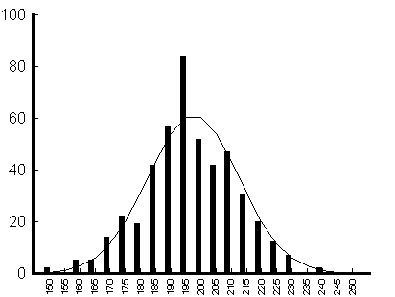
Probability density function
Frequency
A prezentáció alcíme
Length
Notes:
We can represent our data in probability density function, which is a function whose value at any given sample in the sample space can be interpreted as providing a relative likelihood that the value of the random variable would equal that sample.
So that means, how much more likely it is that the random variable would equal one sample compared to the other sample.
These density functions have a kind of distribution, and the shape of this distribution is important in case of the statistical analysis.

Slide 70
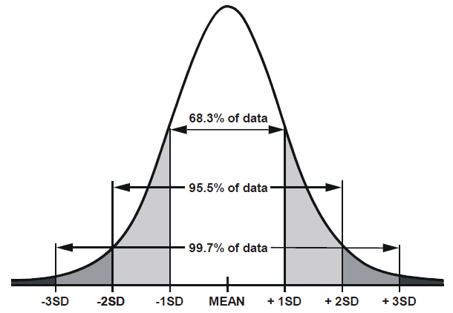
Normal distribution
Mean
Median
A prezentáció alcíme
Notes:
Normal distribution is called symmetrical distribution as well.
Symmetry means that one half of the distribution is a mirror image of the other half. So normal distribution has no skew. The tails are exactly the same. In the case of normal distribution the mean is equal to the median ∆. And for instance the 95.5% of the sample are within two standard deviation from the mean.

Slide 71
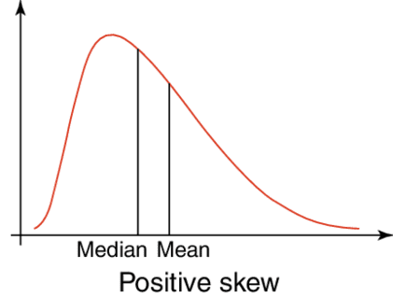
Skew distribution
Mean
Median
Notes:
If one tail is longer than the other, the distribution is skewed. These distributions are sometimes called asymmetric or asymmetrical distributions as they don’t show any kind of symmetry. We say that positively skew the distribution, when the mean is higher than the median. And inversely the negative skew means the mean is lower than the median.
Sometimes it is important to transform skew distribution to normal, beacause some statistical trials has premise for the normal distribution. It is a possibility to make for example a logarithmical transform, but in some cases, it is imposible to transform. Later we will see some trials for the asymmetrical distribution as

Slide 72
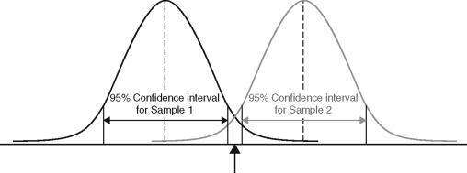
Confidence interval
A prezentáció alcíme
No overlap of confidence 95% confidence intervals. Therefore, samples are significantly different.
Notes:
The intervall estimation is a value range, which containes the estimate parameter with the pre-fixed reliability, which is usually 95 or 90 percent. It is possible to calculate it for a lot of variables, but most of the time, it is calculated for the mean. In this case, the mean is a fixed value, while the end points of the intervall are come from the sample. The 95 percent raliability means, that if we take a huge amount of sample, than the confidence intervalls of these samples, will contain the estimate parameter, in this case the mean, in the 95 percent of the cases. Here you can see, there is no overlap of the two confidence intervals, so the two sample are certainly different.

Slide 73
Sample size and Confidence interval
Huge sample size
Small confidence interval
Huge sapmle size
Money and other resources
Golden middle way
Perfect sample size
Notes:
It is important to know, that if smaller the confidence interval, than it is more accurate. The interval will decrease if we increase the sample size ∆. But working with a too high amount of sample is wasting ∆. The sample size ∆ has to be as big, as we can just reach the required accurate.

Slide 74
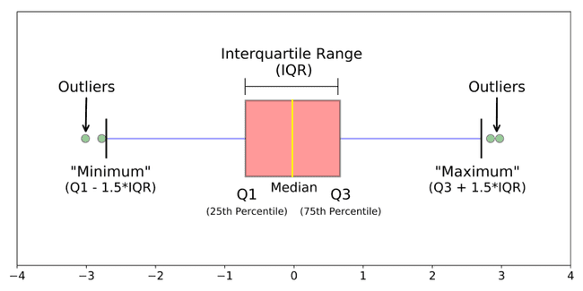
Boxplot
A prezentáció alcíme
Notes:
The distribution of our variable can be presented with boxplot for example. This is usually appears with median and interquartile range. It can be seen, that the yellow line is the median, and the right and left side of the pink box are the first and third quartile. That means, the pink box is contained the interquartile range. The blue lines are IQR multiplicate with 1.5 far from the first and from the third quartile. So the values, which are out of this margin, called outliers. They have to be treated somehow, because normaly, they are not supposed to be exist. These are usually the results of some kind of mistake, like erratum, or counting mistake.

Slide 75
Bar chart
A prezentáció alcíme
Notes:
The bar charts are used for present the percentage distribution. So we can easily recognise the difference in percentages. So that is the purpose of the bar charts.

Slide 76
Thank you for your attention
Dávid Németh
davidsum96@gmail.com

Slide 77
PRACTICE
Why is the study described in the article descriptive and not analytical? What data would be required for the study to be analytical?
Precisely which type of descriptive study is this? What does that mean?
Identify the items of the descriptive pentad in the article (Who? What? Why? When? Where?)!
Which type of bias is mentioned as being a major limitation of this study?
Does the study make the common mistake of not providing precise definitions?
A prezentáció alcíme
Notes:
Here you can see our questions

Slide 78
Analytical studies
Cohort, case-control and cross-sectional
Szilárd Váncsa

Slide 79
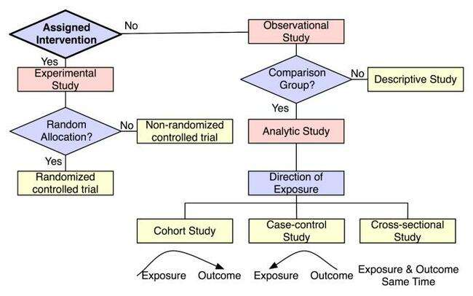
Population level
Individual level
Ecological study
Case study
Case series
Cross-sectional
Survaillance
https://irb.research.chop.edu/study-design

Slide 80
Introduction to observational studies
Observational studies dominate the literature
Is the study design appropriate to answer the research question?
E.g. descriptive studies cannot assess associations
Analytical vs. Descriptive studies

Slide 81
Cohort studies
General characterisctics:
Synonim: follow-up studies
Exposed and unexposed groups
Track people forward in time from exposure to outcome
May be mandatory as RCTs are unethical in certain settings (e.g. risk factors)
The term cohort has military, not medical, roots. A cohort was a 300–600-man unit in the Roman army; ten cohorts formed a legion.

Slide 82
IVF vs. Non-IVF
Multiple birth
Follows-up two or more groups from exposure to outcome
Cohort study moves in the same direction, although gathering data might not:
1. prospective / concurrent cohort
2. retrospective cohort
3. ambidirectional
IVF vs. Non-IVF
Multiple birth
IVF vs. Non-IVF
Ovarian carcinoma
Multiple birth

Slide 83
Advantages:
best way to ascertain both the incidence and natural history of a disorder
useful in investigation of multiple outcomes
useful in the study of rare exposures
more accurate data collection
can strongly suggest causality
Disadvantages:
Selection bias
is not optimal for rare diseases (outcomes)
Loss to follow-up (non-differential!)
Expensive (follow-up)
Time-consuming (follow-up)
https://catalogofbias.org/biases/selection-bias/

Slide 84
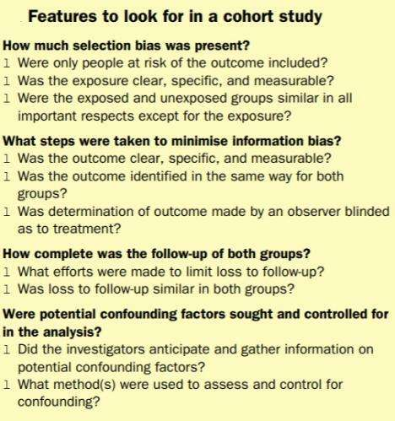
Features to look for in a cohort study
Women who have had a tubal sterilisation
operation have almost no risk of salpingitis, e.g. they should
not be included in cohort studies of pelvic inflammatory
disease.
Minimum exposure might
have to be 14 cigarettes per day or less,18. Definition of exposure levels in this
way can result in more than two groups—eg, nonsmokers,
light smokers, and heavy smokers
Lung-cancer
death rates among workers in the factory with rates of
persons of the same age and sex in the population.
Healthy-worker effect

Slide 85
Outcomes must be defined in advance! Failure to define
objective outcomes leads to uninterpretable results.
In endometritis:
Just how tender must a uterus be?
Important for subjective outcomes, such as tenderness or erythema.
By contrast, with objective outcome measures, such as
fever or death, blinding the exposure status is less
important.

Slide 86
For example, some participants
given a new antibiotic might have such poor outcomes
that they are unable to complete questionnaires or to
return for examination.
E.g. Obtaining the names of several
family members or friends who do not live with the
respondent is often helpful at the start of such studies.
The participant’s family doctor might also be helpful.
Death Registries!

Slide 87
Careful planning with a –preferably published - study protocol
Restriction
Matching
Stratification
Multivariate techniques

Slide 88
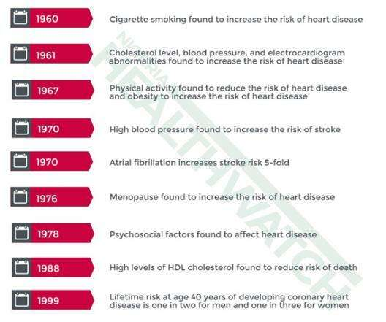
Commenced in 1948
5209 participants
Identify the risk factors that contributes to cardiovascuar diseases
Thousands of publications

Slide 89
Case-control studies
General characteristics:
One of the most common study type
Relatively simple to organize
Can yield important scientific findings with relatively little time, money, and effort
Aims to identify predictors of an outcome
Permit assessment of the influence of predictors on outcome via calculation of an odds ratio
Useful for hypothesis generation
Can only look at one outcome
Bias is a major problem
Runs backwards in time

Slide 91
Selection of case and control groups
1. Case group:
All cases from a population could be included
Investigators should state how the sample was selected: providing a clear definition of the outcome being studied
Researchers should detail eligibility criteria used for selection (such as age range and location)
They should gather data preferably from incident (new) rather than prevalent (both old and new) cases → diagnostic patterns change over time, recent diagnoses are likely to be more consistent than those obtained from different periods

Slide 92
2. Control group
provides the background proportion of exposure expected in the case group
should be free of the disease (outcome) being studied
should be representative
population at risk of becoming cases. Selection of controls must be independent of the exposure being investigated

Slide 93
Advantages:
the most efficient design in terms of time, money, and effort
efficient in the investigation of diseases that have a long latency period
good for investigation of rare diseases
Disadvantages:
„selection bias”
difficulty with the selection of the control group
difficulties with the rare exposures
casuality could be suggested

Slide 94
3 groups
HIV+
HIV- from STD clinic (OR 2.9)
HIV- from the general population (OR: 52)
Outcome: risk of HIV infection
Aim: to reduce selection bias

Slide 95
2 groups
Women with breast cancer
Healthy controls
Exposure: oral contraceptives
Aim: to reduce recall bias

Slide 96
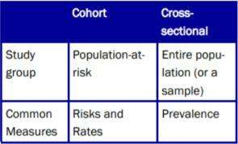
Cross-sectional studies
General characteristics:
Conceptually begin with a population based
We do not follow individuals over time
Only look at the prevalence of disease and/or exposure at one moment in time
Take „snapshot” of the proportion of individuals (diseased vs. non diseased at one point in time)
Two types: 1. descriptive (no control group); 2. analytical (control group)
Cross sectional studies are the best way to determine prevalence
Are relatively quick – no follow up – less resources needed
Can study multiple outcomes
Do not themselves differentiate between cause and effect or the sequence of events

Slide 97
- data on the prevalence of both exposure and a health outcome are obtained for the purpose of comparing health outcome differences between exposed and unexposed.
- attempt to describe the prevalence, for example, of a disease by first beginning with a population-based sample
- differ from descriptive cross-sectional studies in that they have a control group
Emerg Med J 2003;20:54–60

Slide 98
Cohort | Case-control | Cross-sectional
Runs foward in time | Runs backward in time | Take a snapshot in time
Multiple outcomes | Rare diseases | Prevelence of the diseases
Rare exposures | Diseases with long latency period | Not able to assess temporal relations
„expensive” | „cheap” | „cheap”
Strongly suggest causality Hypothesis generation | Could suggest causality Hypothesis generation | Hypothesis generation

Slide 99
'TAKE HOME MESSAGE'
Obsevational studies are essential part of clinical research
Finding the optimal study type for your question is the most important
Think ahead! – publish a protocol before starting the study
Detailed statisctical planning is esential

Slide 100
COMMON MISTAKES
Do not overinterpret your results, know the limitations of your research
Testing null hypotheses at arbitrary p values of 0.05 has no basis in medicine and should be discouraged

Slide 101
PRACTICE
Does it have a control group?
Were the exposed and unexposed groups similar in all important respects except for the exposure?
Were only people at risk of the outcume included?
What kind of outcomes are reported? Was the outcome clear, specific and measurable?
What efforts were made to limit loss to follow up?

Slide 102
Bias in observational studies
Zsolt Szakács

Slide 103
TABLE OF CONTENTS
A question
A story from the 2nd WW
Selection bias
Ecological error
The choice of control group
How to deal with bias?
Recall bias
The cuase-effect relationship
The question again
Take home message
Bias in observational studies

Slide 104
A question
Does smoking cuase lung cancer?

Slide 105
A story from the 2nd WW
50-50%

Slide 106
A story from the 2nd WW
50-50%

Slide 107
A story from the 2nd WW
50-50%

Slide 108
A story from the 2nd WW
Case-control
Cross-sectional
Cohort

Slide 109
Selection bias
Is the sample representative to the entire population?
Which made it home
All aircrafts
Non-response bias in questionnaires
Random vs. convenience samples

Slide 110
Selection bias

Slide 111
Selection bias

Slide 112
Selection bias
Systematic error
Bias
Imprecision
Random error
Valid?
Precise?
Sample size
Risk
Sample size
Risk

Slide 113
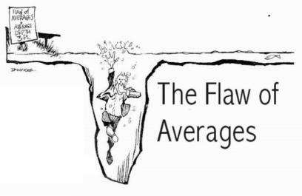
Ecological error
But mortality of coronary heart disease correlates with the sales of color TVs…
Average depth: 1 meter

Slide 114
The choice of control group
Berkson bias

Slide 115
How to deal with selection bias?
Stratification
Matching
Standardization
Multivariate analysis

Slide 116
Recall bias
Oral contraceptives and BC
Case-control
Cohort

Slide 117
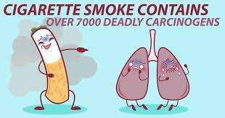
Observer or performance bias
Case-control
Cohort

Slide 118
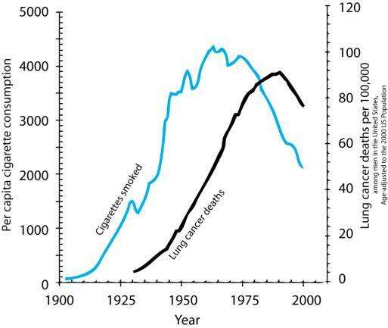
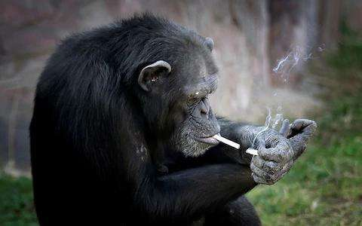
Cause-effect relationship
Does smoking cause lung cancer?

Slide 119
The question again
Does smoking cuase lung cancer?

