Slide 1

BREAK
A prezentáció alcíme

Slide 2


Interventions and outcomes
Lajos Szakó
Clinical trial coordinator group

Slide 3
Summary
  Interventions
  Outcomes
  Metrics of outcomes
  Example
Interventions and outcomes

Slide 4
Interventions
Design to affect clinical phenomenon
Must be:
  Reproducible
  Standardized
  Clearly defined
Can be:
  Invasive/non-invasive
  Preventive/therapeutic
  Acute/chronic
A prezentáció alcíme

Slide 5
Outcome/endpoint
Quantitative measure(s)
Reflects the objectives of the trial
  Efficacy/effectiveness
  Safety
  Process
  Costs
Usually determined in each study participant
  Objectives are met by the aggragate of outcomes
A prezentáció alcíme

Slide 6
Hierarchy of outcomes
Primary outcome
  Reflects objectives and primary hypothesis
  Design variable (sample size calculation)
  Related to stage/type of research
Secondary outcomes
  Other important potential effects (defined safety outcomes, mechanism effect)
  Allow more complete evaluation (risk-benefit)
A prezentáció alcíme
Other outcomes
  Other data on patient’s health or participation (compliance)
  Exploratory

Slide 7
Primary outcome
A priori
Relevant and likely to be influenced by treatment
Accurate and reliable measurement
Evaluate in all participants
Assessment independent of treatment assignment (no bias)
Power considerations
  Variability, freqency, anticipated differences
A prezentáció alcíme

Slide 8
Metrics for events as outcomes
Dichotomus
  Presence/absence, yes/no, normal/abnormal
  Clinical state or cut-off value
  Typically at a specified time point
Time-to-event
  Add dimension of time to dichotomous outcome
  Allow for censoring
  More powerful than dichotomous
A prezentáció alcíme

Slide 9
Metrics for events as outcomes
Rates
  1/0 but allows for „repeats”
  Need follow-up time
  Analyze count or rate
Composite measures
  Two or more events related to disease process
  Could be considered dichotomous or time-to-event or rate
A prezentáció alcíme

Slide 10
Metrics for events as outcomes
Continuous variables
  Outcomes are value or change from baseline
  Standard units, e.g: lab values
  Need to define an important difference
  Repeated measures possible
  Typically more powerful than discrete outcomes
  Distributional assumptions more important
A prezentáció alcíme

Slide 11
Metrics for events as outcomes
  Ordinal scale
    Ranked categories, eg. 1-5, A-D
    Difference between categories is usually qualitative
    Adverse event severity
A prezentáció alcíme

Slide 12
Objective-subjective
Objective-clinical events or measurements that are definitive, require little or no subjective judgements
  Rigorous definitions to limit interpretion
  May include test results for confirmation
Subjective-assessments that rely on judgement
  Patient’s reported outcomes
  Observer reported outcomes
A prezentáció alcíme

Slide 13
Influence on design
Effectiveness vs. Efficacy
  Asthma
    Effectiveness: hospitalizations/steroid courses
    Efficacy: FEV1
  Vaccine trial
    Effectiveness: clinical case of influenza
    Efficacy: clinical case with laboratory confirmation
A prezentáció alcíme

Slide 14
Example
HIV treatment outcomes measured
1. survival (death, AIDS status)
2. Immunologic response
3. Virologic response
4. Change in patients’ status (QoL, etc)
5. Specified toxicity
6. Other side effects
LONG-TERM EFFECTIVENESS
LONG-TERM EFFICACY
A prezentáció alcíme
SORT-TERM EFFICACY
SAFETY

Slide 15
Protection of outcomes
randomization
masking
Intention-to-treat
A prezentáció alcíme

Slide 16
Take home message
  Choose the best primary outcome (hardest one)
  Define your intervention as detailed as possible
  Primary outcome as outlined in the protocol must be assessed
A prezentáció alcíme

Slide 17
Practice
What is the clinical question and hypothesis of the study? (Library)
What were the interventions? Were they clearly described? (Mecsek)
What was the primary outcome of this work? Did they define it sufficiently? (Bálint’s Office)
Which outcomes were assessed? Are they soft or hard outcomes? (Peter’s Office)
A prezentáció alcíme

Slide 18
BREAK
A prezentáció alcíme

Slide 19
Statistics
Special considerations
Dávid Németh

Slide 20
TABLE OF CONTENTS
  Sample size
  Sample size estimation
  Data we need
  Subgroup
  Per-protocol
Statistics
Special considerations

Slide 21
Sample size and confidence interval
Huge sample size
Small confidence interval
Huge sample size
Money and other resources
A prezentáció alcíme
Golden middle way
Perfect sample size
Notes:
It is important to know, that if smaller the confidence interval is, than it is more accurate. The length of the interval will decrease if we increase the sample size. But working with a too high amount of sample is wasting. The sample size has to be as big, as we can just reach the required accuracy.

Slide 22
Sample size estimation
Sample size estimation
Null hypothesis
Worth?!
Benefit
Notes:
The size of the sample is really important. That is why we have to calculate the estimated required sample size, before the research. At this time, we need to know the null hypothesis. We want to verify or reject the null hypothesis, and we are curious about the primary outcome. For that, we can perform a sample size estimation, to know how many subject do we need to envince the difference. So calculating the sample size is essential to reduce the cost of a study and to prove the hypothesis effectively.
It is important to know, how many patiant do we need, so we could compare the benefit with it, and we will be able to decide if it worth or not.

Slide 23
Previous researches
Previous publications
No other researches
Accurate estimation
Uncertain estimation
Notes:
For the best sample size estimation, we need the results of the previous researches, because the estimation is more accurate, if we know, what was the outcome for other researches. If we can not find any previous publications about the topic, than we just groping in the dark, so it is more difficult to estimate. That is why, our estimation will be uncertain. In this case, we prepare pilot studies, which are small-scale, preliminary studies which aim to investigate whether crucial components of a main study will be feasible.

Slide 24
Data we need
Continuous variable
SD
Mean
(standard deviation)
Event
Non-event
Dichotome variable
Number of
Control
Non-event-control
Notes:
For a sample size estimation, we need the mean and the standard deviation, if it is a continuous variable. In case of dichotome variable, we need the percentage distribution. That means, we need for example the percentage of the patients who have take a medicine and died which can be the event, and who take it and survived which can be the non-event. And of course we need to know the percentage of the patients who died without the medicine, control, and who survived, non-event control. The event and non-event can be changed based on the hypothesis.

Slide 25
Data we need
main rules
    one type of data into one cell
    use labels to name every column (number of patients, age…)
    raw data (not interested in percentages)
    one measure of variability for one measure of central tendency:
        mean with standard error (SE) or standard deviation (SD)
        median with range (min, max) or interquartiles (IQR)

Slide 26
Data we need
Changes of fertility parameters (for example testosterone level)
using vitamin D
Notes:
For a sample size estimation, we need the mean and the standard deviation, if it is a continuous variable. In case of dichotome variable, we need the percentage distribution. That means, we need for example the percentage of the patients who have take a medicine and died which can be the event, and who take it and survived which can be the non-event. And of course we need to know the percentage of the patients who died without the medicine, control, and who survived, non-event control. The event and non-event can be changed based on the hypothesis.

Slide 27
Data we need
BAVENO VI recommendations for ruling out varices needing treatment against variceal screening endoscopy to reduce unnecessary endoscopies
Notes:
For a sample size estimation, we need the mean and the standard deviation, if it is a continuous variable. In case of dichotome variable, we need the percentage distribution. That means, we need for example the percentage of the patients who have take a medicine and died which can be the event, and who take it and survived which can be the non-event. And of course we need to know the percentage of the patients who died without the medicine, control, and who survived, non-event control. The event and non-event can be changed based on the hypothesis.

Slide 28
Subgroup
Different scale
High heterogeneity
Subgroup analysis
Different patient characteristic
Different treatment
Notes:
Different duration of followup

Slide 29
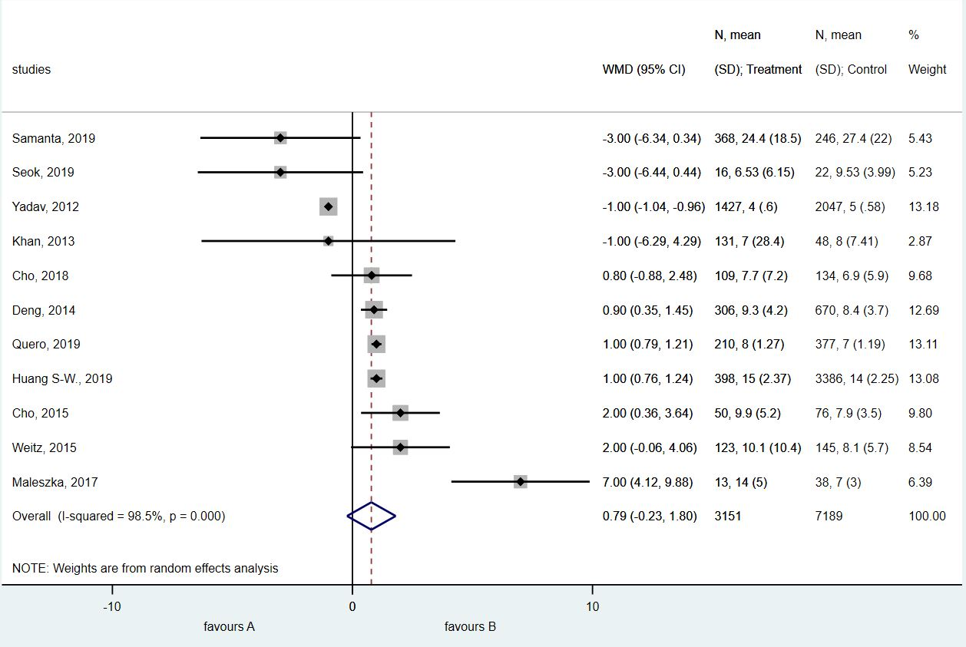
Subgroup: example

Slide 30
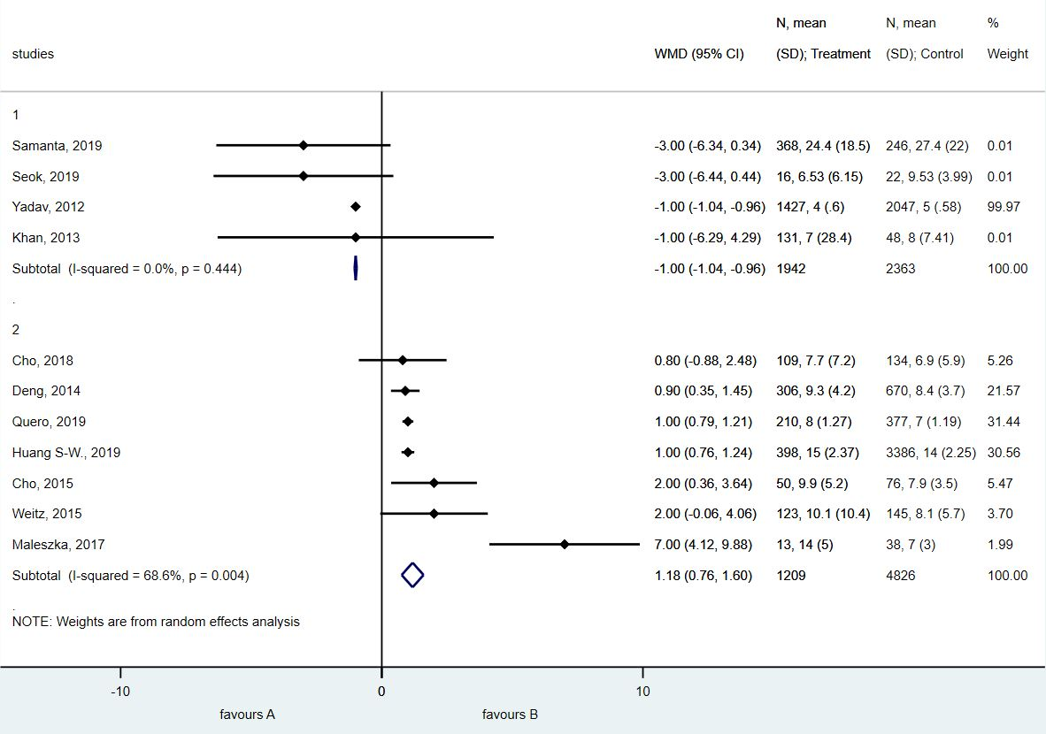
Subgroup: example

Slide 31
Per-protocol analysis
Complete participations
Per-protocol
Intention-to-treat
All randomized
Notes:
Heter_ caused sometimes by the different duration of follow-up.

Slide 32

Thank you for your attention
Dávid Németh
davidsum96@gmail.com

Slide 33
BREAK
A prezentáció alcíme

Slide 34
Bias
in randomized studies
Zsolt Szakács

Slide 35
TABLE OF CONTENTS
  Pyramid of the EBM
  Selection bias
  Performance bias
  Detection bias
  Attrition bias
  Reporting bias
  Sponsorship bias
Bias
in observational studies

Slide 36
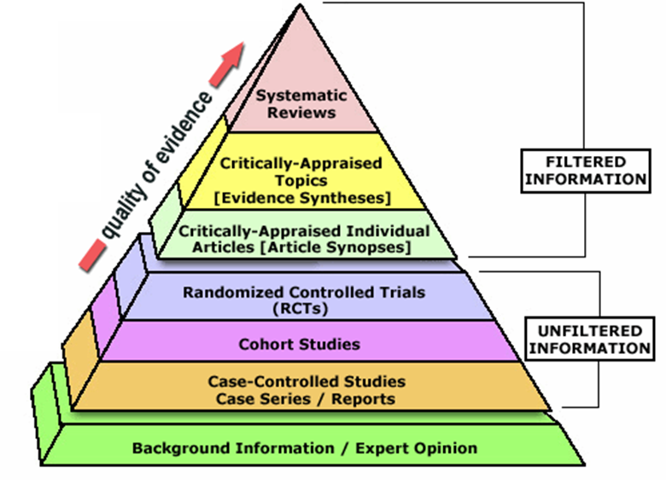
Pyramid of the EBM
Bias
Causality

Slide 37
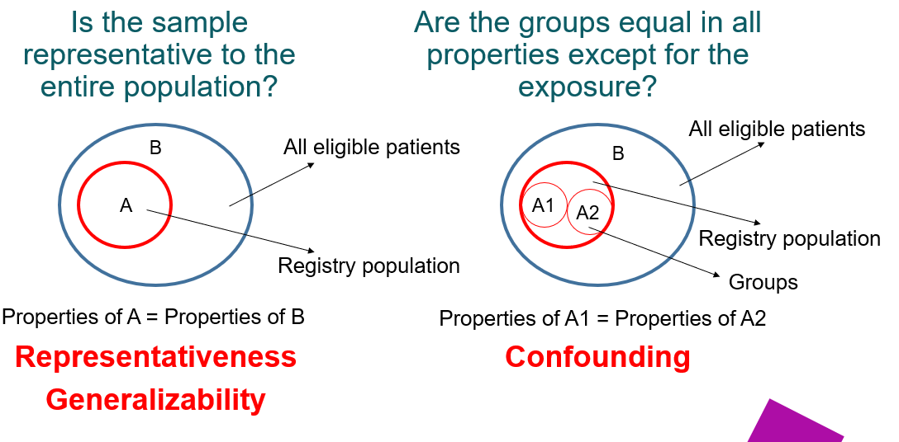
Selection bias

Slide 38
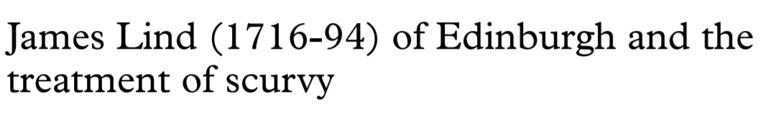
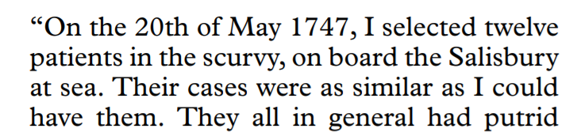
Selection bias
…a quart of cyder (2)
…sea-water (2)
…elixir vitriol (2)
…orange and lemon (2)
…electuary (2)
…vinegar (2)

Slide 39

Selection bias
Pitfall 1
How was the random sequence generated?
Pitfall 2
How was the random sequence implemented?

Slide 40
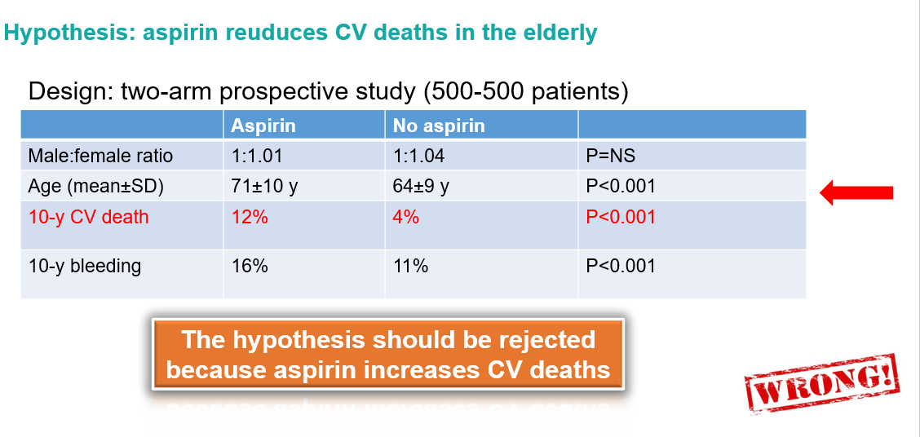
Selection bias

Slide 41
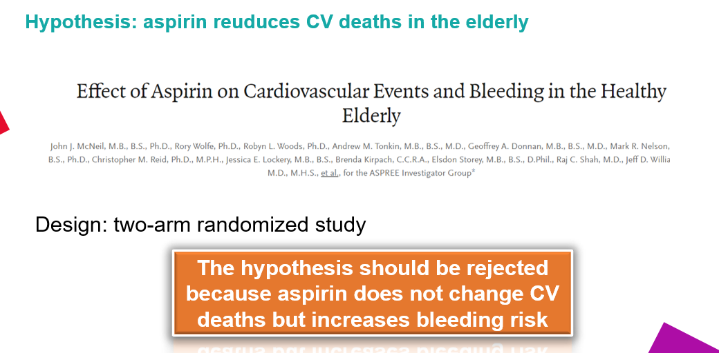
Selection bias

Slide 42
Examples for performance bias
Performance bias
Let’s compare a new drug to the old one…
Design: experimental, parallel (2 arms), randomized, open-label.
The new drug reduces thrombosis rate by 20% (95% CI: 15-25%).
But doctors do not trust the new drug…
20% of patient (old drug) and 85% of patients (new drug) were prescribed additional anticoagulants
Blinding
An ancillary exposure distrubuting unequally between groups

Slide 43
Examples for detection bias
Detection bias
Let’s compare a new drug to the old one…
Design: experimental, parallel (2 arms), randomized, open-label.
The new drug reduces pneumonia rate by 20% (95% CI: 15-25%).
But doctors do not trust the new drug…
20% of patient (old drug) and 85% of patients (new drug) were ordered chest X-ray (p<0.001)
Blinding
Any detecting modality distrubuting unequally between groups

Slide 44


Selection bias/Attrition bias
Attrition bias
Chance for a bomber to make it: 50-50%
(Ábrahám Wald)
Iintention-to-treat vs. per-protocol analysis?

Slide 45
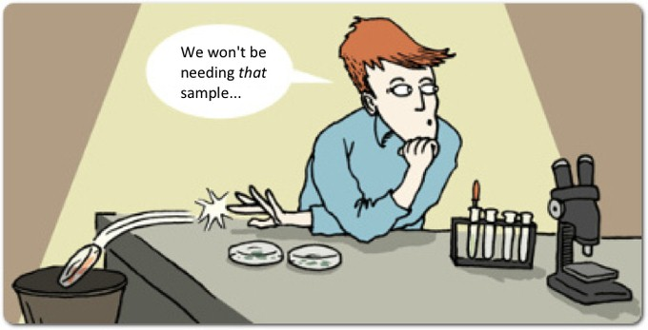
Types of bias
Reporting bias
Definition: differences between reported and unreported findings
Odds ratios for reporting significant results:
efficacy: OR=2.4 (95%CI: 1.4-4.0)
harms: OR=4.7 (95%CI: 1.8-12.0)
Chan AW, Hróbjartsson A, Haahr MT, Gøtzsche PC, Altman DG. Empirical evidence for selective reporting of outcomes in randomized trials: comparison of protocols to published articles. JAMA2004; 291: 2457-2465.

Slide 46

Examples for detection bias
Reporting bias
Let’s compare a new drug to the old one…
Design: experimental, parallel (2 arms), randomized, double-blind
Results:
mortality reduced by 2% (95% CI: 1.5-2.5%)
organ failure rate reduced by 1.0% (95% CI: 0.8-1.2%)
short-term (1-month) neurological deficit did not change
Picking of the desired results

Slide 47
Examples for detection bias
Reporting bias – sponsorship?
Let’s compare a new drug to the old one…
Design: experimental, parallel (2 arms), randomized, double-blind
Results:
mortality reduced by 2% (95% CI: 1.5-2.5%)
organ failure rate reduced by 1.0% (95% CI: 0.8-1.2%)
short-term (1-month) neurological deficit did not change
long-term (1-year) neurological deficit increased by 40% (95% CI: 34-60%)
Picking of the desired results

Slide 48
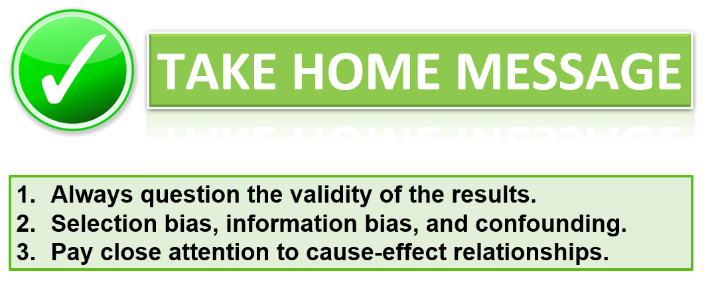

Slide 49
Practice
What types of bias can you find in the articles?
selection bias
performance bias
detection bias
attrition bias
reporting bias
sponsorship bias
+1: how confident are you that the findings reflect the truth?

