Slide 1


Meta-analysis Workshop
21-22nd September, 2020
University of Pécs
Pécs

Slide 2
10th Meta-analysis Workshop
GENERAL OVERVIEW OF META-ANALYSES
PRACTICAL GUIDE ON HOW TO UNDERSTAND META-ANALYSES

Slide 3
General Overview Of Meta-analyses
Schedule (14:00-15:55)
Opening remarks
Introduction: the role of meta-analyses in translational medicine
Main steps of the workflow: How to be transparent and reproducible?
Questions of meta-analyses
Break (15:55-16:00)
How to gather information from electronic databases systematically?
First impression of forest plots - introduction to meta-analytical statistics
Bias - the truth is beyond
Should we trust in meta-analyses?
Closing remarks

Slide 4
TRANSLATIONAL MEDICINE
taking discoveries for patients benefits
TRANSLATIONAL MEDICINE
taking discoveries for patients benefits
PETER HEGYI
(Pécs)

Slide 5

ACADEMIA EUROPAEA
J Clin Med. 2020 May 19;9(5):1532. doi: 10.3390/jcm9051532.

Slide 6
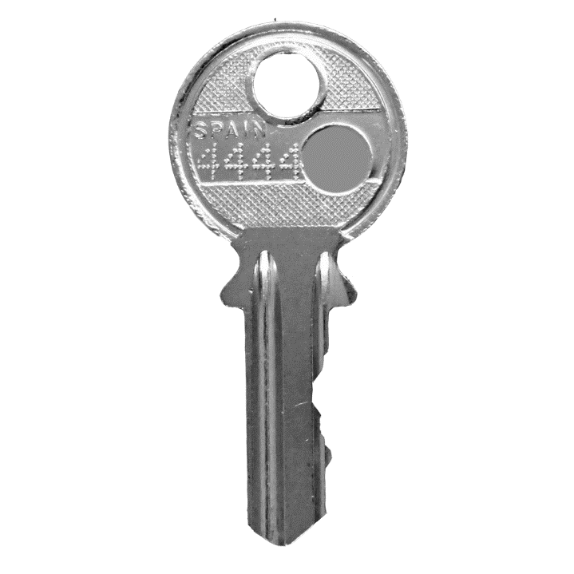
Key points
Translational medicine
Systematic review
Meta-analysis
Evidence pyramid

Slide 7
WHAT IS SCIENCE?

Slide 8
Science
Latin scientia = knowledge
is a systematic enterprise that builds and organizes knowledge in the form of testable explanations and predictions about the universe
modern science is regarded as good scientific practice to aim for principles such as objectivity and reproducibility

Slide 9
Science
UNKNOWN
KNOWN
QUESTION
HYPOTHESIS
METHODOLOGY
COLLECTING DATA
ANALYSES
ANSWERS

Slide 10
HOW CAN I ANSWER QUESTIONS IN MEDICINE?

Slide 11
Science
Q
A
THEORETICAL KNOWLEDGE
BASIC
SCIENCE
PURE FUNDAMENTAL RESEARCH
APPLIED SCIENCE
DEVELOP KNOWLEDE
FOR PRACTICAL APPLICATION
CLINICAL
SCIENCE
PRACTICAL APPLICATION
CLINICAL PRACTICE
EBM
DISCOVERING NEW MECHANISMS AND TARGETS
DEVELOPING NEW DRUGS AND INTERVENTIONS
UNDERSTANDING
SAFTEY AND EFFECTIVENESS
TEACHING
TEACHING
PATIENTS
CARE
MOLECULAR BIOLOGY
IMAGING
SYSTEM BIOLOGY
PROSPECTIVE DA
PHARMACOLOGY
RETROSPECTIVE DA
DEVICE D.
INTERVENTIONAL D.
META-ANALYSIS
INTERVENTIONAL CT
OBSERVATIONAL CT

Slide 12
TRANSLATIONAL MEDICINE
taking discoveries for patients benefits
Q
A
THEORETICAL KNOWLEDGE
BASIC
SCIENCE
PURE FUNDAMENTAL RESEARCH
APPLIED SCIENCE
DEVELOP KNOWLEDE
FOR PRACTICAL APPLICATION
CLINICAL
SCIENCE
PRACTICAL APPLICATION
CLINICAL PRACTICE
EBM
DISCOVERING NEW MECHANISMS AND TARGETS
DEVELOPING NEW DRUGS AND INTERVENTIONS
UNDERSTANDING
SAFTEY AND EFFECTIVENESS
TEACHING
TEACHING
PATIENTS
CARE
MOLECULAR BIOLOGY
IMAGING
SYSTEM BIOLOGY
PROSPECTIVE DA
PHARMACOLOGY
RETROSPECTIVE DA
DEVICE D.
INTERVENTIONAL D.
META-ANALYSIS
INTERVENTIONAL CT
OBSERVATIONAL CT

Slide 13
TRANSLATIONAL MEDICINE
taking discoveries for patients benefits
Q
A
THEORETICAL KNOWLEDGE
BASIC
SCIENCE
PURE FUNDAMENTAL RESEARCH
APPLIED SCIENCE
DEVELOP KNOWLEDE
FOR PRACTICAL APPLICATION
CLINICAL
SCIENCE
PRACTICAL APPLICATION
CLINICAL PRACTICE
EBM
DISCOVERING NEW MECHANISMS AND TARGETS
DEVELOPING NEW DRUGS AND INTERVENTIONS
UNDERSTANDING
SAFTEY AND EFFECTIVENESS
TEACHING
TEACHING
PATIENTS
CARE
MOLECULAR BIOLOGY
IMAGING
SYSTEM BIOLOGY
PROSPECTIVE DA
PHARMACOLOGY
RETROSPECTIVE DA
DEVICE D.
INTERVENTIONAL D.
META-ANALYSIS
INTERVENTIONAL CT
OBSERVATIONAL CT

Slide 14
TRANSLATIONAL MEDICINE
taking discoveries for patients benefits
Q
A
THEORETICAL KNOWLEDGE
BASIC
SCIENCE
PURE FUNDAMENTAL RESEARCH
APPLIED SCIENCE
DEVELOP KNOWLEDE
FOR PRACTICAL APPLICATION
CLINICAL
SCIENCE
PRACTICAL APPLICATION
CLINICAL PRACTICE
EBM
DISCOVERING NEW MECHANISMS AND TARGETS
DEVELOPING NEW DRUGS AND INTERVENTIONS
UNDERSTANDING
SAFTEY AND EFFECTIVENESS
TEACHING
TEACHING
PATIENTS
CARE
MOLECULAR BIOLOGY
IMAGING
SYSTEM BIOLOGY
PROSPECTIVE DA
PHARMACOLOGY
RETROSPECTIVE DA
DEVICE D.
INTERVENTIONAL D.
META-ANALYSIS
INTERVENTIONAL CT
OBSERVATIONAL CT

Slide 15
Translational medicine
WHAT IS TRANSLATIONAL MEDICINE?

Slide 16

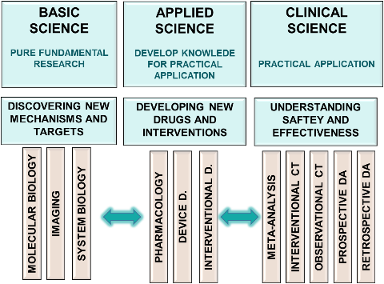
Translational medicine
There are various existing definitions….
It is a highly interdisciplinary field aiming to speed up up the process of moving research discoveries for patients benefit by combining disciplines, different expertise, methods, resources and data with no restrictions
PATIENTS
BENEFIT

Slide 17
WHY DO WE NEED TRANSLATIONAL MEDICINE?

Slide 18

TRANSLATIONAL MEDICINE
taking discoveries for patients benefits
126,900 DEATH
*State of Health in the EU, Magyarország, Egészségügyi országprofil 2019
In 2016 126 900 death occured in Hungary

Slide 19





TRANSLATIONAL MEDICINE
taking discoveries for patients benefits
Nearly 30,000 deaths (23.6%)* could have been avoided through public health and prevention
PREVENTION
Additional 16,000 deaths (12.6%) could have been avoided by more effective and timely healthcare.
EFFECTIVENESS
63,000 deaths (50%) were linked to
life-style risk factors (EU 39%)
EDUCATION
*State of Health in the EU, Magyarország, Egészségügyi országprofil 2019
In 2016 126 900 death occured in Hungary

Slide 20
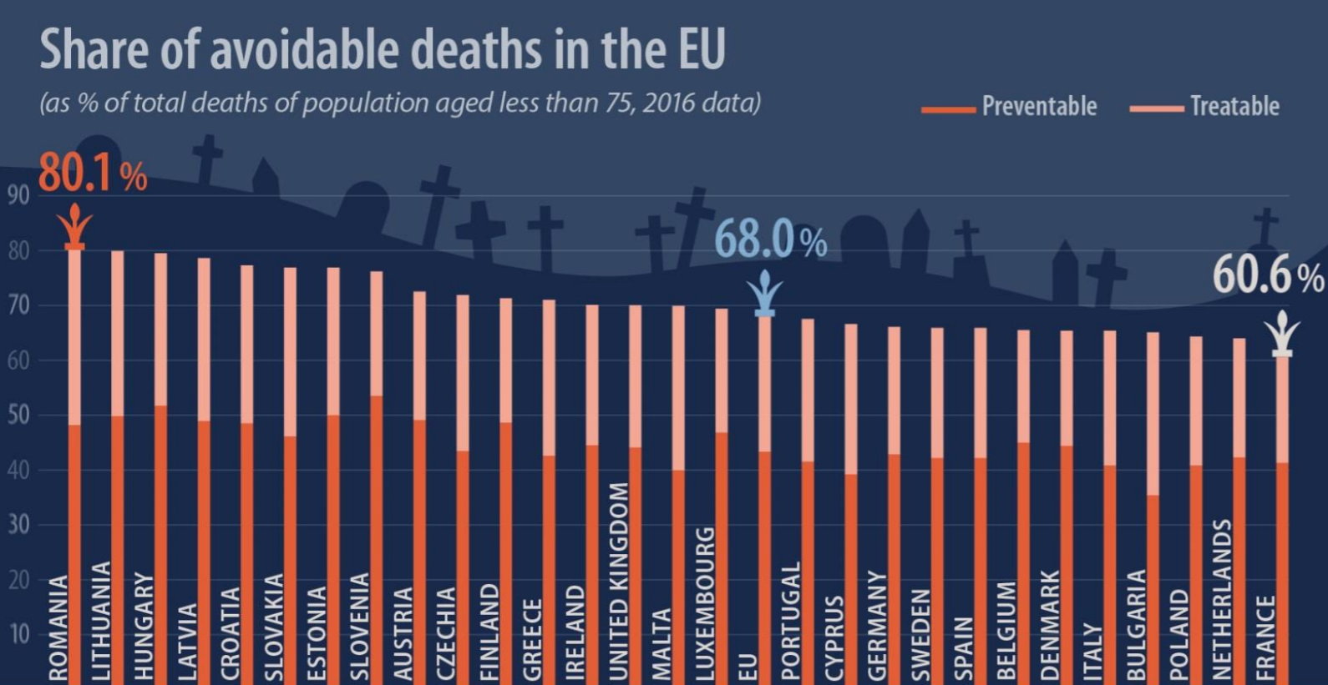

TRANSLATIONAL MEDICINE
taking discoveries for patients benefits
2016
under
75
1.7 million persons died
1.2 million aviodable mortality

Slide 21
TRANSLATIONAL MEDICINE
taking discoveries for patients benefits
2016
under
75
1.7 million persons died
1.2 million aviodable mortality

Slide 22
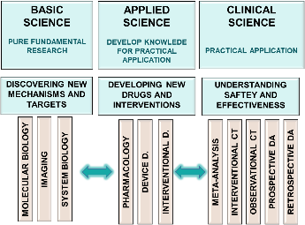


TRANSLATIONAL MEDICINE
taking discoveries for patients benefits
THERE IS AN UNMET NEED
TO TRANSLATE
SCIENTIFIC
RESULTS
HEALTH
CARE
INTO
PREVENTION
DIAGNOSIS
TREATMENT
FOLLOW UP

Slide 23
WHO WINS BY TRANSLATIONAL MEDICINE?

Slide 24
Translational medicine
EVERYONE
PATIENTS
HEALTHCARE BUDGET
INDUVIDUAL SCIENTISTS
INSTITUTIONS
COUNTRIES

Slide 25
Translational medicine
EVERYONE
PATIENTS
HEALTHCARE BUDGET
INDUVIDUAL SCIENTISTS
INSTITUTIONS
COUNTRIES

Slide 26
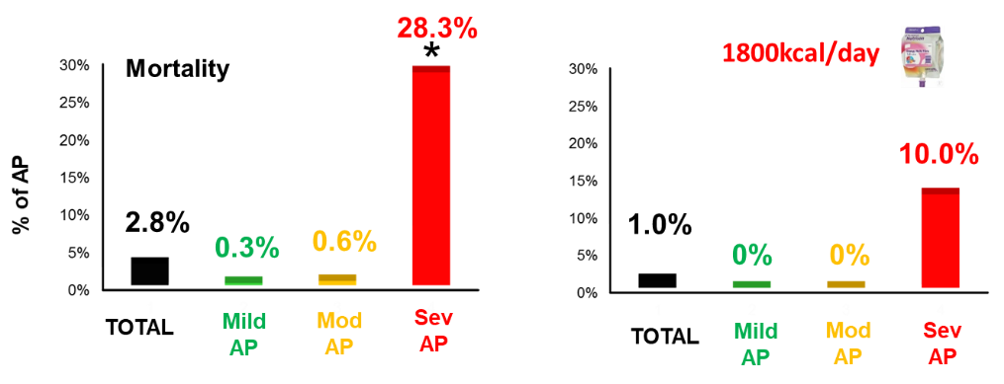
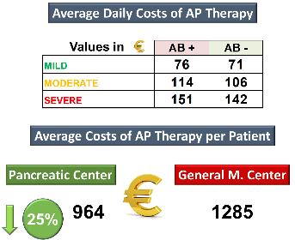

TRANSLATIONAL MEDICINE
taking discoveries for patients benefits
IMMEDIATE PATIENTS’ BENEFITS
NECESSITY AND USAGE OF ANTIBIOTICS
DECREASED WITH 50%
MORTLITY DECREASED IN ACUTE PANCREATITIS
23 countries
62 centres
9728 patients
9 TRIALS ARE RUNNING
HEALTHCARE COSTS
25%

Slide 27



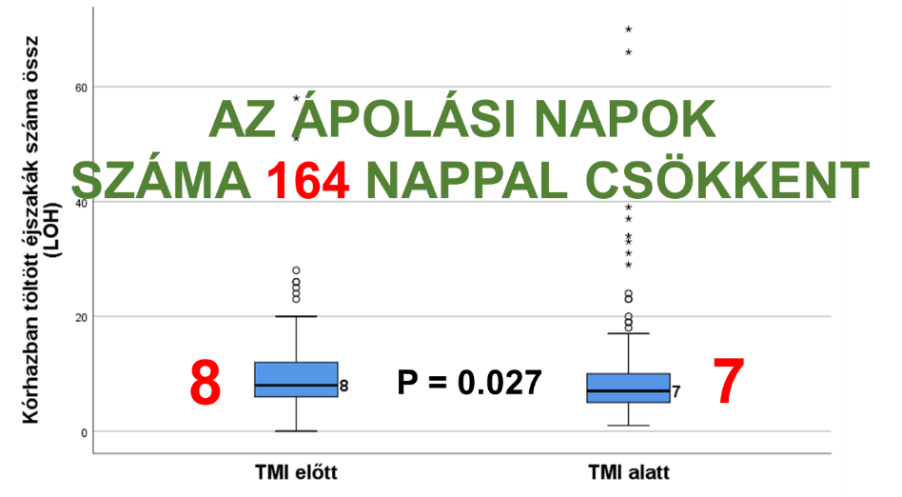
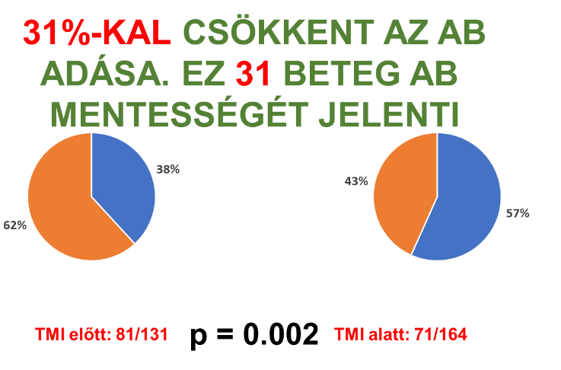
TRANSZLÁCIÓS MEDICINA
A jobb betegellátásért
LOH DECREASED WITH 164 DAYS
USAGE OF ANTIBIOTICS DECREASED WITH 31%

Slide 28
Translational medicine
EVERYONE
PATIENTS
HEALTHCARE BUDGET
INDUVIDUAL SCIENTISTS
INSTITUTIONS
COUNTRIES

Slide 29
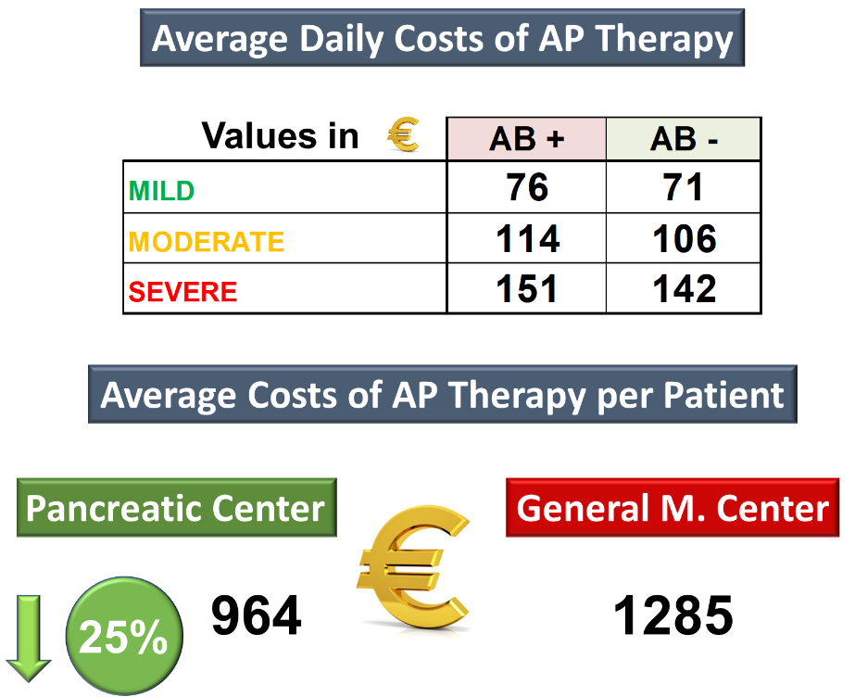

Translational medicine

Slide 30
TRANSLATIONAL MEDICINE
taking discoveries for patients benefits
EVERYONE
PATIENTS
HEALTHCARE BUDGET
INDUVIDUAL SCIENTISTS
INSTITUTIONS
COUNTRIES

Slide 31
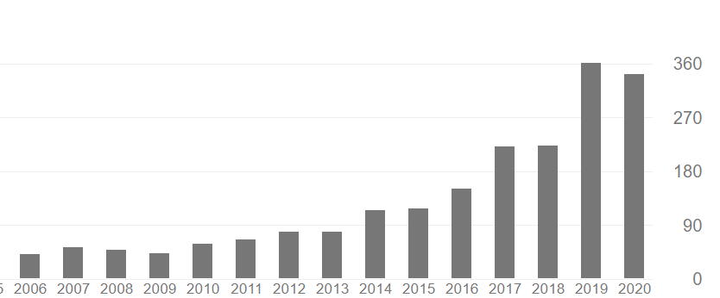
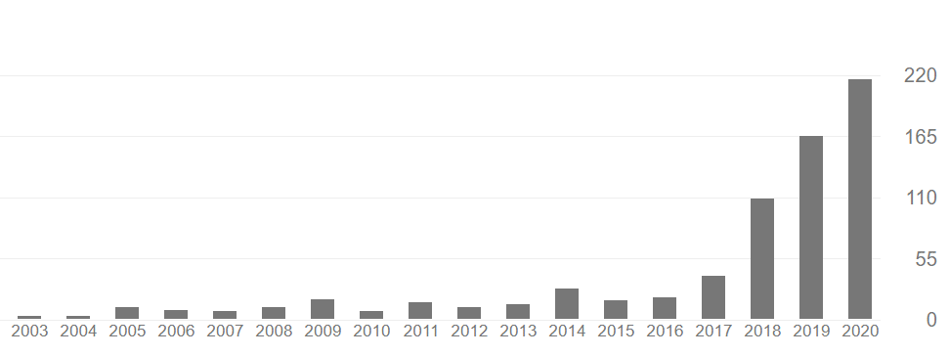
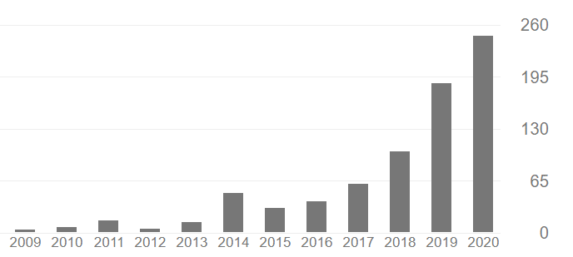
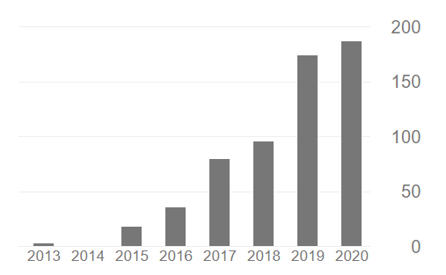
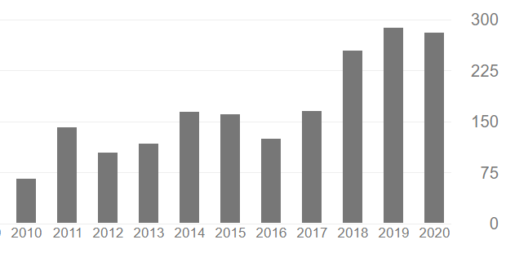
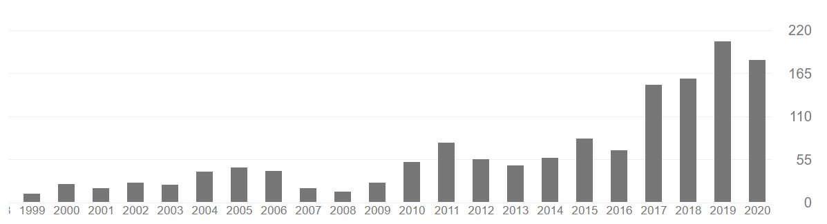
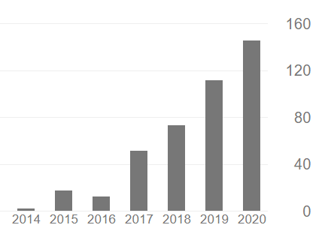
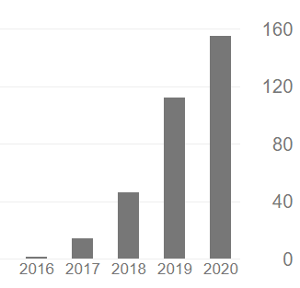
Translational medicine
CITATIONS
ÁRON VINCZE
JUDIT BAJOR
PATRÍCIA SARLÓS
ANDREA PÁRNICZKY
ANDRÁS GARAMI
MÁRTA BALASKÓ
ALEXANDRA MIKÓ
KATALIN MÁRTA

Slide 32
Translational medicine
EVERYONE
PATIENTS
HEALTHCARE BUDGET
INDUVIDUAL SCIENTISTS
INSTITUTIONS
COUNTRIES

Slide 33

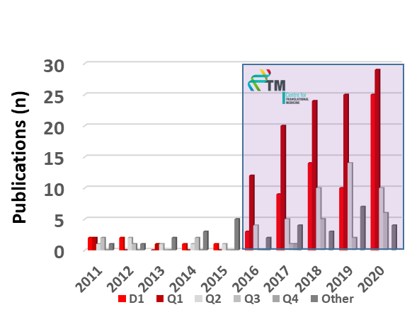
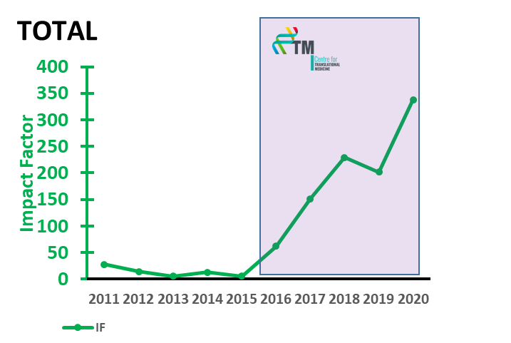
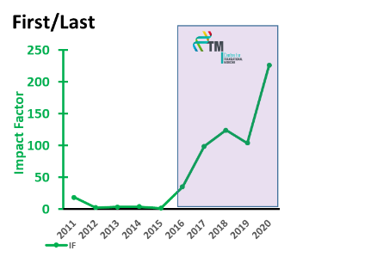
Translational medicine
ALL: 670
UP: 40
n: 8:6:4:7:7: 23:40:59:58:76
256
articles
01.01.2016 – 31.08.2020
EXCELLENCE
IS A MUST
16 articles (above IF: 10.0)
32 articles (above IF: 5.0)
Average: 4.311

Slide 34
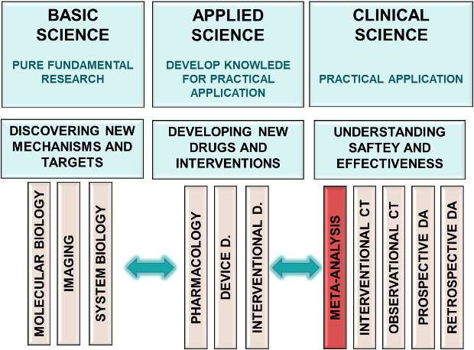
Meta-analysis
WHY WE START
WITH META-ANALYSIS?

Slide 35
Meta-analysis
NO RESTRICTIONS (BASIC OR CLINICAL)
EASY TO LEARN
HELP TO IDENTIFY THE WHOLES IN OUR KNOWLEDGE
EXCELLENT LEARNING METHOD
OF THE GOOD PUBLICATION PRACTICE
QUICK ANSWER

Slide 36
Meta-analysis
NO RESTRICTIONS (BASIC OR CLINICAL)
EASY TO LEARN
HELP TO IDENTIFY THE WHOLES IN OUR KNOWLEDGE
EXCELLENT LEARNING METHOD
OF THE GOOD PUBLICATION PRACTICE
QUICK ANSWER

Slide 37
Meta-analysis
NO RESTRICTIONS (BASIC OR CLINICAL)
EASY TO LEARN
HELP TO IDENTIFY THE WHOLES IN OUR KNOWLEDGE
EXCELLENT LEARNING METHOD
OF THE GOOD PUBLICATION PRACTICE
QUICK ANSWER

Slide 38
TRANSLATIONAL MEDICINE
taking discoveries for patients benefits
NO RESTRICTIONS (BASIC OR CLINICAL)
EASY TO LEARN
HELP TO IDENTIFY THE WHOLES IN OUR KNOWLEDGE
EXCELLENT LEARNING METHOD
OF THE GOOD PUBLICATION PRACTICE
QUICK ANSWER

Slide 39
TRANSLATIONAL MEDICINE
taking discoveries for patients benefits
NO RESTRICTIONS (BASIC OR CLINICAL)
EASY TO LEARN
HELP TO IDENTIFY THE WHOLES IN OUR KNOWLEDGE
EXCELLENT LEARNING METHOD
OF THE GOOD PUBLICATION PRACTICE
QUICK ANSWER

Slide 40
Meta-analysis
NO RESTRICTIONS (BASIC OR CLINICAL)
EASY TO LEARN
HELP TO IDENTIFY THE WHOLES IN OUR KNOWLEDGE
EXCELLENT LEARNING METHOD
OF THE GOOD PUBLICATION PRACTICE
QUICK ANSWER

Slide 41
Meta-analysis
REG
BASIC
TRIAL
NEW DRUG DEV
META
CLINICAL
PRACTICE &
EDUCATION
ANSWERS FROM THE QUESTIONS
1
2
3
4
5
10
20
YEARS

Slide 42
WHAT IS META-ANALYSIS?

Slide 43
THEORETICAL KNOWLEDGE
BASIC
RESEARCH
PURE FUNDAMENTAL RESEARCH
APPLIED RESEARCH
DEVELOP KNOWLEDE
FOR PRACTICAL APPLICATION
CLINICAL
RESEARCH
PRACTICAL APPLICATION
CLINICAL PRACTICE
EBM
DISCOVERING NEW MECHANISMS AND TARGETS
DEVELOPING NEW DRUGS AND INTERVENTIONS
UNDERSTANDING
SAFTEY AND EFFECTIVENESS
TEACHING
PATIENT
EDUCATION
MOLECULAR BIOLOGY
IMAGING
SYSTEM BIOLOGY
PHARMACOLOGY
DEVICE D.
INTERVENTIONAL D.
OBSERVATIONAL CT
META-ANALYSIS
INTERVENTIONAL CT

Slide 44
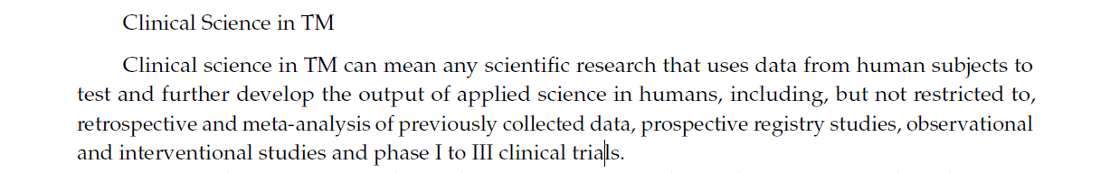

Translational medicine

Slide 45
Meta-analysis, definition
„Systematic reviews are a type of literature review that uses systematic methods to collect secondary data, critically appraise research studies, and synthesize findings qualitatively or quantitatively.„
  Armstrong R et al "Cochrane Update. 'Scoping the scope' of a cochrane review". Journal of Public Health. 2011;33 (1): 147–50.
Meta analysis: „The statistical analysis of a large collection of analysis results from individual studies for the purpose of integrating the findings.”
  Glass GV. Primary, secondary and meta-analysis of research. Educational Researcher. 1976;5:3–8.

Slide 46
Meta-analysis, definition
Systematic review
Meta-analysis
Specific question
Comprehensive search and selection
Narrative summary of evidence
Answer to the question (if there is any)
Specific question
Comprehensive search and selection
Statistical summary of evidence
Answer to the question (if there is any)
Qualitative synthesis
Quantitative synthesis

Slide 47
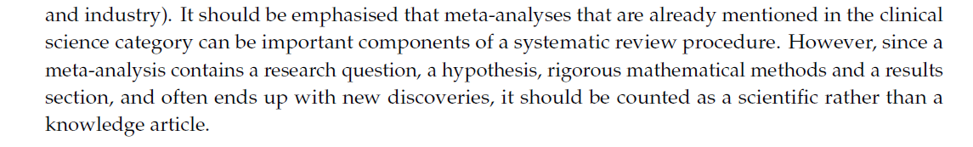
Meta-analysis, definition

Slide 48
Meta-analysis, definition
SYSTEMATIC REVIEW
META-ANALYSIS

Slide 49
What is the evidence level of meta-analysis?
RCT
Prospective Controlled Trial
M e t a - a n a l y s i s
Prospective Observational Trial
Prospective Registry
Retrospective Analysis

Slide 50
WHAT ARE OUR CURRENT ACTIVITIES?

Slide 51

Current activities
NINE ROUNDS FINISHED
152
76
69
7
sum IF: 307.89
sum cited: 554
published
accepted
34
42
submitted
In prep
Last update 2020.08.07

Slide 52
Current activities
HOW CAN WE PERFORM
SO MANY….?

Slide 53
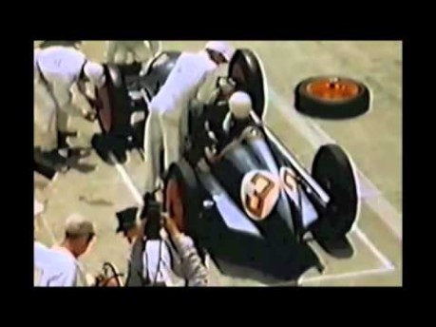

Slide 54

















Interdisciplinarity
Interdisciplinary Research Group
STRATEGY
Péter Hegyi
OPERATION
Andrea Szentesi
MEDICAL GROUP
Bálint Erőss
PHD PROGRAM
Zsolt Szakács
CLINICAL TRIAL COORDINATON
Nóra Vörhendi
CLINICAL TRIAL COORDINATION
Katalin Márta
CLINICAL TRIAL COORDINATON
Noémi Zádory
METAANALYSIS COORDINATION
Szabolcs Kiss
PATIENT REGIST.
COORDINATION
Vivien Vass
BIOSTATISTiCS GROUP
Nelli Farkas
INFORMATICS GROUP
Richárd Farkas
DATA&PATIENT COORD. GROUP
Emőke Miklós
LEGAL GROUP
Dóra Czapári
COMMUNICATION GROUP
Dalma Dobszai
HR&FINANCIAL GROUP
Margit Solymár
HEALTH ECONOMICS G. Antal Zemplényi

Slide 55

Systematic search
TAKE HOME MESSAGE
Translational medicine has an essential role in modern medicine.
Meta-analysis is an important method in clinical science.

Slide 56

Main steps of the workflow:
how to be transparent and reproducible?
Szabolcs Kiss

Slide 57
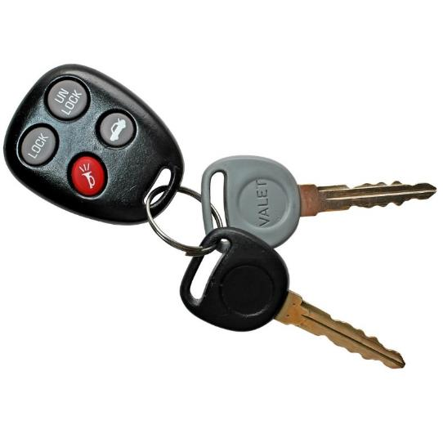
Key points
Concept of systematic reviews and meta-analyses
Main steps of the workflow

Slide 58
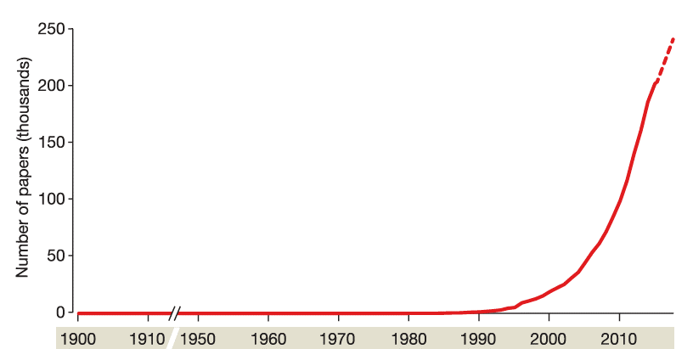
History
COCHRANE COLLABORATION
TERM SR
TERM MA
1ST MA
doi:10.1038/nature25753

Slide 59
Definitions
Systematic review
Meta-analysis
Specific question
Comprehensive search and selection
Transparency and reproducibility
(along quality standards)
Narrative synthesis
Answer to the question (if possible)
Specific question
Comprehensive search and selection
Transparency and reproducibility
(along quality standards)
Mathematical synthesis
Answer to the question (if possible)
Qualitative synthesis
Quantitative synthesis

Slide 60
Definitions
Reviews
Systematic reviews
Meta-analyses

Slide 61
Flowchart
Question
Preliminary search
Search
Protocol
Data
collection
Bias assessment
Selection
Synthesis
Limitations
Implication
Dissemination of results

Slide 62
Flowchart
Question
Preliminary search
Search
Protocol
Data
collection
Bias assessment
Selection
Synthesis
Limitations
Implication
Dissemination of results

Slide 63
Problem
Type of question Study design
Interventional Experimental or observational studies
Diagnostic Observational studies
(diagnostic accuracy studies)
Prognostic/predictive Observational studies
(prognostic studies)
Epidemiological Descriptive studies
60%
<5%
20%
15%

Slide 64
Flowchart
Question
Preliminary search
Search
Protocol
Data
collection
Bias assessment
Selection
Synthesis
Limitations
Implication
Dissemination of results

Slide 65
Search
systematic
vs.
non-systematic
(non-selective)
(selective, arbitrary)

Slide 66
Flowchart
Question
Preliminary search
Search
Protocol
Data
collection
Bias assessment
Selection
Synthesis
Limitations
Implication
Dissemination of results

Slide 67

Protocol registration
Aims:
to facilitate careful planning
to avoid duplication
to reduce reporting bias
Notes:
Yield: helps to ensure that medical research studies are conducted by the highest standards, leading to reproducible evidence

Slide 68
What is PROSPERO?
PROSPERO is an international database of prospectively registered systematic reviews in health and social care.
Key features from the review protocol are recorded and maintained as a permanent record.
Systematic reviews should be registered at inception (i.e. at the protocol stage) to help avoid unplanned duplication and to enable comparison of reported review methods
with what was planned in the protocol.

Slide 69
Flowchart
Question
Preliminary search
Search
Protocol
Data
collection
Bias assessment
Selection
Synthesis
Limitations
Implication
Dissemination of results

Slide 70
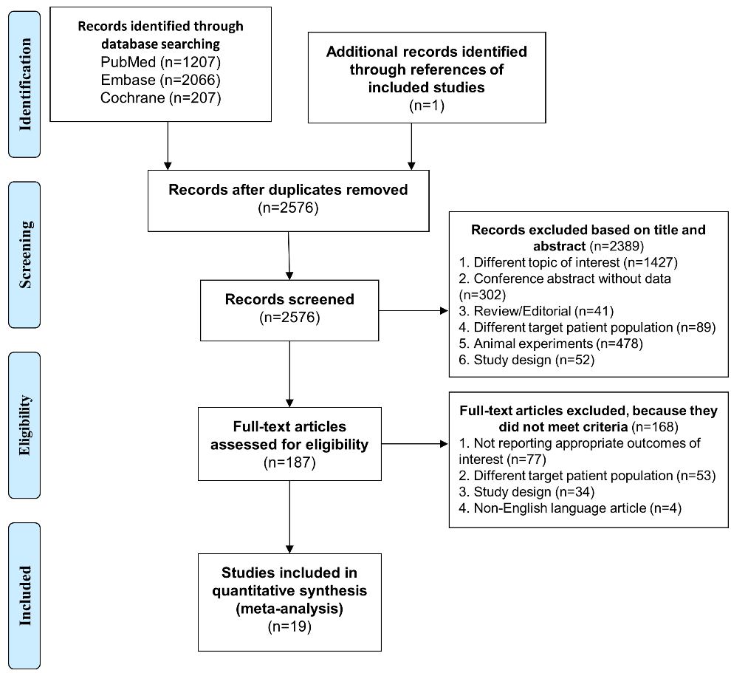
Flowchart

Slide 71
Flowchart
Question
Preliminary search
Search
Protocol
Data
collection
Bias assessment
Selection
Synthesis
Limitations
Implication
Dissemination of results

Slide 72
Flowchart
Question
Preliminary search
Search
Protocol
Data
collection
Bias assessment
Selection
Synthesis
Limitations
Implication
Dissemination of results

Slide 73
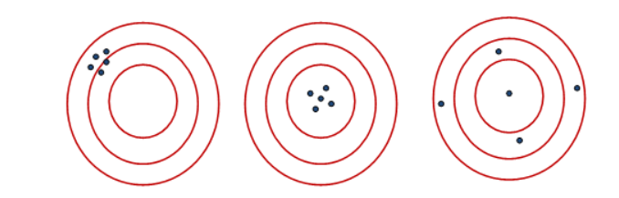
Errors in epidemiological studies
Bias
Imprecision
Systematic error
Random error
Sample size
Risk
Sample size
Risk

Slide 74
Flowchart
Question
Preliminary search
Search
Protocol
Data
collection
Bias assessment
Selection
Synthesis
Limitations
Implication
Dissemination of results

Slide 75
Flowchart
Question
Preliminary search
Search
Protocol
Data
collection
Bias assessment
Selection
Synthesis
Limitations
Implication
Dissemination of results

Slide 76
Flowchart
Question
Preliminary search
Search
Protocol
Data
collection
Bias assessment
Selection
Synthesis
Limitations
Implication
Dissemination of results

Slide 77

Translation
Implication for practice
Implication for research

Slide 78

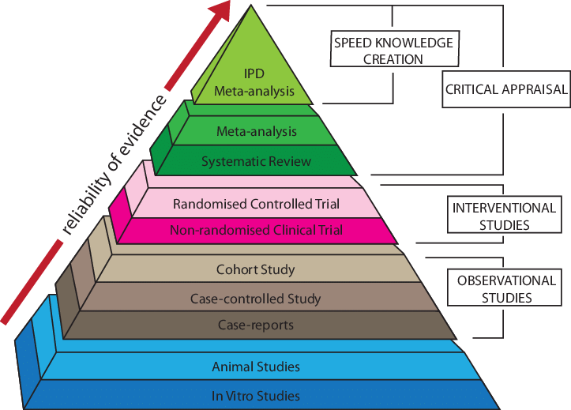

M E T A - A N A L Y S I S

Slide 79
Standard methodology
COCHRANE COLLABORATION
MOOSE
TERM SR
QUOROM
TERM MA
1ST MA
PRISMA
doi:10.1038/nature25753

Slide 80

PRISMA: be transparent
Statement
Explanation and Elaboration (E&E)
  PMID 20171303
  Citations: 65365
  PMID 19631507
  Citations: 25718
Checklist
Flow diagram
Extensions…

Slide 81


The Bible…
Cochrane Handbook for Systematic Reviews of Interventions
Version 6
[updated in 2019]
Editors: Julian Higgins and James Thomas
https://training.cochrane.org/handbook

Slide 82
TAKE HOME MESSAGE
Plan carefully!
Get informed before you start working on your project.

Slide 83
Questions of meta-analyses
Lajos Szakó

Slide 84

Flowchart
Question
Preliminary search
Search
Protocol
Data
collection
Bias assessment
Selection
Synthesis
Limitations
Implication
Dissemination of results

Slide 85

Key points
Characteristics of a good scientific question
PICO(TS) framework
Importance of having a hypothesis

Slide 86


Scientific questions
Aim: to construct a well-designed, relevant scientific question
Benefit: a question appropriate for systematic review and meta-analysis

Slide 87
Good scientific questions
What is a good scientific question?
„Those questions that are clearly related to a clinical decision about whether to use a therapeutic, preventive, or diagnostic intervention are the ones that warrant the most time.” JAMA, 1993
Implication for practice
Implication for research

Slide 88
Good scientific questions
So what?

Slide 89
Inspirations for questions
Scientific community calls for it
Your practice calls for it
Your research calls for it
Gaps in guidelines call for it
An update…

Slide 90


Slide 91
PICO(TS) framework
Designed to make the process of defining interventional questions
Population/Problem
Intervention
+ Timing
Comparison
+ Study design
Outcome

Slide 92
PICO(TS) framework
Population/Problem
Consider the following characteristics:
-disease/condition, including localization, duration, type of symptoms
-age
-gender
-standard diagnostic criteria
EXAMPLE: Acute myocardial infarction

Slide 93
PICO(TS) framework
Intervention
Comparator
The following should be described:
-type of intervention
-intensity of intervention
-frequency of intervention
-duration of intervention
EXAMPLE: Oral beta‐blockers administered within 8 hours of presentation
EXAMPLE: Oral placebo

Slide 94
PICO(TS) framework
Outcome
-primary/secondary
-explicit outcome measures and tools
-standardized, validated, established outcome measures appropriate for disease condition
-focus on outcomes that are important (have relevance)
-efficacy and safety
-hard vs. soft outcomes
EXAMPLE: 28-day mortality, in-hospital mortality

Slide 95
PICO(TS) framework
Hard
vs.
Soft
Objective
Might be subjective
Certain
Less certain
All-cause
mortality
Need for
dialysis
LOH
Pain
QoL
Cause-specific
mortality
Need for
surgery
Laboratory changes

Slide 96
PICO(TS) framework
Timing
Timing of availability of results
Timing of assessment of disease status and outcomes
EXAMPLE : P : Adult patients undergoing elective surgery
I: Multimodal treatment (e.g. epidural+sth)
C: Single-modal treatment (e.g. epid. alone)
O: Pain score (VAS)
T: 24 hours after surgery
Notes:
epidural anagesia in combination with acetaminophen and NSAIDs

Slide 97
PICO(TS) framework
Study design
Type of question Study design
Interventional Experimental or observational studies
Diagnostic Observational studies
(diagnostic accuracy studies)
Prognostic/predictive Observational studies (prognostic studies)
Epidemiological Observational studies
60-70%
3-5%
5-10%
20-30%

Slide 98
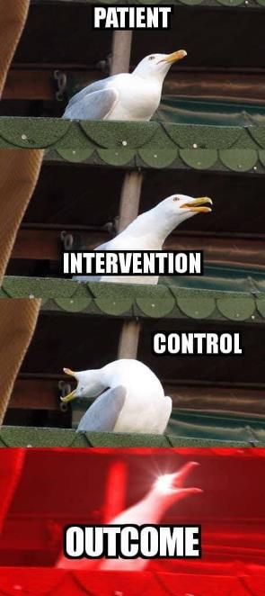
Example for an interventional question
Should we chose antibiotics or appendectomy in acute appendicitis?
Patient, Problem
Acute appendicitis
Intervention
Antibiotics
Comparator
Appendectomy
Outcome
Morbidity/mortality
Huston JM., et al., Surg Infect (Larchmt) . 2017 Jul;18(5):527-535.
Kessler U., et al., Arch Dis Child. 2017 Dec;102(12):1118-1124

Slide 99
Hypothesis in a lay point of view…
What answer do you expect to your question?
Main features:
refers to the question
testable
Accept or reject
Colleagues who attend „Meta-analysis workshop” have higher chance to perform meta-analysis than those who skip this.

Slide 100
Scientific questions
TAKE HOME MESSAGE
PICO: patients/intervention/comparator/outcome
Pay attention to hypothesis generation

Slide 101
BREAK

Slide 102
How to gather information from electronic databases systematically?
Márk Félix Juhász

Slide 103
Flowchart
Question
Preliminary search
Search
Protocol
Data
collection
Bias assessment
Selection
Synthesis
Limitations
Implication
Dissemination of results

Slide 104
Key points
Preliminary search
Concept of systematic search
Design of a search key
Boolean operators

Slide 105

Cochrane
Cochrane Handbook for Systematic Reviews of Interventions
Version 6
[updated in 2019]
Editors: Julian Higgins and James Thomas
Part 2, Chapter 4: Searching for and selecting studies
https://training.cochrane.org/handbook/current/chapter-04

Slide 106
Systematic vs non-systematic
systematic
vs.
non-systematic
(non-selective)
(selective, arbitrary)

Slide 107
Systematic search
Aim: to capture all the relevant articles published
Yield: records eligible for selection

Slide 108
Data sources
Search in electronic databases
Handsearch of printed material (journals)
Handsearch of reference lists (reviews, guidelines, included and excluded studies)
Handsearch of citing articles with Google Scholar
"Grey" literature
conference abstracts
unpublished and ongoing studies
(trial registries)
original authors of the studies
non-indexed journals (?)

Slide 109
Databases, search engines
MEDLINE
Google Scholar
EMBASE
Cochrane TRIAL
TRIP
Scopus
Grey literature
(BIOSIS)
PsycINFO
ClinicalTrials.gov
Web of Science
WHO GLobal Health Library

Slide 110
Search – MeSH / EMTREE
Controlled vocabulary (thesaurus of terms)
MEDLINE: MeSH
EMBASE: EMTREE
automatic ‚explosion’
spark search ideas
What am I trying to research again?

Slide 111
Example
query
celiac AND disease AND ((mucosal AND healing) OR (mucosal AND recovery) OR (villous AND atrophy))
query transcript
celiac[All Fields] AND ("disease"[MeSH Terms] OR "disease"[All Fields]) AND ((("mucous membrane"[MeSH Terms] OR ("mucous"[All Fields] AND "membrane"[All Fields]) OR "mucous membrane"[All Fields] OR "mucosal"[All Fields]) AND (("wound healing"[MeSH Terms] OR ("wound"[All Fields] AND "healing"[All Fields]) OR "wound healing"[All Fields] OR "healing"[All Fields]) OR recovery[All Fields])) OR (villous[All Fields] AND ("atrophy"[MeSH Terms] OR "atrophy"[All Fields])))

Slide 112
Search – Free-text terms
Controlled vocabulary (thesaurus of terms)
MEDLINE: MeSH
EMBASE: EMTREE
Free-text terms (what you write in the search bar)
synonyms (recovery vs. healing)
related words (head vs. brain)
variant spelling (tumor vs. tumour)
truncation (pharmaco*)
spark search ideas

Slide 113
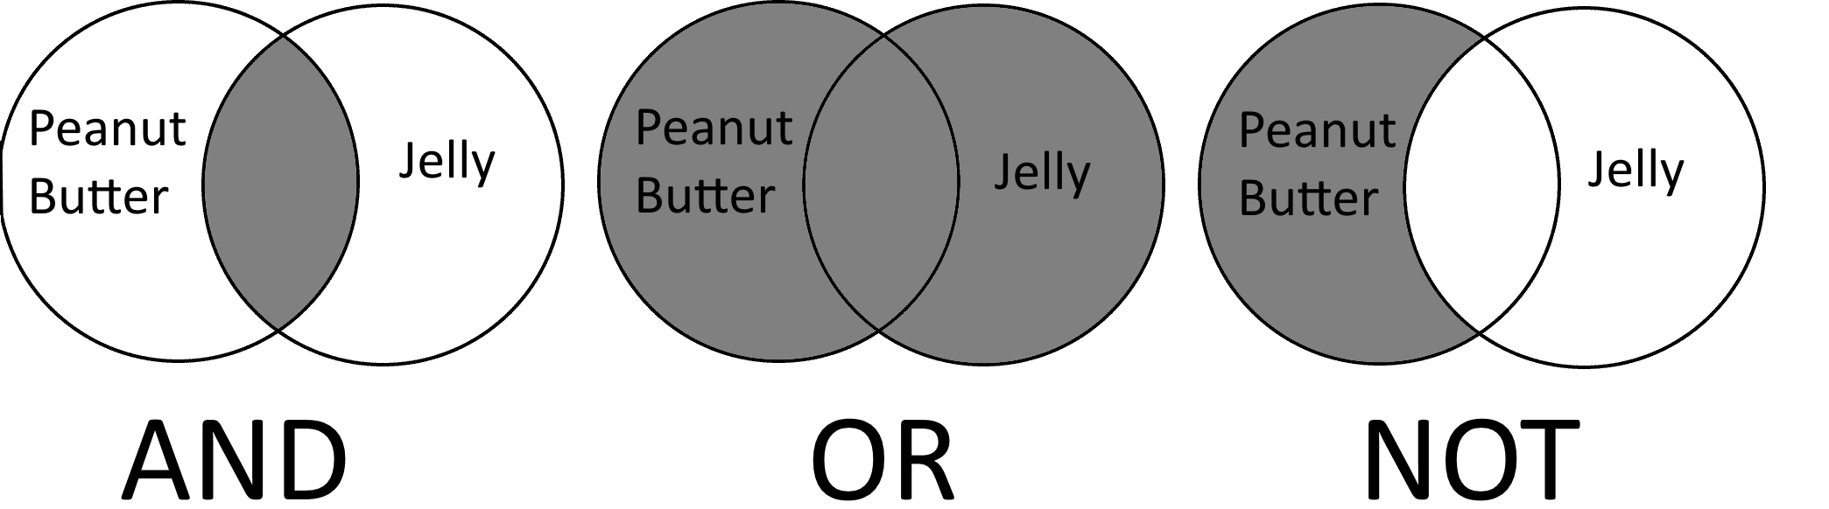
Boolean operators
Narrows
Expands
Source of figure: https://sru.libguides.com/c.php?g=531870&p=3883641

Slide 114
Quotation marks
good AND clinical AND practice
n=22 230
vs.
"good clinical practice"
n=1 539

Slide 115
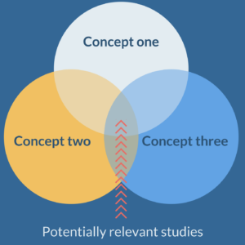
Connecting concepts
P: acute myocardial infarction
P: acute myocardial infarction
I: nebivolol
C: atenolol
O: 28-day mortality

Slide 116
Connecting concepts
P: acute myocardial infarction
{
(myocardial infarction OR AMI OR heart infarction OR ”acute coronary syndrome” OR ACS)
AND
(atenolol OR Tenormine OR ICI66082 OR nebivolol OR Nebilet OR Silostar OR Lobivon OR Bystolic OR R67555 OR ”adrenergic beta-antagonists” OR “beta adrenergic receptor blocking agent" OR beta blocker OR β-blocker)
IC: nebivolol & atenolol
{
AND
O: 28-day mortality
{
(mortality OR death OR fatality OR deceas*)

Slide 117
Common mistake!
celiac AND disease AND ((mucosal AND healing) OR (mucosal AND recovery) OR (villous AND atrophy))
n=1358
celiac AND disease AND (mucosal AND healing) OR (mucosal AND recovery) OR (villous AND atrophy))
n=6112
Mind the order of operations!

Slide 118
Search restrictions
Filtering
Design
Genres
Filters:
English language records
humans
trials/RCTs
time frames
Later…

Slide 119
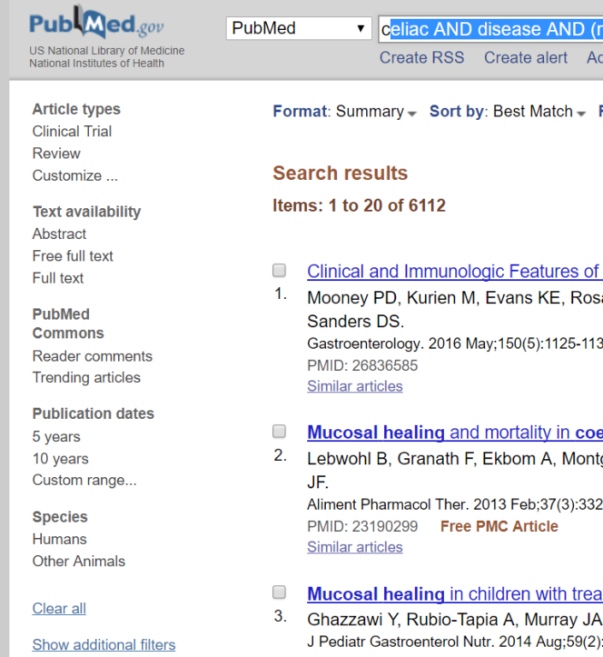
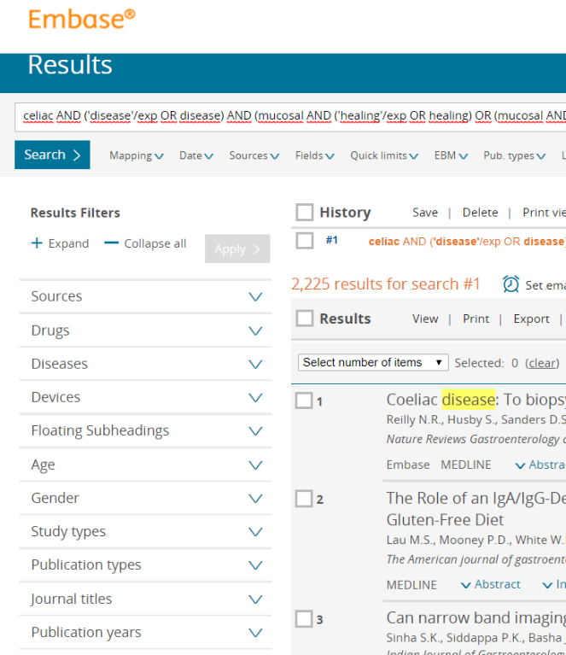
Search restrictions

Slide 120
Search restrictions
Filtering
Design
Genres
Filters:
English language records
humans
trials/RCTs
time frames
Later…
Not recommended

Slide 121
Hits yielded by search
Database | Raw search
Embase | 3914
PubMed | 2848
Cochrane Trials | 128
Web of Science | 2266
Scopus | 2437
ClinicalTrials.gov | 45
WHO Global Health Libary | 2432
∑ | 14071
No rules!!!
(magnitude: 100-1000)

Slide 122
Sensitivity vs. precision
relevant reports identified
total number of relevant reports
Sensitivity
versus
precision?
relevant reports identified
total number of reports identified

Slide 123
Sensitivity vs. precision
2 abstracts in a minute
120 abstracts in an hour
about 1000 abstracts in an 8-hour shift

Slide 124
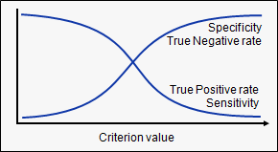
Sensitivity vs. precision
Yield
Relevant
OPTIMAL
relevant reports identified
total number of reports identified
10
2/20
50
6/20
100
12/20
500
14/20
1000
16/20
relevant reports identified
total number of relevant reports
5000
17/20
10000
18/20

Slide 125
Designing good search strategies
1. Design a preliminary search key without using filters based on the medical terminology you know
2. Start selecting and pick a few key articles
3. Review these articles thoroughly and identify key terms (words, phrases, concepts)
4. Pick previous reviews through the preliminary search and identify key terms (words, phrases, concepts)
5. Design the final query
6. Test the query whether it identifies the key articles you had found previously

Slide 126
Take home message
TAKE HOME MESSAGE
Design your search strategy with caution
Do not underestimate the yield of preliminary search
Avoid missing records by:
  Conducting a comprehensive search
  Using no filters
  Using more databases (at least: MEDLINE, CENTRAL, Embase)

Slide 127
First impression of forest plots -
introduction to meta-analytical statistics
Szabolcs Kiss

Slide 128

Key points
Main part of the forest plot
Critical appraisal of them

Slide 129
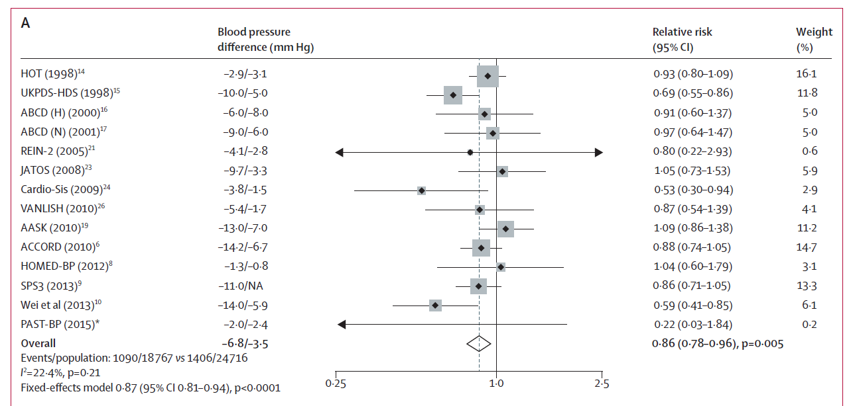
What does this plot tell you?
Nothing!

Slide 130
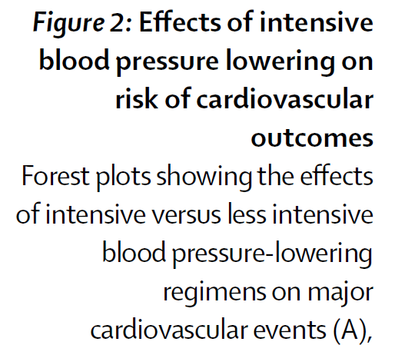
What does the title and legend tell you?

Slide 131
What was the PICO of the paper?
PICO:
P: Patients with hypertension
I: Intensive blood pressure lowering strategy
C: Standard blood pressure lowering strategy
O: major CV events

Slide 132
Now, let’s see the plot…

Slide 133

Let’s see the results
The intensive blood pressure lowering therapy decreased the incidence of major CV events with 14% compared to standard therapy

Slide 134
Let’s see the results
The intensive blood pressure lowering therapy decreased the incidence of major CV events with 14% (95% CI: 4-22%) compared to standard therapy

Slide 135
Heterogeneity

Slide 136

Heterogeneity

Slide 137
Does this plot reflect the truth?
We do not know…

Slide 138
Grade of evidence
TAKE HOME MESSAGE
Analyze the plot in detail, then analyze the paper in detail.
Explore strengths and limitations thoroughly.
Determine how confident your are in your conclusion.

Slide 139
Bias - the truth is beyond
Bálint Erőss

Slide 140
Flowchart
Question
Preliminary search
Search
Protocol
Data
collection
Bias assessment
Selection
Synthesis
Limitations
Implication
Dissemination of results

Slide 141

Key points
Concept of bias
Types and definition of bias
Examples for risk of bias assessment tools

Slide 142

Risk of bias assessment
Aim: to explore potential factors in included studies leading to false associatons
Benefit: the internal validity of the conclusions can be secured

Slide 143


Errors in epidemiological studies
Bias
Imprecision
Valid?
Precise?

Slide 144
Errors in epidemiological studies
Bias
Imprecision
Systematic error
Random error
Sample size
Risk
Sample size
Risk

Slide 145
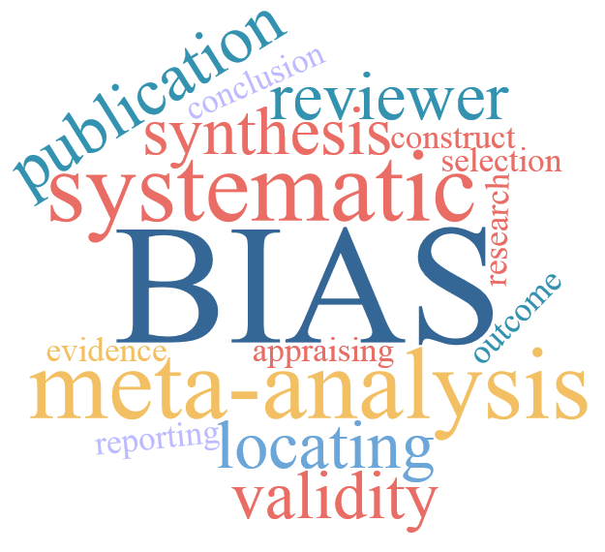
What is bias?
Bias is the deviation from the truth

Slide 146
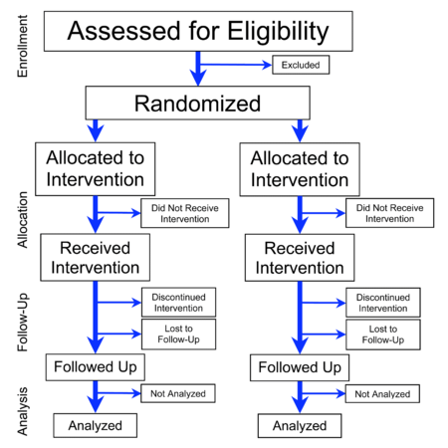
An ideal setting…
Only the treatment is different
Difference in outcomes is caused by treatment

Slide 147


A biased setting…
Not only the treatment is different
Difference in outcomes may be caused by treatment or other factors

Slide 148

What is bias?
Bias is the deviation from the truth
Overestimation
Underestimation
False negative/positive conclusions

Slide 149

Where should we seek for biases?
In the studies included in the analysis!
Threaten internal validity!

Slide 150
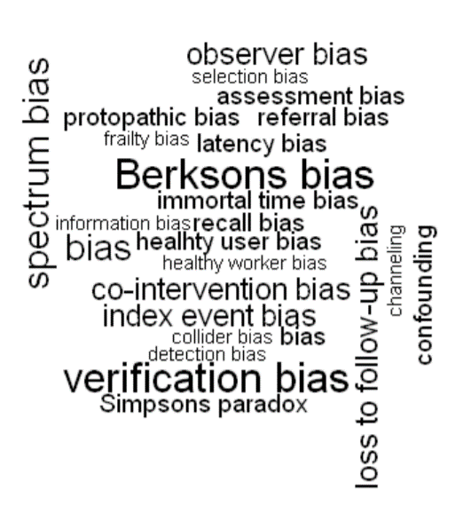
What type of biases should we seek for?
Terminology: vague
Selection bias
Performance bias
Detection bias
Attrition bias
Reporting bias

Slide 151

Types of bias
Selection bias
Definition: differences between baseline characteristics of groups compared

Slide 152

DOI:
  10.1016/S0140-6736(02)07283-5
Confounding
Hypothesis: aspirin reuduces CV deaths in the elderly
Design: two-arm prospective study (500-500 patients)
 | Aspirin | No aspirin
Male:female ratio | 1:1.01 | 1:1.04 | p=NS
Age (mean±SD) | 71±10 y | 64±9 y | p<0.001
10-y CV death | 12% | 4% | p<0.001
10-y bleeding | 16% | 11% | p<0.001
The hypothesis should be rejected because aspirin increases CV deaths

Slide 153
Example for overestimation of the effect
Let’s compare a new drug to the old one…
Design: experimental, parallel (2 arms), non-randomized.
The new drug reduces mortality by 20% (95% CI: 15-25%).
But…
Mean age of groups are 74±8 y (old drug) and 61±2 y (new drug)
(p<0.001)
Biased!

Slide 154
Examples for selection bias
Let’s compare a new drug to the old one…
Design: experimental, parallel (2 arms), non-randomized.
The new drug reduces mortality by 20% (95% CI: 15-25%).
But…
Mean age of groups are 74±8 y (old drug) and 61±2 y (new drug)
(p<0.001)
Others: gender, stage of disease, severity of disease, comorbidities…

Slide 155
Types of bias
Selection bias
Definition: differences between baseline characteristics of groups compared
How can you prevent it from occurring?
Randomization
What to assess?
Random sequence generation
Allocation concealment

Slide 156
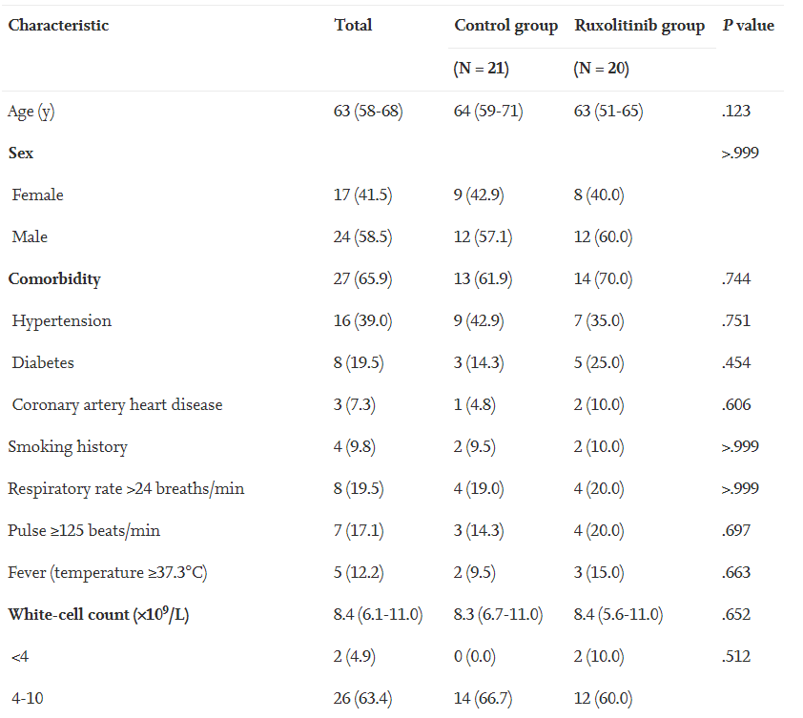

Good example of randomization

Slide 157

Types of bias
Performance bias
Definition: differences in care or exposure to factors (other than the intervention) between groups

Slide 158
Examples for performance bias
Let’s compare a new drug to the old one…
Design: experimental, parallel (2 arms), randomized, open-label.
The new drug reduces thrombosis rate by 20% (95% CI: 15-25%).
But doctors do not trust the new drug…
20% of patient (old drug) and 85% of patients (new drug) were prescribed additional anticoagulants.
Any intervention distrubuting unequally between groups

Slide 159

Types of bias
Performance bias
Definition: differences in care or exposure to factors (other than the intervention) between groups
How can you prevent it from occurring?
Blinding
What to assess?
Blinding (participants and personnel)

Slide 160

Types of bias
Detection bias
Definition: differences in how outcomes were assessed between groups

Slide 161
Examples for detection bias
Let’s compare a new drug to the old one…
Design: experimental, parallel (2 arms), randomized, open-label.
The new drug reduces pneumonia rate by 20% (95% CI: 15-25%).
But doctors do not trust the new drug…
20% of patient (old drug) and 85% of patients (new drug) were ordered chest X-ray (p<0.001)
Any diagnostic modality distrubuting unequally between groups

Slide 162
Types of bias
Detection bias
Definition: differences in care or exposure to factors (other than the intervention) between groups
How can you prevent it from occurring?
Blinding
What to assess?
Blinding (outcome assessment)

Slide 163

Types of bias
Attrition bias or follow-up bias (drop-outs)
Definition: differences in withdrawals between groups

Slide 164
Examples for attrition bias
Let’s compare a new drug to the old one…
Design: experimental, parallel (2 arms), randomized, double-blind
The new drug reduces 1-y mortality by 20% (95% CI: 15-25%) in those completed the whole follow-up period (per protocol).
But had severe side effects in women (dysmenorrhea).
Withdrawal rate: 20% (50% women) with the old drug, 40% (90% women with the new drug (p<0.001)
In the disease: females’ mortality is higher than that of males
Imbalanced drop-out

Slide 165
Types of bias
Attrition bias or follow-up bias (drop-outs)
Definition: differences in care or exposure to factors (other than the intervention) between groups
How can you minimize it?
Intention-to-treat analysis (imputations)
What to assess?
Incomplete outcome data

Slide 166
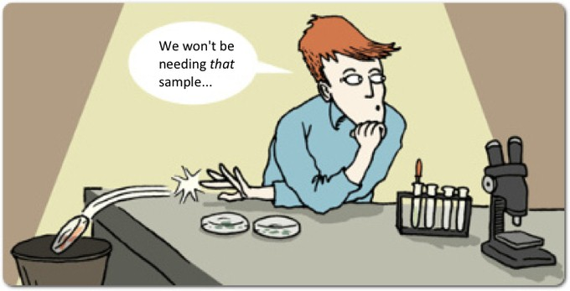
Types of bias
Reporting bias
Definition: differences between reported and unreported findings
Odds ratios for reporting significant results:
efficacy: OR=2.4 (95%CI: 1.4-4.0)
harms: OR=4.7 (95%CI: 1.8-12.0)
Chan AW, Hróbjartsson A, Haahr MT, Gøtzsche PC, Altman DG. Empirical evidence for selective reporting of outcomes in randomized trials: comparison of protocols to published articles. JAMA2004; 291: 2457-2465.

Slide 167

Examples for reporting bias
Let’s compare a new drug to the old one…
Design: experimental, parallel (2 arms), randomized, double-blind
Results:
mortality reduced by 2% (95% CI: 1.5-2.5%)
organ failure rate reduced by 1.0% (95% CI: 0.8-1.2%)
short-term (1-month) neurological deficit did not change
Picking of the desired results

Slide 168

Examples for reporting bias
Let’s compare a new drug to the old one…
Design: experimental, parallel (2 arms), randomized, double-blind
Results:
mortality reduced by 2% (95% CI: 1.5-2.5%)
organ failure rate reduced by 1.0% (95% CI: 0.8-1.2%)
short-term (1-month) neurological deficit did not change
long-term (1-year) neurological deficit increased by 40% (95% CI: 34-60%)
Picking of the desired results

Slide 169
Types of bias
Reporting bias
Definition: differences between reported and unreported findings
How can you prevent it from occurring?
Complete reporting
Assessment in Cochrane Tool?
Incomplete outcome data

Slide 170
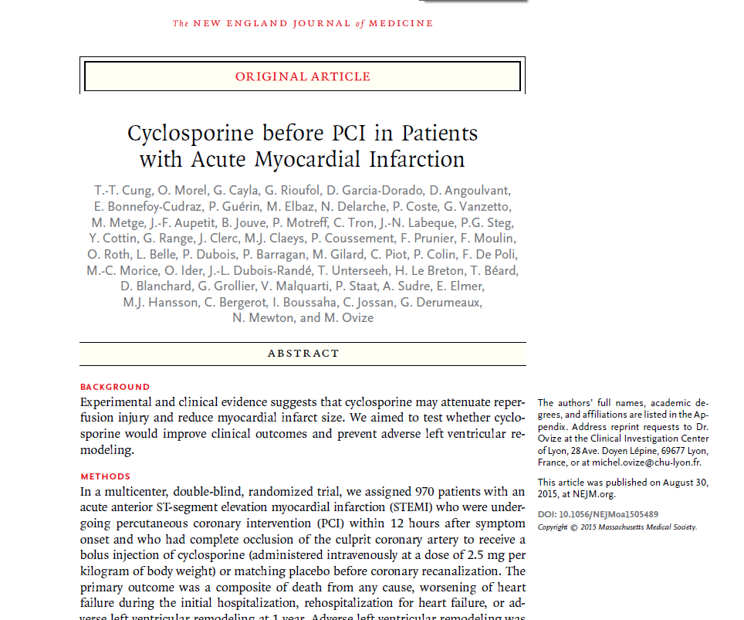
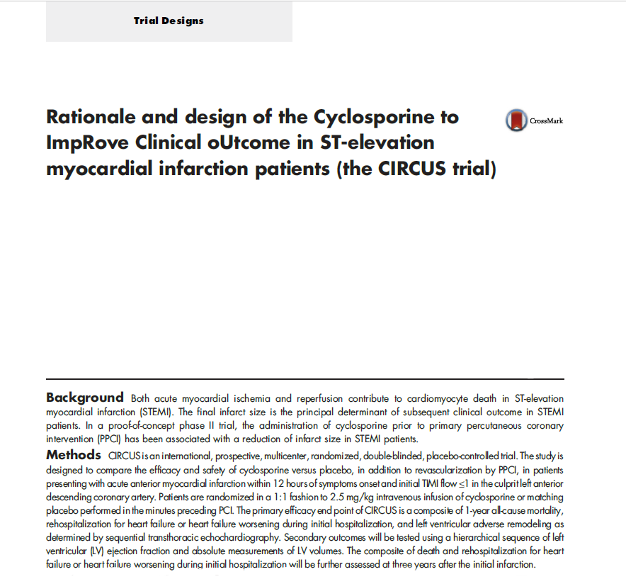

Slide 171

Observational studies
Bias in observational studies?
Unavoidable..

Slide 172
Tools for risk of bias assessment
Randomized Controlled
Trials
Cochrane Risk of Bias
Tool-2
Non-randomized
Experimental interventional
ROBINS-I
Observational interventional
Diagnostic
QUADAS-2
Prognostic
QUIPS and PROBAST

Slide 173
Risk of bias assessment
TAKE HOME MESSAGE
Understand the concept of bias
Assess risk of bias
Integrate the results of risk of bias assessment

Slide 174
Should we trust in meta-analyses?
Szabolcs Kiss

Slide 175

Key points
Strengths
Limitations
Common errors

Slide 176

Strengths
Relevance and novelty
Methodology (transparent & reproducible)
Comprehensiveness of search
Higher statistical power
Verification of current and unraveling of
new associations (cause-effect?)
Development of a critical attitude
towards the existing evidence

Slide 177

Limitations
Publication bias
Indirectness
Generalizability and applicability
Imprecision
Risk of bias
Heterogeneity
Methodological errors

Slide 178
What is publication bias?
Comes from prejudice against smaller „negative” studies
Less frequent or delayed publication in smaller journals
Bias at the level of meta-analysis (meta-bias)

Slide 179

What is publication bias?
They said I had to stay here because I wasn’t ‚positive’ enough
Unavoidable

Slide 180
Indirectness
Meta-analysis
Study 1
Study 2
P: pancreatitis
I: antibiotics
C: placebo
O: in-hosp mortality
P: severe pancreatitis
I: antibiotics
C: placebo
O: in-hosp mortality
P: pancreatitis
I: antibiotics
C: placebo
O: 1-week mortality
PICO of individual studies should match the
PICO of meta-analysis!
Avoidable

Slide 181
Errors in epidemiological studies
Risk of bias assessment
Trial sequential analysis
Bias
Imprecision
Valid?
Precise?
Estimatable

Slide 182
Heterogeneity
Definition: variance in the sample that cannot be explained by the play of chance
Non-statistical
Statistical
Risk of bias
Indirectness
Study design
Chance (imprecision)
Overlap of confidence intervals
Tests (I², chi²)
Estimatable
Avoidable

Slide 183
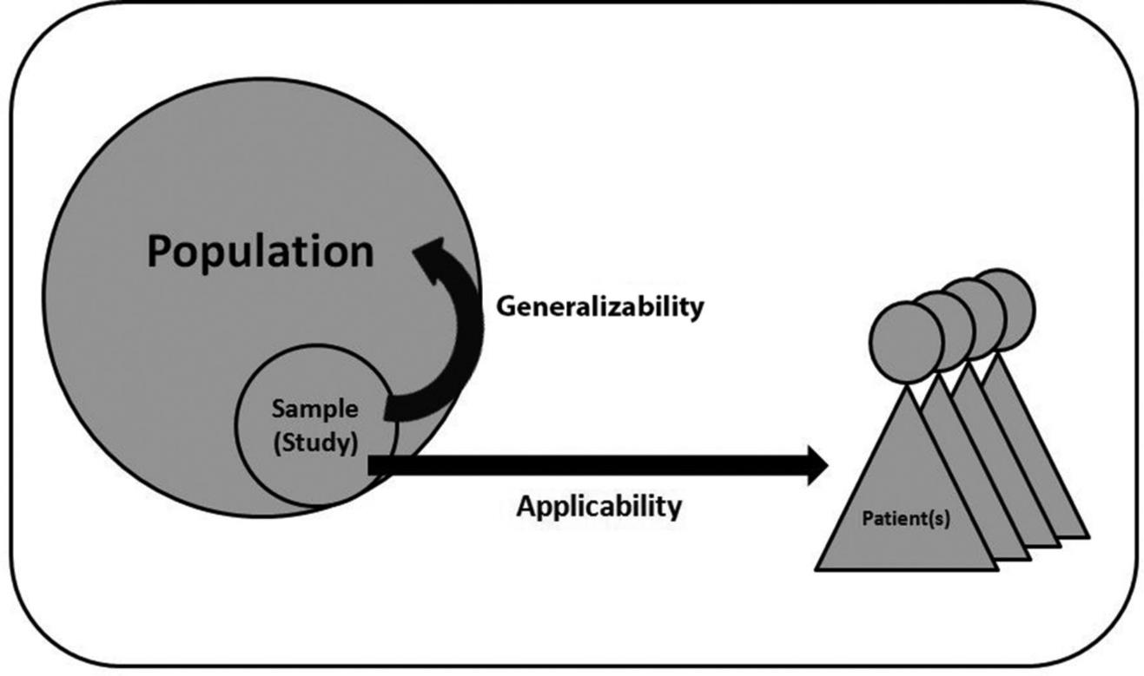
Generalizability and applicability
Selection bias?
Avoidable

Slide 184
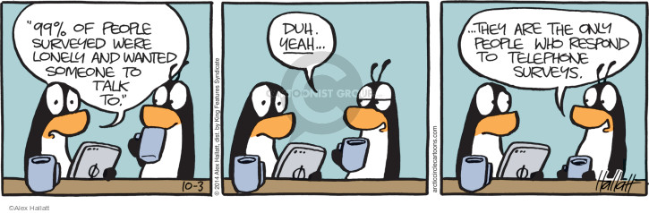
Generalizability and applicability
What are your results representative to?

Slide 185
Common methodological errors
Protocol is lacking or major deviation from it without rationale
No preliminary search, no implications (so what?)
Incomprehensive search: use of filters, wrong order of operations, lack of testing (‚trial and error’ strategy)
Poor documentation of search and selection
Inaccurate data collection: not done in duplicate
Analyses not done by statisticians
Avoidable

Slide 186
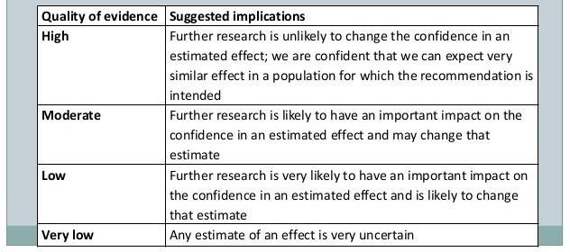
The GRADE approach
Briefly: how confident we are that our results are TRUE

Slide 187
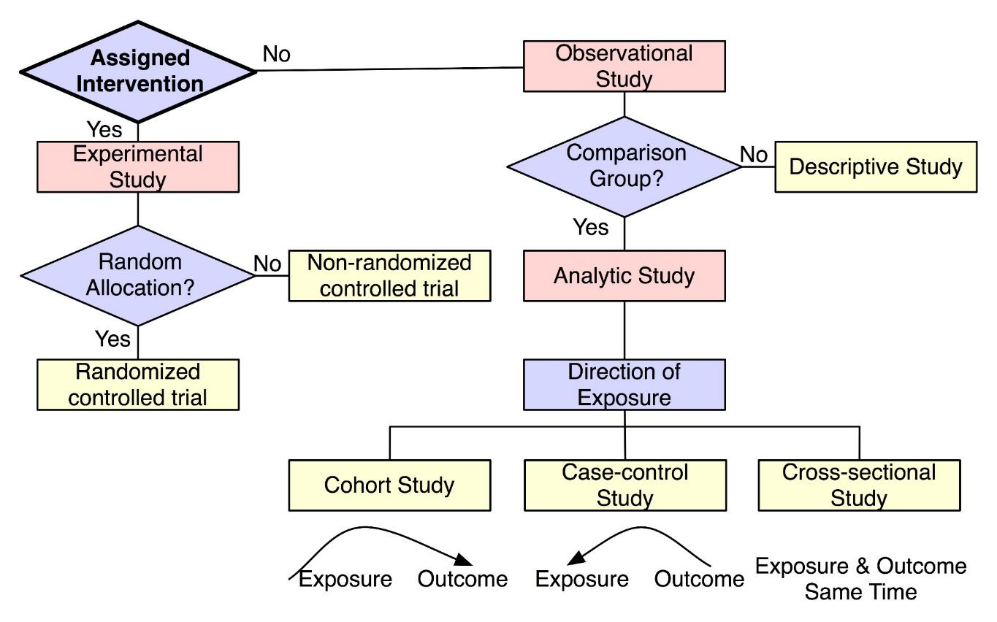
Study designs
Step 1
Low grade of evidence
High grade of evidence
https://irb.research.chop.edu/study-design

Slide 188
How to apply the GRADE system?
Step 2: Downgrading items:
Risk of bias
Inconsistency heterogeneity
Indirectness PICO (generalizability)
Imprecision Sample and event numbers
Publication bias
Step 3: Upgrading items:
Large effect
Dose response
Opposite bias
Rarely used

Slide 189
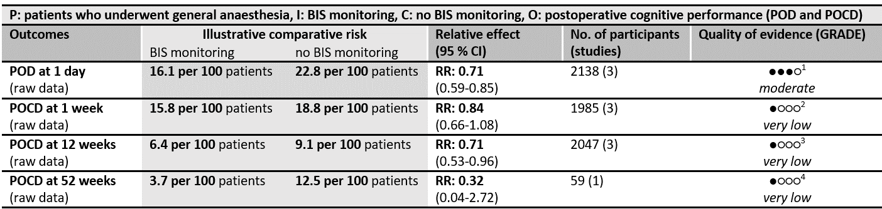
The output: Summary of Findings Table

Slide 190
Grade of evidence
TAKE HOME MESSAGE
Explore strengths and limitations thoroughly.
Determine how confident your are in each of your statements.

Slide 191
BREAK

Slide 192
Meta-analysis Workshop
21-22nd September, 2020
University of Pécs
Pécs

Slide 193
10th Meta-analysis Workshop
GENERAL OVERVIEW OF META-ANALYSES
PRACTICAL GUIDE ON HOW TO UNDERSTAND META-ANALYSES

Slide 194
PRACTICAL GUIDE ON HOW TO UNDERSTAND
META-ANALYSES
Schedule (16:15-18:30)
Opening remarks
Session I. The overview of a meta-analysis
Break (17:15-17:30)
Session II. Systematic search and selection
Closing remarks

Slide 195
Session I.
The overview of meta-analyses
moderator: Márk Félix Juhász

Slide 196
The overview of meta-analyses
Szabolcs Kiss

Slide 197

Key points
Main parts of a publication
PRISMA Statement
Importance of reproducibility

Slide 198
Flowchart
Question
Preliminary search
Search
Protocol
Data
collection
Bias assessment
Selection
Synthesis
Limitations
Implication
Dissemination of results

Slide 199
Title
Identify the report as a meta-analysis or systematic review or both
As SHORT as possible
As INFORMATIVE as possible → citations

Slide 200
Abstract
An abstract is "a brief, comprehensive summary of the contents of [an] article" (American Psychological Association [APA], 2010, p. 25)
"The abstract should be brief without sacrificing important content" (Cochrane Handbook for Systematic Reviews of Interventions, 2008, p. 55)

Slide 201

Introduction
Background: SO WHAT?
Objectives: precisely stated, ideally in a single sentence
Notes:
helps to set the rationale for the review, and explain why the question being asked is important
statement of the primary objective of the review

Slide 202

Methods
What was done to obtain results and conclusion?
It should cite the study protocol
Methods section resembles to “steps of workflow”
Notes:
Methods section should describe what was done to obtain results and conclusion of the current review.
It should cite the study protocol to make it clear that there was one.

Slide 203
Methods
Preliminary search
Data
collection
Problem
Search
Selection
Search
Question
Protocol
Data
collection
Bias assessment
Selection
Synthesis
Eligibility criteria for studies
PICO
Search strategy: Reproductibility!
Information sources: Where? When?

Slide 204

Methods
Data
collection
Preliminary search
Data
collection
Selection
Problem
Selection
Problem
Search
Question
Search
Protocol
Search
Data
collection
Bias assessment
Selection
Synthesis
Method of data extraction.
Who and how?
Notes:
Independently? In duplicate? Standardized forms?

Slide 205
Methods
What were the outcomes?
Methods of handling data (statistical analysis)?
Risk of bias assessment (method)
Synthesis
Data
collection
Bias assessment
Selection
Synthesis

Slide 206

Results
Core findings of a study,
in a logical sequence,
without interpretation from the author.
“Preparation for Discussion”

Slide 207
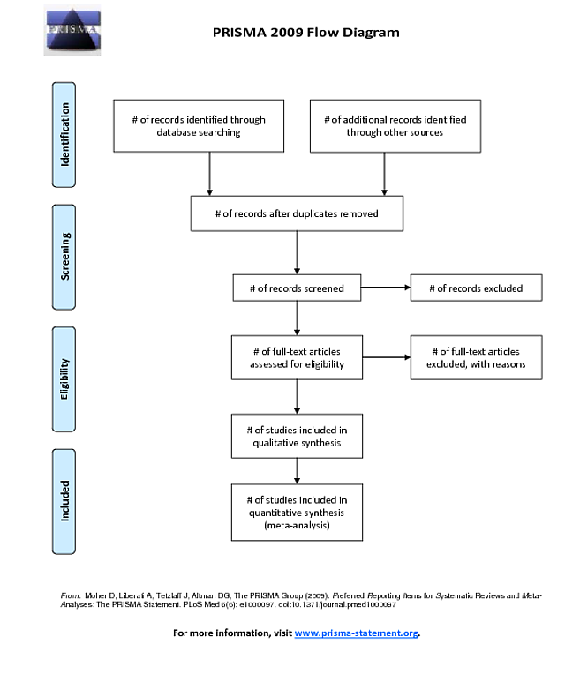

Figures

Slide 208


Figures

Slide 209

How to estimate publication bias?
Large studies
Small studies
„Small‐study effect” are a common threat in systematic reviews and may indicate publication bias
Egger et al. (1997) proposed a test for asymmetry of the funnel plot
Minimum 10 studies!
Notes:
Small‐study effects are a common threat in systematic reviews and may indicate publication bias.
The presence of small‐study effects is often verified by visual inspection of the funnel plot,(3, 4, 5) where for each included study of the meta‐analysis, the estimate of the reported effect size is plotted against a measure of precision or sample size. several tests have been proposed for detecting funnel plot asymmetry.(6, 7) These tests may regress effect estimates against their standard error (the so‐called Egger's test), The plot shows the treatment effect estimates on a suitable scale, e.g., the log relative risk (usually on the x-axis) against a measure of their precision, usually the standard error

Slide 210

Discussion
Interpretation and summary of results.
Discussion contains limitations.
It provides a brief conclusion and implications for future research and practice.
Notes:
at study and outcome level (e.g., risk of bias), and at review-level (e.g., reporting bias).
as a general interpretation of the results in the context of other evidence,

Slide 211

What is PRISMA statement?
PRISMA
referred
“A summary of studies addressing a clear question, using systematic and explicit methods to identify, select, and critically appraise relevant studies, and to collect and analyse data from them.”
eporting
tems for
ystematic reviews and
eta -
“Statistical combination of estimates derived from two or more similar studies, to give an overall effect estimate.”
nalysis

Slide 212
PRISMA
Aim: Get to know the evidence-based minimum set of items

Slide 213


Checklist
http://www.prisma-statement.org/
Moher D et al. The PRISMA Group (2009). Preferred Reporting Items for Systematic Reviews and meta-analyses: The PRISMA statement
PMID 20171303

Slide 214



Other PRISMA checklists

Slide 215





PRISMA Statement

Slide 216
Scientific questions
TAKE HOME MESSAGE
Plan ahead!
Use the PRISMA guidance!

Slide 217
Practice
21-22nd September, 2020
University of Pécs
Pécs

Slide 218
Practice – Day 1, Session I.
What are the titles telling about the content?
Read the abstracts carefully. Compare the corresponding sections of the abstracts of papers. What are the similarities and differences? Do the titles meet the abstract?
Read the introduction of the papers. What is the motivation (rationale) for doing these studies? What are the objectives/hypotheses?
Does the later study refer to the earlier one? Any references to previous summary publications (e.g. guidelines, reviews, meta-analysis)?
Check the PRISMA Checklist item-by-item. Do you have anything missing? (G1-G3: sample paper 1; G4-G6: sample paper 2)
You have 25 minutes to complete this task.

Slide 219
Session II.
Search and selection
moderator: Márta Balaskó

Slide 220
Search (briefly)
Márk Félix Juhász

Slide 221
Search – Free-text terms
Controlled vocabulary (thesaurus of terms)
MEDLINE: MeSH
EMBASE: EMTREE
Free-text terms (what you write in the search bar)
synonyms (recovery vs. healing)
related words (head vs. brain)
variant spelling (tumor vs. tumour)
truncation (pharmaco*)
spark search ideas

Slide 222
Boolean operators
Narrows
Expands
Source of figure: https://sru.libguides.com/c.php?g=531870&p=3883641

Slide 223
Search restrictions
Filtering
Design
Genres
Filters:
English language records
humans
trials/RCTs
time frames
Later…
Not recommended

Slide 224
Sensitivity vs. precision
Yield
Relevant
OPTIMAL
relevant reports identified
total number of reports identified
10
2/20
50
6/20
100
12/20
500
14/20
1000
16/20
relevant reports identified
total number of relevant reports
5000
17/20
10000
18/20

Slide 225
Designing good search strategies
1. Design a preliminary search key without using filters based on the medical terminology you know
2. Start selecting and pick a few key articles
3. Review these articles thoroughly and identify key terms (words, phrases, concepts)
4. Pick previous reviews through the preliminary search and identify key terms (words, phrases, concepts)
5. Design the final query
6. Test the query whether it identifies the key articles you had found previously

Slide 226
Selection
Márta Balaskó

Slide 227
Flowchart
Question
Preliminary search
Search
Protocol
Data
collection
Bias assessment
Selection
Synthesis
Limitations
Implication
Dissemination of results

Slide 228
Key points
Concept of selection
General rules in the selection process

Slide 229
Systematic search
Aim: to capture all the relevant articles published
Yield: records eligible for selection

Slide 230


Selection
Needle in the haystack….

Slide 231
Steps of selection
Removal of overlapping database content and duplicates
3-step selection
Removal of overlapping study populations

Slide 232
Steps of selection
Removal of overlapping database content and duplicates
3-step selection
Removal of overlapping study populations

Slide 233

Overlapping database content
Papers are uploaded to multiple databases
McDonald S, Taylor L, Adams C. Searching the right database. A comparison of four databases for psychiatry journals. Health Libr Rev. 1999; 16: 151-156., Smith BJ, Darzins PJ, Quinn M, et al. Modern methods of searching the medical literature. Med J Aust. 1992; 157: 603-611.

Slide 234

Duplicate references
The exact same paper published in
more than one journal
Source: von Elm E, Poglia G, Walder B, et al. Different patterns of duplicate publication: an analysis of articles used in systematic reviews. Jama. 2004; 291: 974-980.

Slide 235
Dealing with duplicates / overlaps
…with a reference manager software (e.g., EndNote)
Step 1.
Import the yield of the search from each database
Aim: to build up a single pool from databases

Slide 236
Dealing with duplicates / overlaps
…with a reference manager software (e.g., EndNote)
Step 2.
Use the ‚Find duplicates’ function of the software and eliminate them
Aim: to gain a near duplicate-free pool of records

Slide 237
Dealing with duplicates / overlaps
…with a reference manager software (e.g., EndNote)
Step 3.
Check the duplicates manually as well!
Aim: to gain a duplicate-free pool of records
Download a 30-day trial from http://endnote.com/downloads/30-day-trial
For further assistance see:
https://tm-centre.org/download/article-realated/114/selection-with-endnote-0809084855.pdf

Slide 238

Importance of removing duplicates / overlaps
Database | Raw search
Embase | 3914
PubMed | 2848
Cochrane Trials | 128
Web of Science | 2266
Scopus | 2437
ClinicalTrials.gov | 45
WHO Global Health Libary | 2432
∑ | 14071
Preliminary search and planning of the search key:
days!!!!
Build up an EndNote pool:
15 min
Removing overlaps:
30 min
After removing them: 3254 records

Slide 239
Steps of selection
Removal of overlapping database content and duplicates
3-step selection
Removal of overlapping study populations

Slide 240

Selection
You need…
a strategy (e.g., EndNote)
labor force (at least two review authors) with at least basic English language skills
pre-defined selection criteria
a decision making strategy
time, patience, and stamina…
expertise?

Slide 241
3-step selection
Selection by title
1000-1200 records per hour
Selection by abstract
100-120 abstracts
per hour
Selection by full-text
1-6 articles
per hour

Slide 242
Steps of selection
Removal of overlapping database content and duplicates
3-step selection
Removal of overlapping study populations

Slide 243
Overlapping study populations
Multiple publications from the same study population which are different in some way
Overrepresentation of some patients in analyses
To exclude these and leave only one copy by checking authors, sites and period of recruitment, and the data

Slide 244
How to carry out a selection?
1. Plan your eligibility criteria before you start selecting!
Example: Does follow-up biopsy predict long-term outcomes in celiac disease?
Inclusion criteria (by scientific content) - PICO!!!
P: diagnosed celiac disease
I: adherence to gluten-free diet
C: at least one follow-up biopsy with available histological results (recovery vs. atrophy)
O: outcomes reported by histology separately

Slide 245
How to carry out a selection?
1. Plan your eligibility criteria before you start selecting!
Example: Does follow-up biopsy predict long-term outcomes in celiac disease?
Inclusion criteria (by study design):
observational studies
Exclusion criteria (by study design):
case studies, case series
conference abstracts

Slide 246

Study designs
First preference
Prospective
Retrospective
David A Grimes, Kenneth F Schulz,An overview of clinical research: the lay of the land, The Lancet, Volume 359, Issue 9300, 2002

Slide 247
How to carry out a selection
1. Plan your eligibility criteria before you start selecting!
2. Make the selection process transparent and reproducible!
Date of search, databases, keywords, filters should be accurately documented!
Flow chart is mandatory (PRISMA)!
List of articles excluded on full-text assessment with reasons (xlsx file uploaded as supporting information)!

Slide 248
PRISMA flow diagram
http://www.prisma-statement.org/PRISMAStatement/FlowDiagram

Slide 249
How to carry out a selection
1. Plan your eligibility criteria before you start selecting!
2. Make the selection process transparent and reproducible!
3. Two review authors should select the records in duplicate to reduce the number of false positives and false negatives!
Calculate Cohen’s Kappa to measure inter-rater agreement!
https://idostatistics.com/cohen-kappa-free-calculator/

Slide 250
Cohen’s Kappa
Cohen’s kappa statistic measures interrater reliability
Out of 500 articles | Both keep | Only A keeps | Only B keeps | Both exclude
 | 50 | 4 | 10 | 436
0 = agreement equivalent to chance.
0.1 – 0.20 = slight agreement.
0.21 – 0.40 = fair agreement.
0.41 – 0.60 = moderate agreement.
0.61 – 0.80 = substantial agreement.
0.81 – 0.99 = almost perfect agreement
1 = perfect agreement.
% of agreement: 97.2%
Cohen’s kappa: 0.86

Slide 251
Selection
1. Plan your eligibility criteria before you start selecting!
2. Make the selection process transparent and reproducible!
3. Two review authors should select the records in duplicate to reduce the number of false positives and false negatives!
4. Describe how discrepancies were resolved between the review authors
Third party arbitration (expert in the field)
Committee concensus (experts in the field)

Slide 252
Selection
TAKE HOME MESSAGE
Selection process: remove duplicates => do 3-step selection by title, abstract, and full-text => remove overlapping populations
Document everything with rationales (transparency, reproducability)
Do the selection in duplicate
Check for overlapping study populations

Slide 253
Practice
21-22nd September, 2020
University of Pécs
Pécs

Slide 254
Practice – Day 1, Session II.
Identify the key elements of the search (e.g. databases, restrictions, query, timing). Are they reported explicitly? Is everything given to reproduce the search? (G1-G3: sample paper 2; G4-G6: sample paper 1)
What are Boolean operators? Were there other operators (e.g., adj, near) or truncation used? (G1-G3: sample paper 2; G4-G6: sample paper 1)
Are you satisfied with the search strategy? Does it meet the question of interest (PICOS)? (G1-G3: sample paper 2; G4-G6: sample paper 1)
Identify the key elements of the selection process. Check the flowchart as well. Is the selection strategy described in a fully reproducible way? (G1-G3: sample paper 2; G4-G6: sample paper 1)
You have 25 minutes to complete this task.

Slide 255
Meta-analysis Workshop
21-22nd September, 2020
University of Pécs
Pécs

Slide 256
PRACTICAL GUIDE ON HOW TO UNDERSTAND
META-ANALYSES
Schedule (16:15-18:30)
Opening remarks
Session I. The overview of a meta-analysis
Break (17:15-17:30)
Session II. Systematic search and selection
Closing remarks

Slide 257
PRACTICAL GUIDE ON HOW TO UNDERSTAND
META-ANALYSES
Schedule of Day 2 (14:00-18:45)
Opening remarks
Session I. Questions of meta-analyses
Short break (14:55-15:05)
Session II. The data from clinical and statistical point of view
Break (16:00-16:15)
Session III. Bias - The truth is beyond (extended)
Session IV. Study protocol – Plan ahead
Short break (18:10-18:20)
Session VII. Perspectives
Closing remarks

