Slide 1


Meta-analysis Workshop
21-22nd September, 2020
University of Pécs
Pécs

Slide 2
10th Meta-analysis Workshop
GENERAL OVERVIEW OF META-ANALYSES
PRACTICAL GUIDE ON HOW TO UNDERSTAND META-ANALYSES

Slide 3
PRACTICAL GUIDE ON HOW TO UNDERSTAND
META-ANALYSES
Schedule of Day 2 (14:00-18:45)
Opening remarks
Session I. Questions of meta-analyses
Short break (14:55-15:05)
Session II. The data from clinical and statistical point of view
Break (16:00-16:15)
Session III. Bias - The truth is beyond (extended)
Session IV. Study protocol – Plan ahead
Short break (18:10-18:20)
Session V. Perspectives
Closing remarks

Slide 4

Session I.
Questions of meta-analyses (extended)
moderator: Kiss Szabolcs

Slide 5


Slide 6


PICO(S) (extended)
Lajos Szakó

Slide 7

Key points
Clinical trials (feedback)
Hierarchy of outcomes
Different types of PICO (S)
How do you use them? (examples)

Slide 8
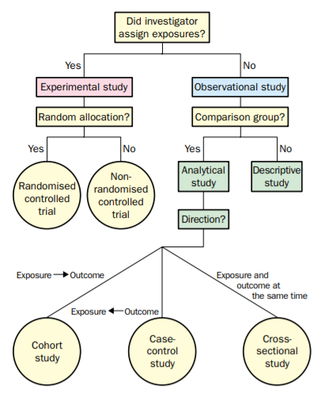
Clinical trials
1. Is the intervention necessary because of the trial?
1.
2. Is it randomized?
2.
3.
3. Is it controlled?
4.
4. How does the exposure and endpoint related to time?
Grimes DA, Schulz KF. Lancet. 2002

Slide 9
PICO framework
Designed to make the process of defining interventional questions
Population/Problem
Intervention
+ Timing
Comparison
+ Study design
Outcome

Slide 10
Hierarchy of outcomes
Outcome
Reflects the objectives of the trial
  Efficacy/effectiveness
  Safety
  Process
  Costs
  …

Slide 11
Hierarchy of outcomes
Primary outcome
A priori
Likely to be influenced by the treatment
Accurate and reliable measurement
Evaluate in all participants
Assessment independent of treatment assignment (no bias)

Slide 12
Hierarchy of outcomes
Primary outcome
  Reflects objectives and primary hypothesis
  Design variable (sample size calculation)
  Hardest outcome
Secondary outcome
  Other important potential effects (defined safety outcomes, mechanism effect)
  Allows more complete evaluation (risk-benefit)

Slide 13
Hierarchy of outcomes
Hard
vs.
Soft
Objective
Might be subjective
Certain
Less certain
All-cause
mortality
Need for
dialysis
LOH
Pain
QoL
Cause-specific
mortality
Need for
surgery
Laboratory changes

Slide 14
Hierarchy of outcomes
Objective-subjective
Objective-clinical events or measurements that are definitive, require little or no subjective judgements
  Rigorous definitions to limit interpretation
  May include test results for confirmation
Subjective-assessments that rely on judgement
  Patient’s reported outcomes
  Observer reported outcomes

Slide 15
PICO framework
Study design
Type of question Study design
Interventional Experimental or observational studies
Diagnostic Observational studies
(diagnostic accuracy studies)
Prognostic/predictive Observational studies
(prognostic studies)
Epidemiological Observational studies
60-70%
3-5%
5-10%
20-30%

Slide 16
PICO framework
Interventional questions
Population/Problem
Patient’s disease or condition
In patients with osteoarthritis of knee
A therapeutic measure, eg., medication, surgery or life style change
is hydrotherapy more effective than
Intervention
Comparison
Standard care, another intervention, or placebo
traditional physiotherapy
Outcome
Mortality rate, number of days off work, pain, disability, etc.
in relieving pain?

Slide 17
PICO framework
Diagnostic questions
( )
P
Specific disease or condition
For deep vein thrombosis
I
A diagnostic test or procedure
is D-dimer testing or
C
Current “reference standard” or “gold standard” test for disease or condition
ultrasound
O
Measures of test utility, i.e. sensitivity, specificity, odds ratio
more accurate for diagnosis?

Slide 18
PICO framework
Predictive questions
( )
P
Duration and severity of main prognostic factor or clinical problem
In healthy older women that suffer hip fractures
I
Usually time or “watchful waiting”
within the year after injury
C
Usually not applicable
O
Survival rates, mortality rates, rates of disease progression
what is the relative risk of death?

Slide 19
PICO framework
Epidemiological questions
( )
P
Target population
In the general population of Europe
I
Usually not applicable
C
Usually not applicable
O
e.g., prevalence, incidence
what is the prevalence of ulcerative colitis?

Slide 20

TRANSLATIONAL MEDICINE
taking discoveries for patients benefits
TAKE HOME MESSAGE
Choose the best primary outcome („hardest one”)
Primary outcome as outlined in the protocol must be assessed

Slide 21

Practice
21-22nd September, 2020
University of Pécs
Pécs

Slide 22
Practice – Day 2, Session I.
1. Describe the study populations. Do they fully meet the target population of the objectives?
2. Describe the interventions. How well-defined they are?
3. Describe the outcomes with timing. What is the primary outcome? Are they hard or soft outcomes? Arrange them in order according to ‘hardness’.
4. Describe the eligible study designs. Would you include experimental and/or observational studies? Justify your choice. Do you agree on their choice?
5. Compare the elements of PICO(ST) in both studies. Similarities and differences?
You have 25 minutes to complete this task.

Slide 23
BREAK

Slide 24
Session II.
The data from clinical and statistical point of view
moderator: Bálint Erőss

Slide 25
General rules of data collection
Fanni Dembrovszky

Slide 26
Flowchart
Question
Preliminary search
Search
Protocol
Data
collection
Bias assessment
Selection
Synthesis
Limitations
Implication
Dissemination of results

Slide 27

Key points
Sources of data
Designing a data collection sheet
General recommendations

Slide 28

Introduction
Cochrane Handbook for Systematic Reviews of Interventions
Version 6
[updated in 2019]
Editors: Julian Higgins and James Thomas
Part 2, Chapter 5: Collecting Data
URL:https://training.cochrane.org/handbook/current/chapter-05

Slide 29


Introduction
Primary sources: published reports of studies (usually journal articles)
Data extraction: important and most time-consuming part
Data collection form: .xls table (other tools are available too)

Slide 30


Introduction
Electronic searches: locating information within a report
e.g.: using search facilities in PDF viewers
Text searching: should not be a replacement for reading the whole report!

Slide 31
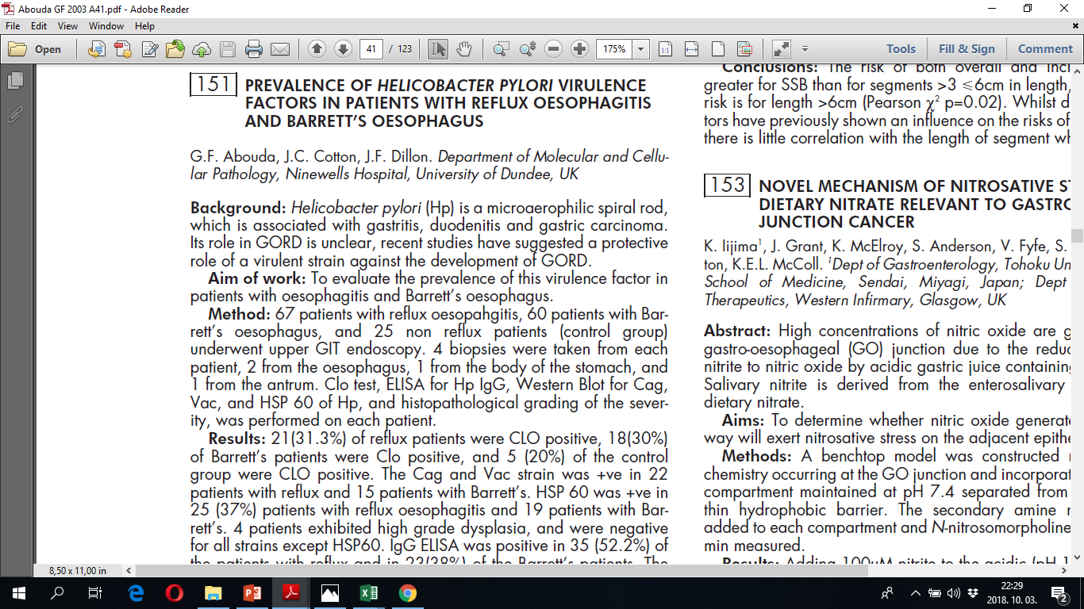
Sources of data

Slide 32
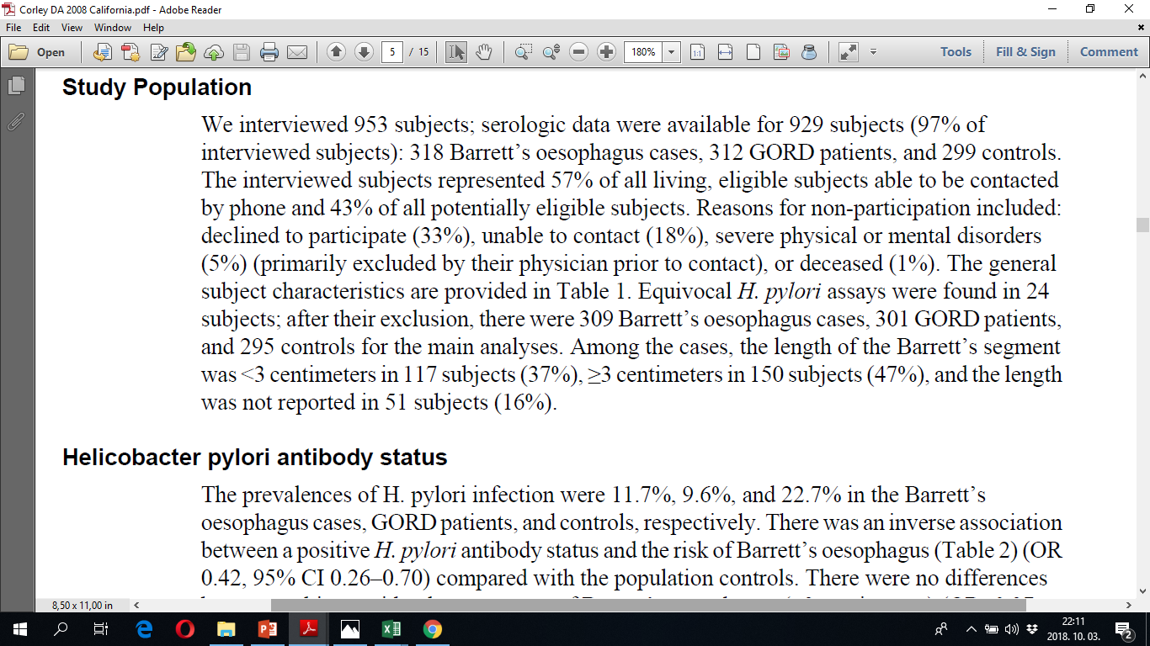
Sources of data

Slide 33
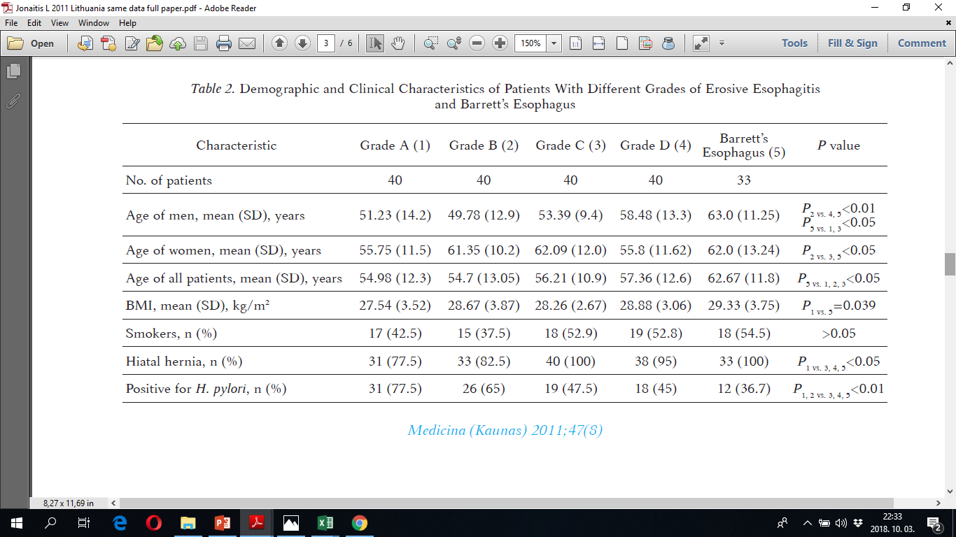
Sources of data

Slide 34
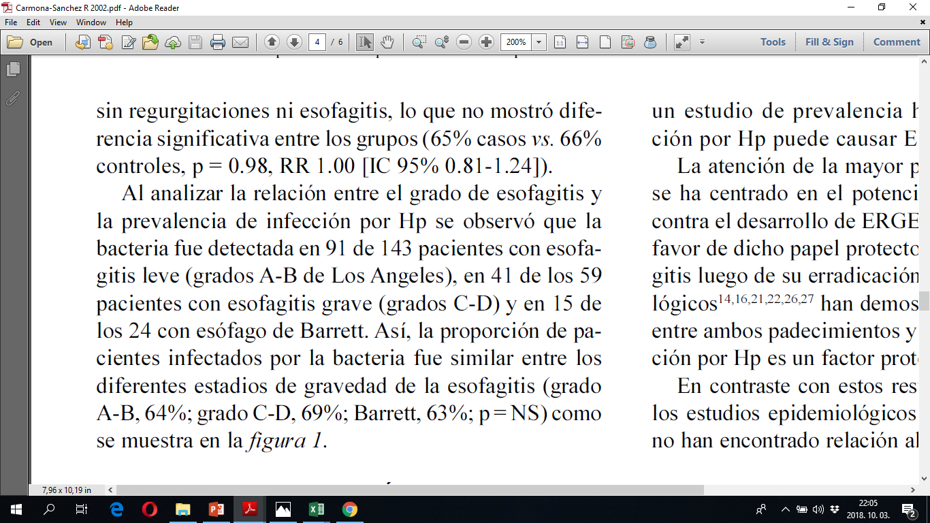
Sources of data

Slide 35

Who should extract data?
Mandatory: at least two person extract data from every report
Independently
Disagreement: consensus or an independent third party
Data extractors: from complementary disciplines
Before the extraction: practice using the form
Data extractors recieve appropriate training

Slide 36

Who should extract data?
Independent data extraction by two authors: fewer errors than extraction by a single author followed by verification by a second (Buscemi 2006)
High prevalence of data extraction errors were observed
Errors in 20 out of 34 reviews (Jones 2005)
Minimum seven out of 27 reviews had substantial errors (Gøtzsche 2007)

Slide 37
Data extraction table
Have to be involved:

Slide 38

Data extraction table
Have to be involved:
Statistician

Slide 39

Data extraction table
Have to be involved:
Statistician Data collectors

Slide 40

Data extraction table
Have to be involved:
Statistician Data collectors Review author(s)

Slide 41


Data extraction table
Data extraction tables should be pilot tested
Entries for the ‘Characteristics of included studies’ table and the ‘Risk of bias’ table using these pilot reports
If major changes are needed after the first testing: repeat the pilot testing on a new set of reports

Slide 42
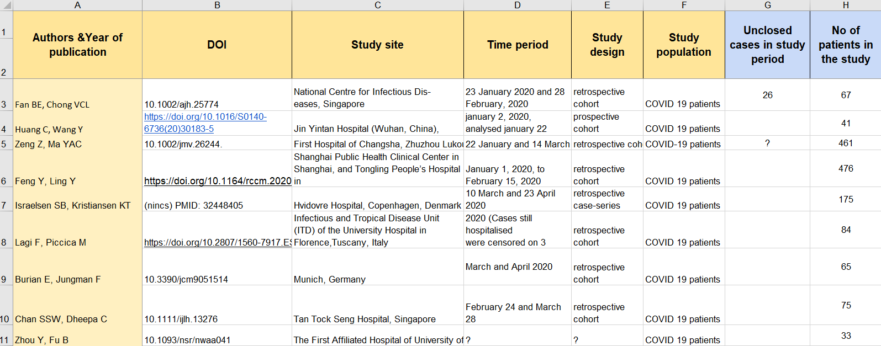

Data extraction table
COLUMNS:
CHARACTERISTICS
OF STUDIES

Slide 43
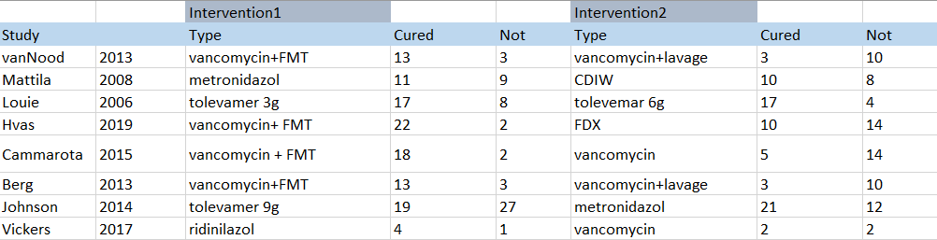
Data extraction table

Slide 44
Multiple reports
Studies are frequently reported in more than one publication
Review authors will need to decide between strategies:
  Extract data from each report separately, then combine information across multiple data collection forms
  Extract data from all reports directly into a single data collection form

Slide 45

Importance of disagreement
More than one author: potential for disagreement
Explicit procedure or decision rule should be identified in the protocol for resolving disagreements.
Disagreements cannot be resolved: should be addressed by contacting the study authors and/or should be reported in reviews

Slide 46
Data extraction
TAKE HOME MESSAGE
A statistician must be involved in the planning!
Plan and pilot the data extraction sheet and process!
Do it in pairs!
Identify and resolve disagreements!

Slide 47
Types of data and general interpretation of your results
Alex Váradi

Slide 48
Flowchart
Question
Preliminary search
Search
Protocol
Data
collection
Bias assessment
Selection
Synthesis
Limitations
Implication
Dissemination of results

Slide 49

Key points
Types of data
Descriptive statistics
Measures of central tendency and spread
Interpretation of categorical and numerical data
General recommendations

Slide 50
Definition of data
Collection of information (numbers, words, measurements…)
Understanding the nature of data is the most fundamental part of the proper and effective use of statistical methods
Notes:
First of all, let’s talk generally about the definition of data.
Data is a collection of information obtained by conducting experiments or making observations.
It can be numbers, words, measurements or descriptions.
Understanding the nature of your data is the most fundamental part of the proper and effective use of statistical methods.

Slide 51
Types of data
DATA
Categorical - Qualitative
Numerical - Quantitative
NOT NUMBERS
NUMBERS
Nominal
Ordinal
type of diseases
stage of tumors
Notes:
Data types are an important concept of statistics, which needs to be understood correctly, since the type of variable greatly determines which kind of analysis you can perform.
The correct test depends on your variables.
There are mainly two types of data: categorical (qualitative) and numerical (quantitative).
In the categorical case information represents characteristics that you do not measure with numbers. Therefore it can represent things like a person’s gender, language and so on.
Categorical data can also take numerical values when coding (for example: 1 for female and 0 for male) but note that those numbers don’t have mathematical meaning.
There are two main types of categorical data, nominal and ordinal.

Slide 52
Categorical data- Examples
    Nominal data
    categories without order or direction
    Ordinal data
    categories with rank or order
biliary
alcohol induced
drug induced
…
Severity of pancreatitis
Etiology of pancreatitis
1.
Mild
2.
Moderately severe
3.
Severe
cystic fibrosis
Odds Ratio (OR) or Risk Ratio (RR)
post ERCP
Notes:
Nominal data represent discrete units and are used to label variables.
Note that nominal data has no order.
Widely used nominal data are for example gender (male/female) or etiology of a disease.
Ordinal data values represent discrete and ordered units. It is therefore nearly the same as nominal data, except that it’s ordering matters.
Note that the difference between categories of ordinal data is not the same for every two consecutive category.
This is the main limitation of ordinal data, the differences between the values are not really known.
Because of that, ordinal scales are usually used to measure non-numeric features like stage of tumors or severity of a disease.

Slide 53
Categorical data collection
Study | Year_of_publication | Male_ratio | Number_of_patient | Severity_of_pancreatitis
 |  |  |  | Mild | Moderate | Severe
Kala Z 2007 | 2007 | 31.7 | 299 | 206 | 78 | 15
Loffeld RJLF 2000 | 2000 | 51 | 213 | 147 | 55 | 11
Meng X 2008 | 2008 | 37.78 | 1015 | 700 | 264 | 51
Nandurkar S 1997 | 1997 | 23.08 | 260 | 179 | 68 | 13
Rajendra S 2004 | 2004 | 34.74 | 173 | 119 | 45 | 9
Sonnenberg S 2010 | 2010 | 74.28 | 454 | 313 | 118 | 23
Inomata 2006 | 2006 | 47 | 112 | 77 | 29 | 6
Johansson 2007 | 2007 | 41.18 | 1741 | 1201 | 453 | 87
Lam 2008 | 2008 | 54 | 76475 | 52768 | 19884 | 3824
Lord 2000 | 2000 | 56.73 | 712 | 491 | 185 | 36
Paull 1988 | 1988 | 40.42 | 210 | 145 | 55 | 11
Peng 2009 | 2009 | 73 | 315 | 217 | 82 | 16
Peng 2010 | 2010 | 16 | 528 | 364 | 137 | 26
Rex KD 2003 | 2003 | 67 | 104 | 72 | 27 | 5
Hackelsberger A 1998 | 1998 | 64.15 | 5341 | 3685 | 1389 | 267
Always raw data (if possible), total number of patient + ratio of…
Notes:
For meta-analysis, when we collect categorical data, we usually create new columns for each category.
If you have only percenteges, for example for male, then you need to collect total number of patients as well, so we can calculate raw data.
In this case the year is a categorical variable , which can be used as a grouping factor for meta-analysis

Slide 54
Types of data
DATA
Categorical - Qualitative
Numerical - Quantitative
NOT NUMBERS
NUMBERS
Discrete
Continuous
heart rate
blood pressure
Notes:
Now let’s take a look at numerical data. In this case, information is recorded as numbers and represents an objective measurement or a count.
Temperature, weight, and a count of interventions are all quantitative data.
There are two main types of numerical data, discrete and continuous.
Continuous data represents measurements and therefore their values can’t be counted but they can be measured.
For example the height of a person, which you can describe by using intervals on the real number line.

Slide 55
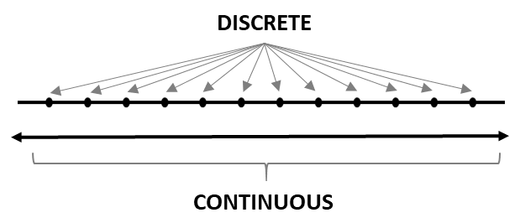
Numerical data- Examples
    Discrete data
    can take only finite numbers
    for example number of interventions (1, 2, 3…) or heart rate
    Continuous data
    can take any numerical values
    infinite number of opportunities
    for example CRP mg/l or hemoglobin g/l
Mean difference, SMD, WMD,
paired mean difference
correlation
Notes:
We speak of discrete data if its values are distinct and separate. In other words: we speak of discrete data if the data can only take certain values.
This type of data can’t be measured but it can be counted, therefore discrete data can only take finite numbers.
For example the number of interventions or heart rate.
On the other hand, continuous data can take any numerical values within a range, and in this case we have infinite number of possible values.
For example CRP or hemoglobin level in acute pancreatitis.

Slide 56
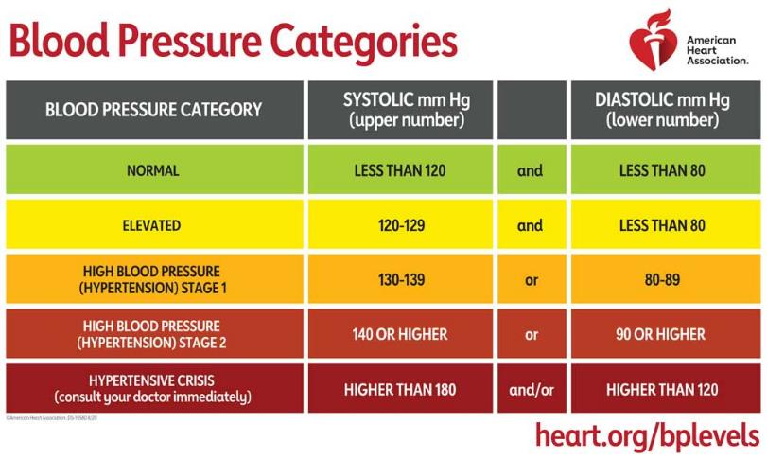
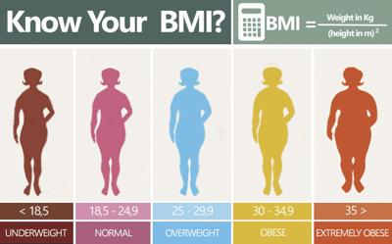
Numerical data- Examples
patient | height | age | blood_pressure | heart_rate | number_of_intervention
1 | 162.2 | 54 | 149 | 80 | 1
2 | 175.3 | 69 | 120 | 80 | 2
3 | 182.7 | 37 | 200 | 76 | 1
4 | 180.1 | 44 | 140 | 90 | 3
5 | 170.3 | 74 | 110 | 76 | 1
6 | 177.6 | 39 | 140 | 80 | 2
7 | 190.1 | 43 | 118 | 85 | 1
8 | 199.5 | 57 | 126 | 58 | 1
9 | 175.3 | 39 | 170 | 104 | 3
10 | 168.5 | 51 | 143 | 89 | 1
11 | 171.6 | 64 | 159 | 109 | 1
12 | 172.9 | 63 | 139 | 64 | 2
13 | 183.4 | 47 | 126 | 108 | 3
14 | 176.5 | 76 | 120 | 90 | 1
15 | 169.6 | 54 | 130 | 82 | 2
Can convert numerical to categorical data
BUT loss of information !!!
Notes:
So, discrete data can take only finite numbers.
For example the number of interventions or heart rate.
On the other hand, continuous data can take any numerical values within a range, and in this case we have infinite number of possible values.
For example blood pressure, height or weight
You can make numerical data into categorical, but you will lose information.

Slide 57
Data interpretation
DESCRIPTIVE STATISTICS
Measures of central tendency
Measures of variability (spread)
Notes:
When you want to interpret or describe your data the the easiest tools are descriptive statistics.
Descriptive statistics describes the basic features of the data in a study, and reduces data into a simplier summary.
When you’ll collect data for your meta-analysis, you’ll need to search for these information.
Descriptive statistics has two main categories. Measures of central tendency and measures of variability (spread).
Central tendency refers to the idea that there is one number that best summarizes the entire set of measurements, a number that is in some way “central” to the set.
Measures of variability are used to measure the amount of spread or dispersion within your data.

Slide 58
Describing the data with numbers
Measures of central tendency
Mean: average of a data set
Median: divides the data into 2 equal parts
Measures of variability (spread)
Standard error: tells you how far your sample mean deviates from the actual population mean
Standard deviation: the measurement of average distance between each quantity and the mean
Range: the difference between the highest and the lowest value
Quartiles: divide the data set into quarters
Notes:
There are two main types of central tendency: mean and median.
Mean is the average of a data set. In a way, it is a single number which can estimate the value of the whole data set.
Median is the value which divides the data into 2 equal parts, that is number of terms on the right side is the same as number of terms on left side when data is arranged in ascending or descending order.
There are four common measures of variability; standard error, standard deviation, range and quartiles.
Standard error tells you how far your sample mean deviates from the actual population mean.
Standard deviation is the measurement of average distance between each quantity and the mean. That is, how data is spread out from mean. A low standard deviation indicates that the data points tend to be close to the mean of the data set, while a high standard deviation indicates that the data points are spread out over a wider range of values.
Range is the difference between the highest (maximum) and the lowest (minimum) value. Sometimes you can find this parameter as range, or as minimum and maximum.
Quartiles are values that divide your data into quarters, provided data is sorted in an ascending order. There are three quartile values, where the second quartile is the median of the whole dataset. IQR stands for interquartile range and it is the difference between the third and the first quartile.

Slide 59
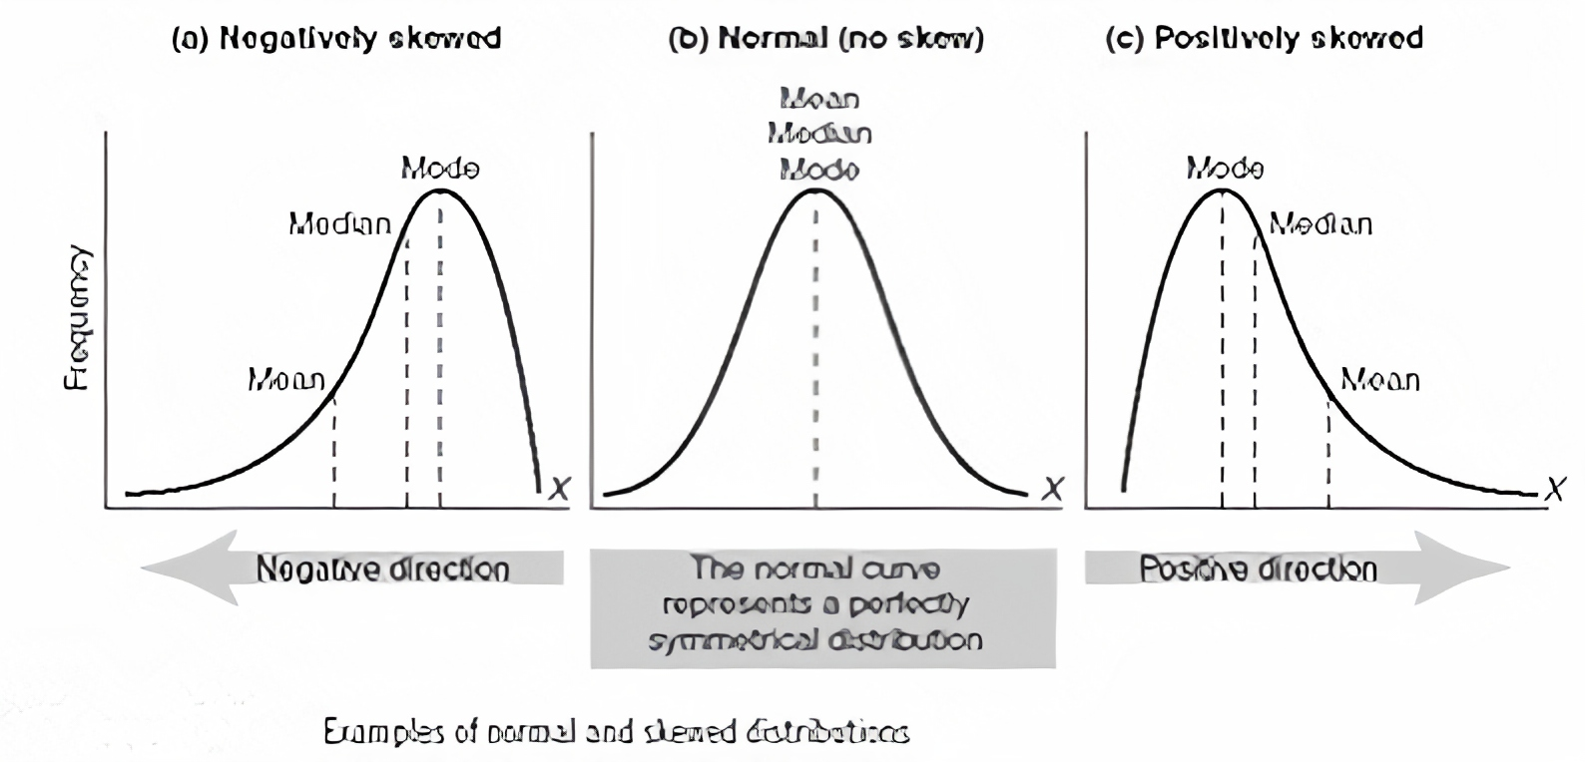
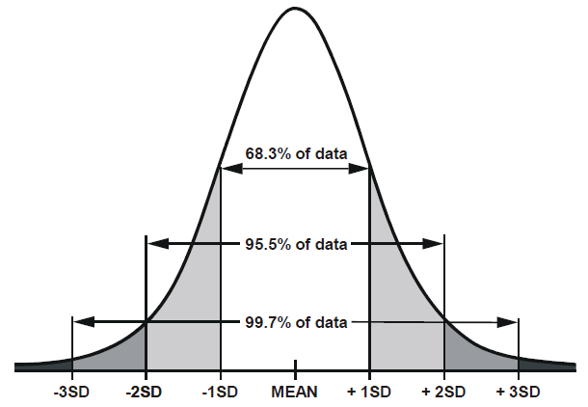
Distribution
Examples of normal and skewed distributions
(a) Negatively skewed
(b) Normal (no skew)
(c) Positively skewed
Mode
Median
Mode
Mean
Mode
Median
Median
Frequency
Mean
Mean
Negative direction
The normal curve
represents a perfectly
symmetrical distribution
Positive direction
Mean
Median
Mean
Median
Mean
Median
Notes:
A kind of central tendency belongs to a kind of a spread. To know which one use, we need to understand the distribution of our data.
Normal distribution is called symmetrical distribution as well. Symmetry means that one half of the distribution is a mirror image of the other half.
So normal distribution has no skew and it centerd around the mean. The tails are exactly the same. In the case of normal distribution the mean is equal to the median.
If one tail is longer than the other, the distribution is skewed.
These distributions are sometimes called asymmetric or asymmetrical distributions as they don’t show any kind of symmetry.
Sometimes it is important to transform skew distribution to normal, beacause some statistical trials has premise for the normal distribution.
It is a possibility to make for example a logarithmical transform, but in some cases, it is imposible to transform.

Slide 60
When do we use what?
Central tendency
Variability (spread)
Normal distribution
      standard error (SE)
      mean
      standard deviation (SD)
Skewed distribution
      range (min, max)
      median
      quartiles (Q1, Q3, IQR)
Notes:
When we think about numerical data collection, we need to keep in mind that mean or median is not enough to do statistics.
For one measure of central tendency you must collect at least one measure of variability.
Here you can see that for mean we usually collect standard error or standard deviation; and for median we usually collect range (or min/max), or quartiles (or IQR).

Slide 61
Special cases I.
Changes of fertility parameters (for example testosterone level)
using vitamin D
Notes:
Before we conclude the main rules of data collection, let’s take a look at 2 special cases of data collection.
Here you can see a part of a table for the changes of fertility parameters (for example testosterone level) using vitamin D.
We have values (mean and SD) before intervention (here, it means before using vitamin D), and after intervention.
It is crucial to collect also the p-values for the comparison between before and after values in every study, because studies without this value must be excluded from the analysis.
I highlighted the ideal studies with green.

Slide 62
Special cases II.
BAVENO VI recommendations for ruling out varices needing treatment against variceal screening endoscopy to reduce unnecessary endoscopies
Notes:
Here you can see another special case when researcher was studying BAVENO VI recommendations for ruling out varices needing treatment against variceal screening endoscopy to reduce unnecessary endoscopies. We have true positive, false positive, false negative and true negative parameters. When talking about diagnostic/prognostic accuracy, we need these raw data to conduct the analysis. Calculated data (for example the sensitivity) are not enough.
There are more special cases beside these 2 but at the first step we need to focus on the basic data collection only.

Slide 63
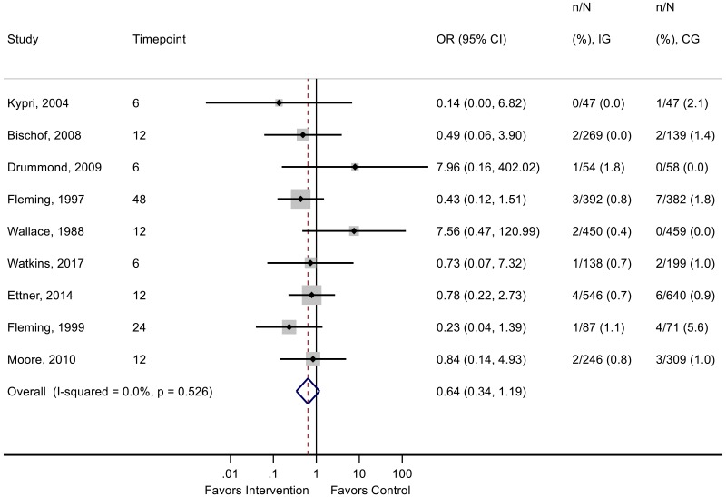
Forest plot- Categorical data
Abbreviations:
CG = control group;
CI = confidence interval;
IG = intervention group;
KQ = key question;
n = number of participants analyzed;
OR = odds ratio.
Note:
Timepoint is measured in months.

Slide 64
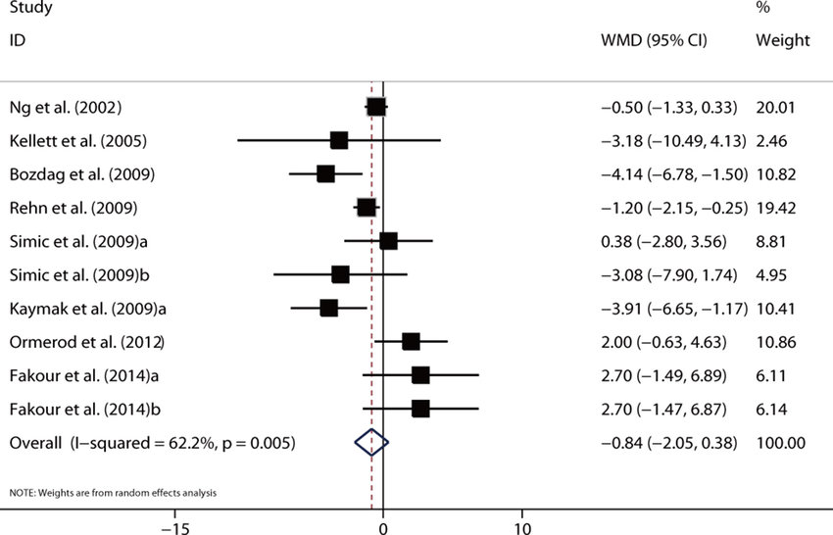
Forest plot- Continuous data

Slide 65
Types of data
TAKE HOME MESSAGE
one type of data into one cell!
name every column (number of patients, age…)
raw data (not interested in percentages)
one measure of variability for one measure of central tendency:
mean with standard error (SE) or standard deviation (SD)
median with range (min, max) or interquartiles (IQR)!
Categorical data: OR/RR, Numerical data: correlation, WMD, SMD
Notes:
At the end of this part of the meta-meeting, let’s gather the main rules of collecting data for meta-analysis.
The most important rule is that you need to collect one type of data into one cell. For example, when you collect minimum and maximum for a numerical parameter (for example for white blood cell count), you need to separate minimum and maximum into two distinct columns.
Use labels to name every column, because when we get your tables to conduct an analysis, you’ll refer to the parameters according to their names.
For all analysis, we need raw data. It means that if you have for example total number of patients, number of females and number of males, you don’t need to calculate the percentages.
And once again, for every measure of central tendency you must collect at least one measure of variability.

Slide 66
Practice
21-22nd September, 2020
University of Pécs
Pécs

Slide 67
Practice – Day 2, Session II.
1. How did they collect the data? Did the paper state all required detail of the process explicitly?
2. What types of variables did they have as outcomes? Categorical vs. continuous? Was there any unnecessary information reduction when creating categories?
3. Check the characteristics of the included studies in both papers. Do the PICO(ST) of the individual studies meet that of the meta-analysis fully?
You have 35 minutes to complete this task.

Slide 68
Session III.
Bias - the truth is beyond (extended)
moderator: Márk Félix Juhász

Slide 69
Bias and grade of evidence
Bálint Erőss

Slide 70
Flowchart
Question
Preliminary search
Search
Protocol
Data
collection
Bias assessment
Selection
Synthesis
Limitations
Implication
Dissemination of results

Slide 71

Key points
Concept of bias
Risk of bias assessment tools
Main steps of risk of bias assessment

Slide 72
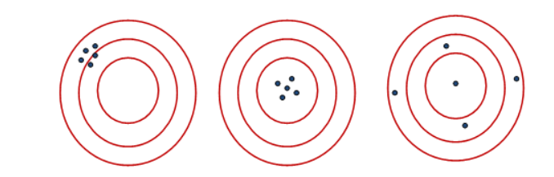
Errors in epidemiological studies
Bias
Imprecision
Systematic error
Random error
Sample size
Risk
Sample size
Risk

Slide 73

What is bias?
Bias is the deviation from the truth

Slide 74
Tools for risk of bias assessment
Randomized Controlled
Trials
Cochrane Risk of Bias
Tool-2
Non-randomized
Experimental interventional
ROBINS-I
Observational interventional
Diagnostic
QUADAS-2
Prognostic
QUIPS and PROBAST

Slide 75
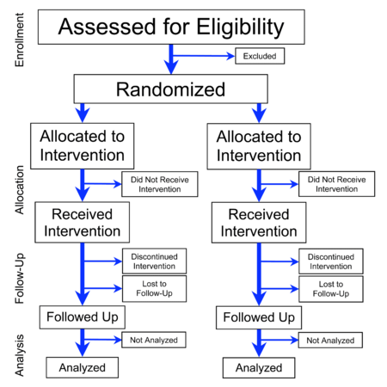
An ideal setting…
Only the treatment is different
Difference in outcomes is caused by treatment

Slide 76
An ideal setting…
Selection bias
Performance bias
Detection bias
Attrition bias (drop-outs)
publication
Reporting bias

Slide 77
The Cohrane Collaboration’s tool
Domain | Support for judgement | Review authors’ judgement
Selection bias.
Random sequence generation. | Describe the method used to generate the allocation sequence in sufficient detail to allow an assessment of whether it should produce comparable groups. | Selection bias (biased allocation to interventions) due to inadequate generation of a randomised sequence.
Allocation concealment. | Describe the method used to conceal the allocation sequence in sufficient detail to determine whether intervention allocations could have been foreseen in advance of, or during, enrolment. | Selection bias (biased allocation to interventions) due to inadequate concealment of allocations prior to assignment.
Performance bias.
Blinding of participants and personnel Assessments should be made for each main outcome (or class of outcomes). | Describe all measures used, if any, to blind study participants and personnel from knowledge of which intervention a participant received. Provide any information relating to whether the intended blinding was effective. | Performance bias due to knowledge of the allocated interventions by participants and personnel during the study.
Detection bias.
Blinding of outcome assessment Assessments should be made for each main outcome (or class of outcomes). | Describe all measures used, if any, to blind outcome assessors from knowledge of which intervention a participant received. Provide any information relating to whether the intended blinding was effective. | Detection bias due to knowledge of the allocated interventions by outcome assessors.
Attrition bias.
Incomplete outcome data Assessments should be made for each main outcome (or class of outcomes). | Describe the completeness of outcome data for each main outcome, including attrition and exclusions from the analysis. State whether attrition and exclusions were reported, the numbers in each intervention group (compared with total randomized participants), reasons for attrition/exclusions where reported, and any re-inclusions in analyses performed by the review authors. | Attrition bias due to amount, nature or handling of incomplete outcome data.
Reporting bias.
Selective reporting. | State how the possibility of selective outcome reporting was examined by the review authors, and what was found. | Reporting bias due to selective outcome reporting.
Other bias.
Other sources of bias. | State any important concerns about bias not addressed in the other domains in the tool. If particular questions/entries were pre-specified in the review’s protocol, responses should be provided for each question/entry. | Bias due to problems not covered elsewhere in the table.
Cochrane Handbook for Systematic Reviews of Interventions
Version 6
[updated in 2019]
Editors: Julian Higgins and James Thomas
Part 2, Chapter 8
https://training.cochrane.org/handbook/current/chapter-08

Slide 78
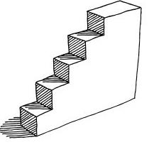
Steps of risk of bias assessment
Make a plan! (trial and error…test and modify)
Assessed by two review authors in duplicate!
Results of tools are non-summative
                Resolve discrepancies
                Reaching concensus
          Third party arbitration (expert in the field)
          Committee (experts in the field)

Slide 79
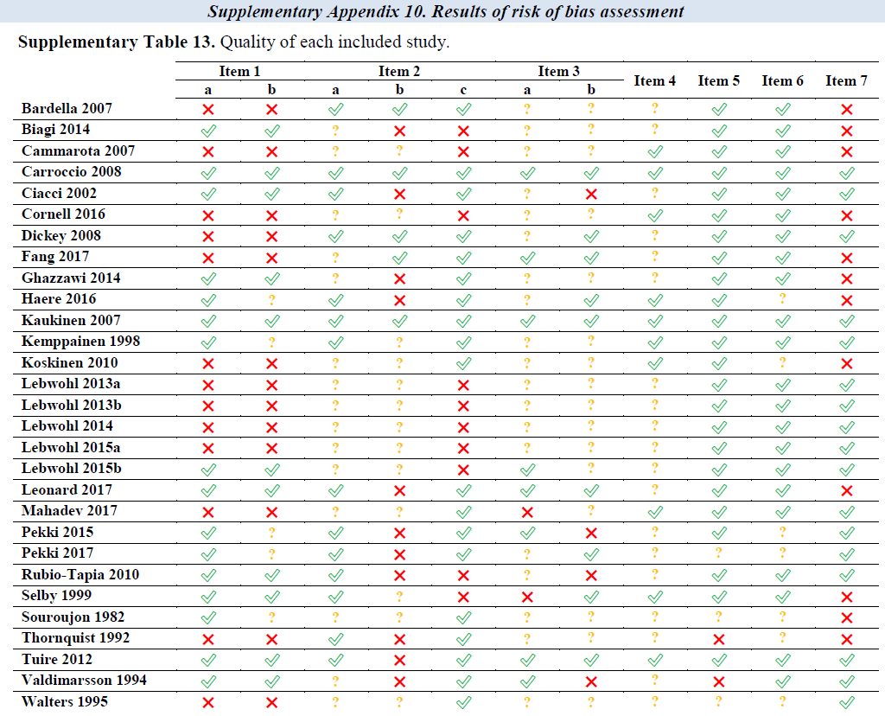
Instead the scores…
Use tables…

Slide 80
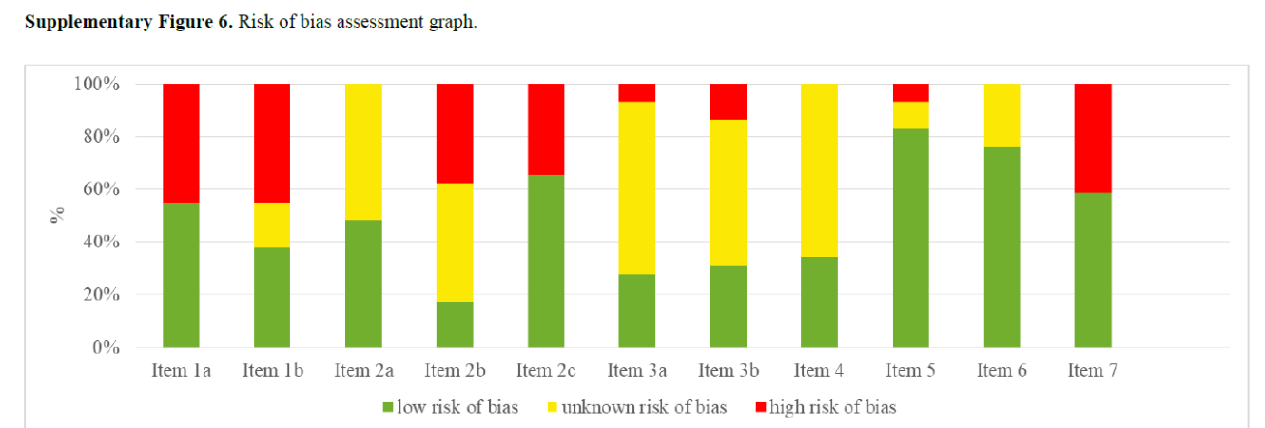
…or graphs!

Slide 81

Steps of risk of bias assessment
Incorporate RoB assessment in each section of manuscript
Methods: description of the tool
Results: brief description, a table and a graph
additional analysis based on RoB
Discussion: integrate into the interpretation
limitations and GRADE approach

Slide 82
Risk of bias assessment
TAKE HOME MESSAGE
Understand the concept of bias!
Assess risk of bias!
Integrate the results of risk of bias assessment!

Slide 83
Practice
21-22nd September, 2020
University of Pécs
Pécs

Slide 84
Practice – Day 2, Session III.
Interpret the main figures (forest plots and funnel plots) of the papers. Groups should compare at least Figure 2 panel A from sample paper 1 and Figure 3 panel A from sample paper 2 in a comparative manner (major CV outcomes).
Identify potential sources of bias along the Cochrane Risk of Bias Tool. Use the figures and charts of papers summarizing risk of bias.
Does bias carry the validity of the results? (G1-G3: Sample paper 1, G4-G6: Sample paper 2)
You have 25 minutes to complete this task.

Slide 85
Session IV.
Study protocol - Plan ahead
moderator: Szabolcs Kiss

Slide 86
Importance of the study protocol
Margit Solymár

Slide 87
Flowchart
Question
Preliminary search
Search
Protocol
Data
collection
Bias assessment
Selection
Synthesis
Limitations
Implication
Dissemination of results
Notes:
Registration should take place once the systematic review protocol has been finalized, but ideally before screening studies for inclusion begins.

Slide 88

Key points
Why is it necessary to register…
When to register…
How to register…
… a systematic review protocol?

Slide 89


Protocol registration- Why?
to facilitate careful planning
to avoid duplication
to reduce reporting bias
Aims:

Slide 90
Protocol registration- Why?
allows peer review of the planned protocol methods before they have been completed
promotes transparency of methods and processes
helps to publish well-designed review articles

Slide 91
What to publish? How to report your data?
Depending on the nature and direction of the results
Publication bias: The publication or non-publication of research findings
Time lag bias The rapid or delayed publication of research findings
Multiple (duplicate) publication bias: The multiple or singular publication of research findings
Location bias The publication of research findings in journals with different ease of access or levels of indexing in standard databases, the accessibility of studies based on variable indexing in electronic databases
Notes:
Studies with positive results are more likely to be accepted for publication than studies with negative results.
Studies with positive findings are likely to be published faster than studies with negative findings.
Studies with significant results are more likely to lead to multiple publications and presentations

Slide 92
What to publish? How to report your data?
Depending on the nature and direction of the results
Citation bias The citation or non-citation of research findings
Language bias The publication of research findings in a particular language
Outcome reporting bias The selective reporting of some outcomes but not others
Report all the outcomes that was planned to be measured in the protocol, irrespective of whether it is positive or negative.
Notes:
Do not cite studies that only support your own results, as this could lead peer reviewers to suspect bias.
Studies with positive results are more likely to be published in English-language journals.
Researchers working on a study in which multiple outcomes were measured are more likely to report positive outcomes than negative outcomes.

Slide 93

What is PROSPERO?
PROSPERO is an international database of prospectively registered systematic reviews in health and social care.
Key features from the review protocol are recorded and maintained as a permanent record.
Notes:
To reduce reporting bias we should have our protocol.

Slide 94
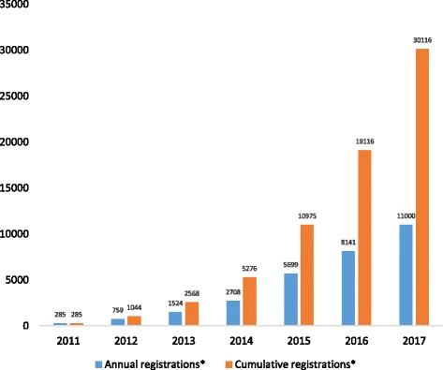
Number of PROSPERO registrations
Notes:
Registration of systematic review protocols in PROSPERO database increased rapidly between 2011 and 2017, thus benefiting users of health evidence who want to know about ongoing SRs.

Slide 95
PROSPERO database
Peer-reviewed
„Open access” system
Works in accordance with PRISMA-P recommendations
Free of charge
English
Gives a citable registration number

Slide 96
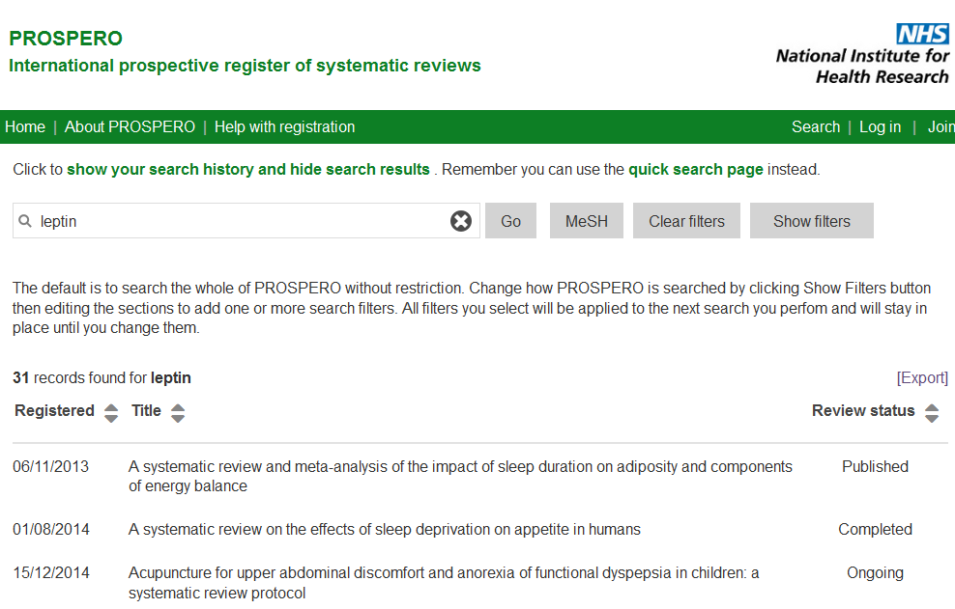
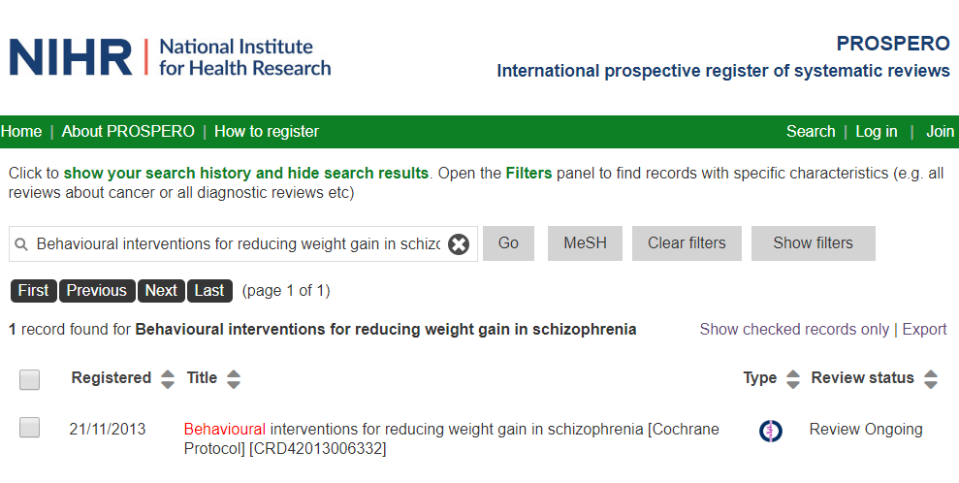

How to do it?
Search PROSPERO
http://www.crd.york.ac.uk/PROSPERO/
Notes:
Search PROSPERO to ensure that your review has not already been registered previously.

Slide 97
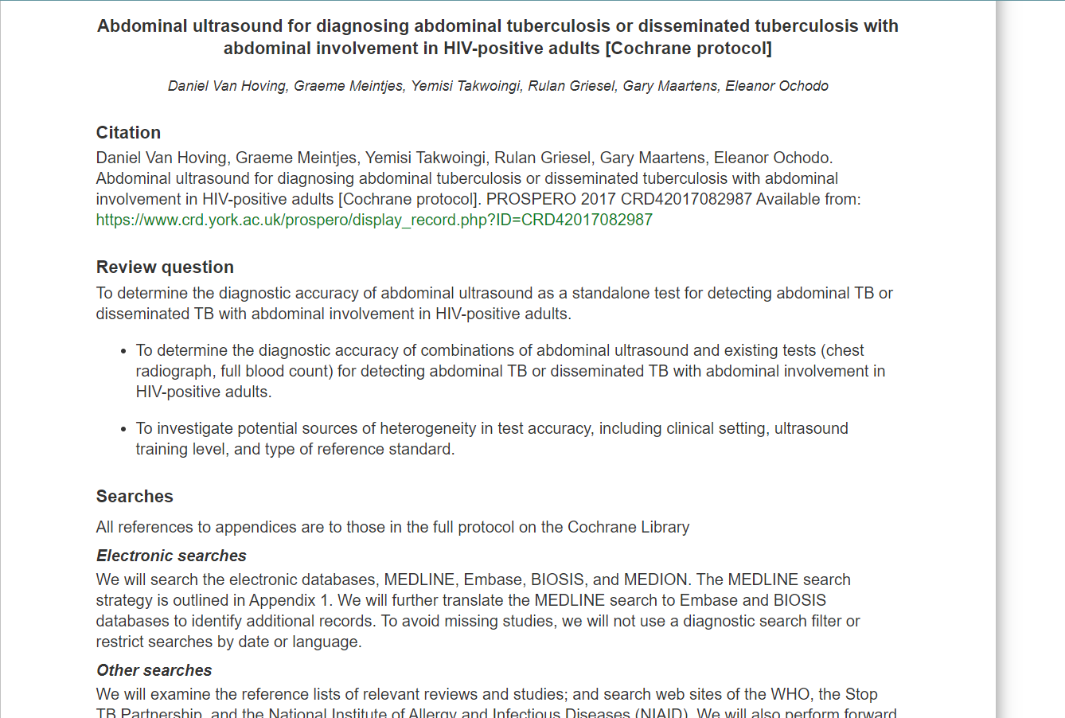

How to do it?
Read protocols similar
to your topic!

Slide 98

How to register your protocol?
Notes:
Join, and log in and you can start registering your protocol….

Slide 99
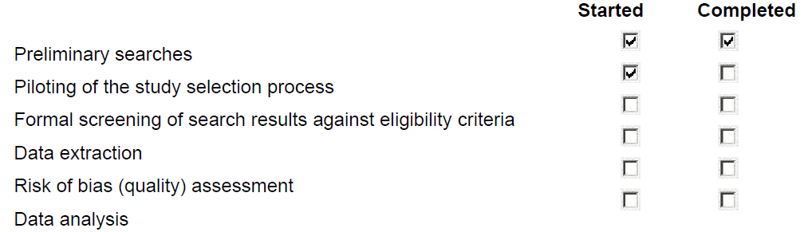
How to register your protocol
Stage of review at time of registration
Notes:
First you will get several questions, for example about your stage of review.
Green fields are optional, but if you have started data extraction before registration, they will reject your protocol.

Slide 100
Practical tips
Read Cochrane review protocols in the PROSPERO database for ideas.
Exact description of your PICO, outcomes and statistical methods is highly important.
If your PICO is not clear, it leads to significant delay of the registration due to a new review process.
Maintain future tense throughout your sentences as this is prospective registration.
If you are unsure about your plans use phrase „we plan to…” instead of „we will do that…”.

Slide 101

Practical tips
Keywords help users find your review in the Register. Always give keywords to your protocol.
Review status should be updated when the review is completed and when it is published.
Changes can be made but a brief explanation of the reason should be given. Edits will appear in the public record.

Slide 102

How can our team help you?
1. First you prepare your protocol with the help of your meta-analysis mentor.
2. Our team will review your protocol before submission.
3. You can submit your high-quality protocol.

Slide 103
Protocol registration
TAKE HOME MESSAGE
Protocol registration is a „must-have”!
Plan your protocol carefully - (example protocols: Cochrane Reviews)!
Publish everything what you planned to publish!

Slide 104
Practice
21-22nd September, 2020
University of Pécs
Pécs

Slide 105
Practice – Day 2, Session IV.
Compare the elements of the protocol and the sample paper. Are there deviations from the protocol?
Is there anything missing from the protocol?
You have 30 minutes to complete this task.

Slide 106
Session V.
Perspectives
moderator: Szabolcs Kiss

Slide 107
Beyond two interventions –
advanced meta-analytical techniques
Zsolt Szakács

Slide 108
Flowchart
Question
Preliminary search
Search
Protocol
Data collection
Bias assessment
Selection
Synthesis
Dissemination of results
Limitations
Implications

Slide 109
Let’s switch level…
Study-level
Individual-level
(IPD-M)
Unit: study
Only between-study variance
Control for co-variates: limited
Harmonization: limited
Subgroup analysis: limited
Unit: ‚participant’
Between- and within-study variance
Control for co-variates: effective
Harmonization: possible
Subgroup analysis: detailed

Slide 110


Let’s switch level…
Study-level
Individual-level
(IPD-M)
Imprecision
Indirectness
Inconsistency
Risk of bias

Slide 111
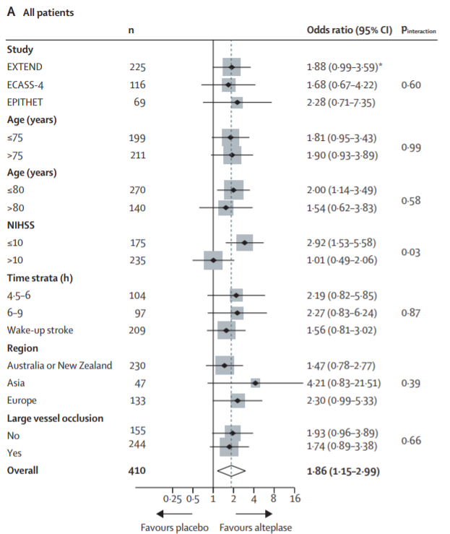
Let’s switch level…
Bruce et al. Extending thrombolysis to 4·5–9 h and wake-up stroke using perfusion imaging: a systematic review and meta-analysis of individual patient data. Lancet, 2019.

Slide 112
Let’s network…
Pairwise
meta-analysis
Network
meta-analysis
A
3
B
A
5
B
‚direct’ evidence
3
0
‚indirect’ evidence
C

Slide 113
Let’s network…
A
1
B
A
3
B
3
0
‚indirect’ evidence
‚direct’ evidence
C
Randomized and non-randomized studies
Minimum N⁰ of studies: ≥3
‚Easy’ statistics and interpretation
Only randomized studies
Minimum N⁰ of studies: ≥3+1
The more interventions, the more studies are required.
Difficult statistics and interpretation

Slide 114
Let’s network…
A
1
B
A
3
B
3
0
‚indirect’ evidence
‚direct’ evidence
C
Imprecision
Indirectness
Inconsistency
Risk of bias

Slide 115
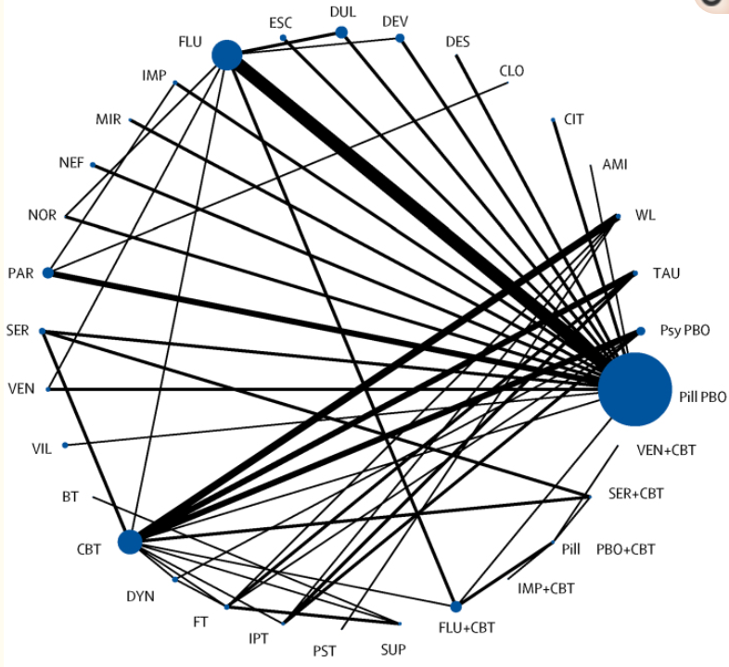
Let’s network…
Zhou et al. Comparative efficacy and acceptability of antidepressants, psychotherapies, and their combination for acute treatment of children and adolescents with depressive disorder: a systematic review and network meta-analysis. Lancet Psych, 2020.

Slide 116
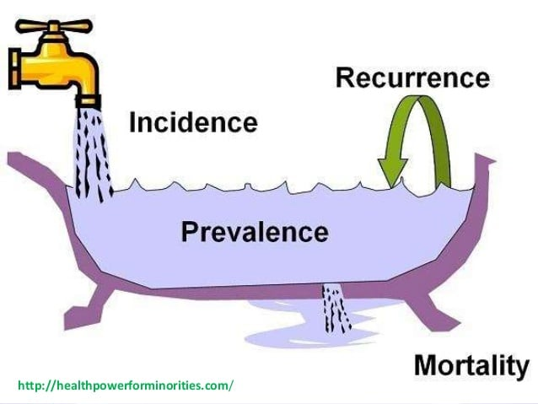
Beyond interventions…
‚How common?’
Particularly useful for rare events to improve precision
Descriptive vs. comparative (absolute vs. relative metrics)
Beware of indirectness

Slide 117

Beyond interventions…
‚I don’t know if I can make it…’
Prognostics vs. prediction
Thinking in 2x2 tables and prognostic metrics
sensitivity, specificity
predictive values
likelihood ratios
prognostic odds ratio

Slide 118
Beyond interventions…
‚I don’t know if I can make it…’
Univariate analysis
=> what you can see…
Multivariate analysis
  => cause-effect (?)
  => scores

Slide 119
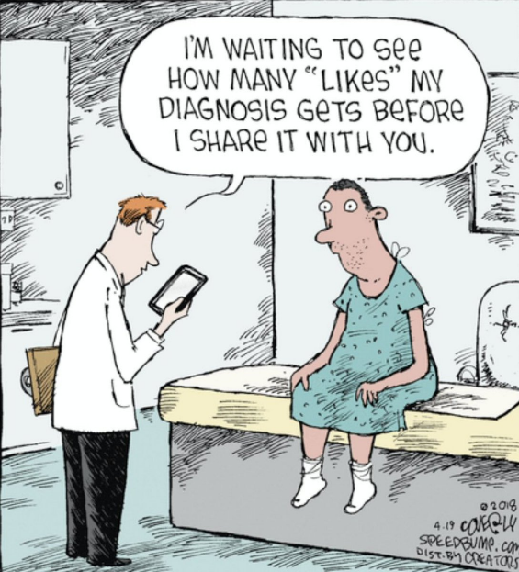
Beyond interventions…
‚Should I order a CT scan?’
Comparison of diagnostic modalities
Thinking in 2x2 tables and diagnostic metrics
sensitivity, specificity
predictive values
likelihood ratios
prognostic odds ratio

Slide 120
Beyond interventions…
‚Should I order a CT scan?’
Invasive vs. non-invasive?
Cheap vs. expensive?
Old vs. new?
Problem: a gold standard is always needed

Slide 121
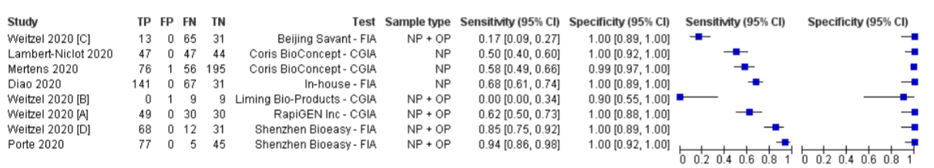
Beyond interventions…
Dinnes et al. Rapid, point-of-care antigen and molecular-based tests for diagnosis of SARS-CoV-2 infection. Cochrane Database Syst Rev, 2020.

Slide 122
TAKE HOME MESSAGE
We recommend starting with a simple, interventional meta-analysis first.
Consult experts before starting individual patient data or network meta-analysis.

Slide 123
TRANSLATIONAL MEDICINE
taking discoveries for patients benefits
TITLE
ABSTRACT
INTRODUCCTION
METHODS
RESULT
DISCUSSION
CONCLUSION

Slide 124
TRANSLATIONAL MEDICINE
taking discoveries for patients benefits
WHICH ORDER SHOULD I START?

Slide 125
TRANSLATIONAL MEDICINE
taking discoveries for patients benefits
TITLE
ABSTRACT
INTRODUCTION
METHODS
RESULTS
DISCUSSION
CONCLUSIONS

Slide 126
TRANSLATIONAL MEDICINE
taking discoveries for patients benefits
TITLE
ABSTRACT
INTRODUCTION
METHODS
RESULTS
DISCUSSION
CONCLUSIONS

Slide 127
TRANSLATIONAL MEDICINE
taking discoveries for patients benefits
TITLE
ABSTRACT
INTRODUCTION
METHODS
RESULTS
DISCUSSION
CONCLUSIONS

Slide 128
TRANSLATIONAL MEDICINE
taking discoveries for patients benefits
TITLE
ABSTRACT
INTRODUCTION
METHODS
RESULTS
DISCUSSION
CONCLUSIONS

Slide 129
TRANSLATIONAL MEDICINE
taking discoveries for patients benefits
TITLE
ABSTRACT
INTRODUCTION
METHODS
RESULTS
DISCUSSION
CONCLUSIONS

Slide 130
TRANSLATIONAL MEDICINE
taking discoveries for patients benefits
TITLE
ABSTRACT
INTRODUCTION
METHODS
RESULTS
DISCUSSION
CONCLUSIONS

Slide 131
TRANSLATIONAL MEDICINE
taking discoveries for patients benefits
TITLE
ABSTRACT
INTRODUCTION
METHODS
RESULTS
DISCUSSION
CONCLUSIONS

Slide 132
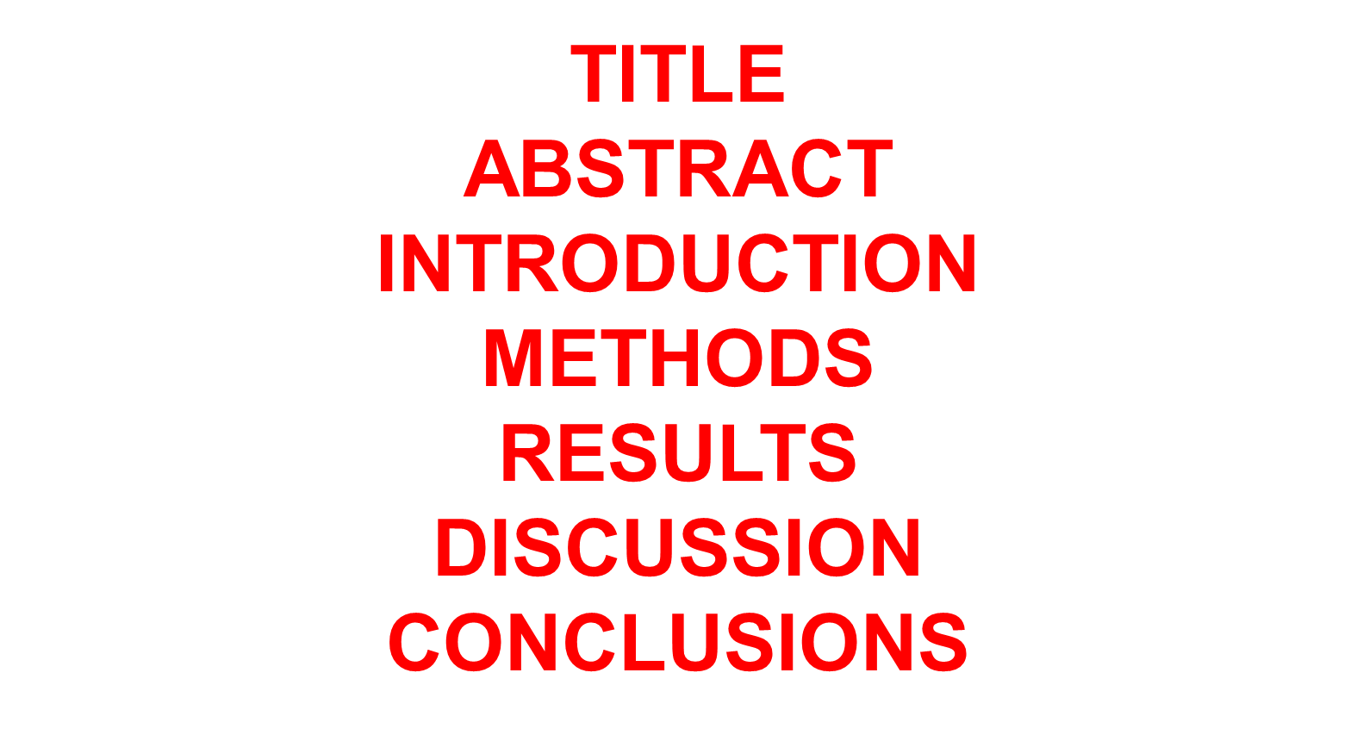
TRANSLATIONAL MEDICINE
taking discoveries for patients benefits
DOI: http://dx.doi.org/10.1053/j.gastro.2014.11.002
IF:18.392

Slide 133
TRANSLATIONAL MEDICINE
taking discoveries for patients benefits
CONCLUSIONS
The most usable ones in practice
No more than two or three points
Highlight the importance
Point the the future
Based on studies of human, mouse, and guinea pig pancreata, alcohol disrupts expression and localization of the CFTR. This appears to contribute to development of pancreatitis. Strategies to increase CFTR levels or function might be used to treat alcohol-associated pancreatitis.

Slide 134
TRANSLATIONAL MEDICINE
taking discoveries for patients benefits
RESULTS
point by point (like in the guidelines)
put them in a logical order (make a story)
put only the undisposable ones into the main text (must have)
put into the section which justify your conclusion
put every other figures to the supplementary part (nice to have)
connect them
highlight the new discoveries, make a table
you can change the order at any time

Slide 135
TRANSLATIONAL MEDICINE
taking discoveries for patients benefits
RESULTS
1. Alcohol Consumption Decreases CFTR Activity and Expression in Human Subjects
2. Ethanol and Fatty Acid Impair Pancreatic Fluid and Bicarbonate Secretion and Inhibit CFTR Cl− Channel Activity In Vivo and In Vitro
3. Low Concentration of Ethanol Stimulates Both the Apical SLC26 Cl−/HCO3− Exchanger and CFTR via Inositol Triphosphate Receptor–Mediated Ca2+ Signaling
4. High Concentration of Ethanol Inhibits Both the Apical SLC26 Cl−/HCO3− Exchanger and CFTR
5. High Concentrations of Ethanol and POA Induce Sustained Elevation of [Ca2+]i, Decreased Mitochondrial Function and Adenosine 3′,5′-Cyclic Monophosphate Level
6. Ethanol and Nonoxidative Ethanol Metabolites Cause Translocation and Expression Defect of CFTR
7. Ethanol and Its Metabolites Decrease CFTR Expression and Plasma Membrane Density via Accelerated Channel Plasma Membrane Turnover and Damaged Protein Folding
8. Genetic Deletion of CFTR Increases the Severity of Alcohol-Induced Pancreatitis

Slide 136
TRANSLATIONAL MEDICINE
taking discoveries for patients benefits
TITLE
Avoid: „chatacterization…., effects of…, investigation of…
The strongest short statement
Alcohol Disrupts Levels and Function of the Cystic Fibrosis Transmembrane Conductance Regulator to Promote Development of Pancreatitis

Slide 137
TRANSLATIONAL MEDICINE
taking discoveries for patients benefits
INTRODUCTION
Two or three relevant points which introduce the necessity of the work
Do not describe important knowledge which is not relevant to understand the study
Acute pancreatitis (AP) is the most common cause of hospitalization for nonmalignant gastrointestinal diseases in the United States, with an estimated annual cost of at least $2.5 billion.¹ The mortality of the disease is unacceptably high, and no specific pharmaceutical therapy is currently available. Therefore, there is a pressing economic and clinical need to develop new therapies for patients with AP.
Immoderate alcohol consumption is one of the most common causes of AP and chronic pancreatitis (CP),
CFTR…. these data suggest that changes in the function or expression of the CFTR Cl⁻channels in pancreatic ductal epithelial cells (PDECs), which alone express CFTR in the exocrine pancreas,⁸ may play a central role in the pathogenesis of alcohol-induced pancreatitis.

Slide 138
TRANSLATIONAL MEDICINE
taking discoveries for patients benefits
DISCUSSION
Discuss all the relevant articles which support or are against your results
AVOID: repeating the result session
Do not describe important knowledge which is not relevant to understand the study
describe the limitations
Highlight the usefulness of the result
Taken together, our observations provide evidence that loss of CFTR function not only plays a crucial role in CFTR mutation–related pancreatitis but also contributes to the pathogenesis of alcohol-induced pancreatitis. These data indicate that correcting CFTR function should offer therapeutic benefit in AP.

Slide 139
TRANSLATIONAL MEDICINE
taking discoveries for patients benefits
METHODS
Only a summary of the method
All details can go to the supplementary materials
Must be repeatable (!!)

Slide 140
TRANSLATIONAL MEDICINE
taking discoveries for patients benefits
HOW TO AVOID PLAGIARISM?

Slide 141
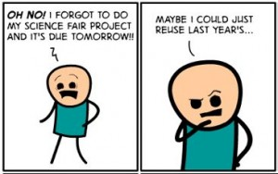
Concept of plagarism
      Plagiarism is unauthorized appropriation of other people’s ideas, processes or text without giving correct credit and with intention to present it as own property.
      Source: Mehić B. (2013). Plagiarism and self-plagiarism. Bosnian journal of basic medical sciences, 13(3), 139. https://doi.org/10.17305/bjbms.2013.2344
      Self-plagiarism: as bad as plagarism
This Photo by Unknown Author is licensed under CC BY-SA

Slide 142

Concept of plagiarism
Article retractions irreversibly damage the authors’ reputation. The scientific community begins doubting the integrity of the concerned research group. Journals avoid entertaining authors whose articles have been retracted on previous occasions. Even high-profile researchers find it difficult to publish again, after a retraction. Authors with retracted journal articles sometimes also lose their jobs. If the fraud committed is extremely serious, then they face legal repercussions and even imprisonment.

Slide 143

A recent example…
      ”too many results”: let’s make it double
      TIME
      Manuscript 1: Submitted, under review
      Manuscript 2: Submitted without refering to MS1
      Manuscript 1: Published
      Manuscript 2: Retracted because of self-plagarism

Slide 144


How to avoid this?
      Mistakes:
      Not referring to the previous manuscript
      Self-plagarism
      Untransparency
      Prevention:
      Automatic and manual plagarism screening
      Transparent publication strategy

Slide 145
TRANSLATIONAL MEDICINE
taking discoveries for patients benefits
WHAT IS OUR TIMETABLE?

Slide 146

TRANSLATIONAL MEDICINE
taking discoveries for patients benefits
6 MEETINGS
AIM
1
21-22 September 2020
EDUCATION
2
15 October 2020
SUPPORT PROVIDED BY
3
10 November 2020
course presentations
course material (pdf)
sample and blank ppts for the next presentation
sample and blank xls for the next presentation
sample articles
4
1 December 2020
5
2 February 2021
6
2 March 2021

Slide 147
TRANSLATIONAL MEDICINE
taking discoveries for patients benefits
6 MEETINGS
AIM
1
21-22 September 2020
SEARCH FOR PRELIMINARY
IDEAS AND CHECKING FEASIBILITY
2
15 October 2020
3
CONTACT PERSON PROVIDED BY
10 November 2020
4
1 December 2020
SZABOLCS KISS
5
2 February 2021
DURATION
6
2 March 2021
THREE WEEKS

Slide 148
TRANSLATIONAL MEDICINE
taking discoveries for patients benefits
6 MEETINGS
AIM
1
21-22 September 2020
DISCUSSION OF THE NEW PROJECTS
2
15 October 2020
SUPPORT PROVIDED BY
list of appointed statistitians (continous communication)
list of appointed consultants (continous communication)
sample and blank ppts for the next presentation
3
10 November 2020
4
1 December 2020
5
2 Februay 2021
VENUE: BASED ON EPIDEMIOLOGICAL RESTRICTIONS
6
2 March 2021

Slide 149
TRANSLATIONAL MEDICINE
taking discoveries for patients benefits
6 MEETINGS
AIM
1
21-22 September 2020
COMPLETION OF SYSTEMATIC SEARCH AND SELECTION
2
SUPPORT PROVIDED BY
15 October 2020
reference managemant software
tool for assessing inter-investigator agreement
standardized protocol for search and selection
appointed consultants (continous communication)
3
10 November 2020
4
1 December 2020
DURATION
5
2 Februay 2021
FOUR WEEKS
VENUE: BASED ON EPIDEMIOLOGICAL RESTRICTIONS
6
2 March 2021

Slide 150
TRANSLATIONAL MEDICINE
taking discoveries for patients benefits
6 MEETINGS
AIM
1
21-22 September 2020
COMPLETION OF DATA COLLECTION
2
15 October 2020
SUPPORT PROVIDED BY
3
10 November 2020
preliminary data collection sheet
appointed statistitians (continous communication)
appointed consultants (continous communication)
4
1 December 2020
DURATION
5
2 Februay 2021
THREE WEEKS
VENUE: BASED ON EPIDEMIOLOGICAL RESTRICTIONS
6
2 March 2021

Slide 151
TRANSLATIONAL MEDICINE
taking discoveries for patients benefits
6 MEETINGS
AIM
INTERPRETATION OF RESULTS
1
21-22 September 2020
SUPPORT PROVIDED BY
2
15 October 2020
sample and blank ppts for the next presentation
appointed statistitians (continous communication)
appointed consultants (continous communication)
private consultations for the projects (RoB, GRADE)
3
10 November 2020
4
1 December 2020
DURATION
5
2 February 2020
EIGHT WEEKS
VENUE: BASED ON EPIDEMIOLOGICAL RESTRICTIONS
6
2 March 2021

Slide 152
TRANSLATIONAL MEDICINE
taking discoveries for patients benefits
AIM
6 MEETINGS
PRESENTATION OF METHODS AND RESULTS SECTION OF THE MANUSCRIPT
1
21-22 September 2020
SUPPORT PROVIDED BY
2
15 October 2020
methodological review of these sections
list of appointed statistitians and consultants (continous communication)
choosing target journal and publication strategy
3
10 November 2020
4
1 December 2020
5
2 Februay 2021
DURATION
FOUR WEEKS
6
2 March 2021
CAN BE PERFORMED IN PÉCS

Slide 153
TRANSLATIONAL MEDICINE
taking discoveries for patients benefits
6 MEETINGS
AIM
1
21-22 September 2020
FINALIZATION AND SUBMISSION OF THE MANUSCRIPT
2
15 October 2021
CONTACT PERSON PROVIDED BY
3
10 November 2020
PREPARATION Szabolcs Kiss & Fanni Dembrovszky
METHODOLOGY Szabolcs Kiss & Fanni Dembrovszky
LANGUAGE Bálint Erőss
STRATEGY Péter Hegyi
4
1 December 2020
5
2 Februay 2021
AFTER THE 6TH MEETING
6
2 March 2021

Slide 154
TRANSLATIONAL MEDICINE
taking discoveries for patients benefits
WHAT IS OUR PUBLICATION STRATEGY?

Slide 155
TRANSLATIONAL MEDICINE
taking discoveries for patients benefits
YOU CAN BE AN AUTHOR
ONLY IF YOU ARE SCIENTIFICALLY INVOLVED!

Slide 156
TRANSLATIONAL MEDICINE
taking discoveries for patients benefits
You must be involved in either of the followings:
Study design, methods, data collection, analyses, writing the article, review and correction, etc.

Slide 157
TRANSLATIONAL MEDICINE
taking discoveries for patients benefits
You will be appointed to be involved in some of the studies based on your expertise
if you perform a meta-analyses.
You can accept or decline the challenge
Within months you can have 2-4 articles
based on your activity.

Slide 158
TRANSLATIONAL MEDICINE
taking discoveries for patients benefits
THANK YOU FOR THE WHOLE TEAM!

