Slide 1
Vérzéses sokk, hemosztázis
- Dr. Tánczos Krisztián, PhD -
Notes:
Ladies and gentlemen, deer collages! It is my verygreat pleasure to be here, and I am honored to talk about these point of care devices and about our experiences gained in monitoring severly bleeding patients.

Slide 2
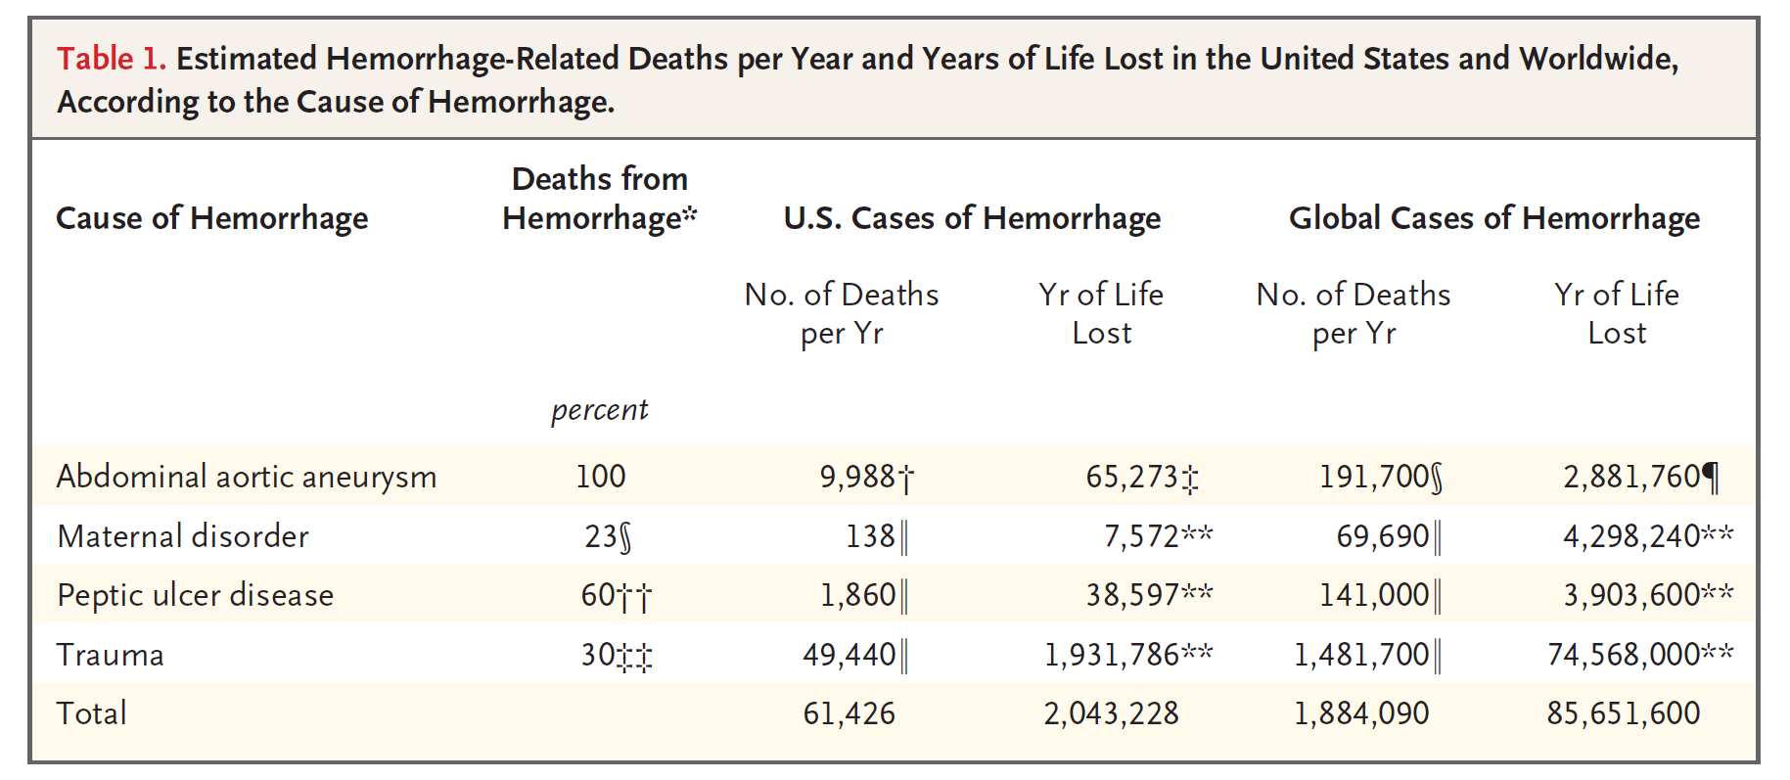
Epidemiológiai adatok
JW. Cannon. N Engl J Med 2018;378:370-9.

Slide 3
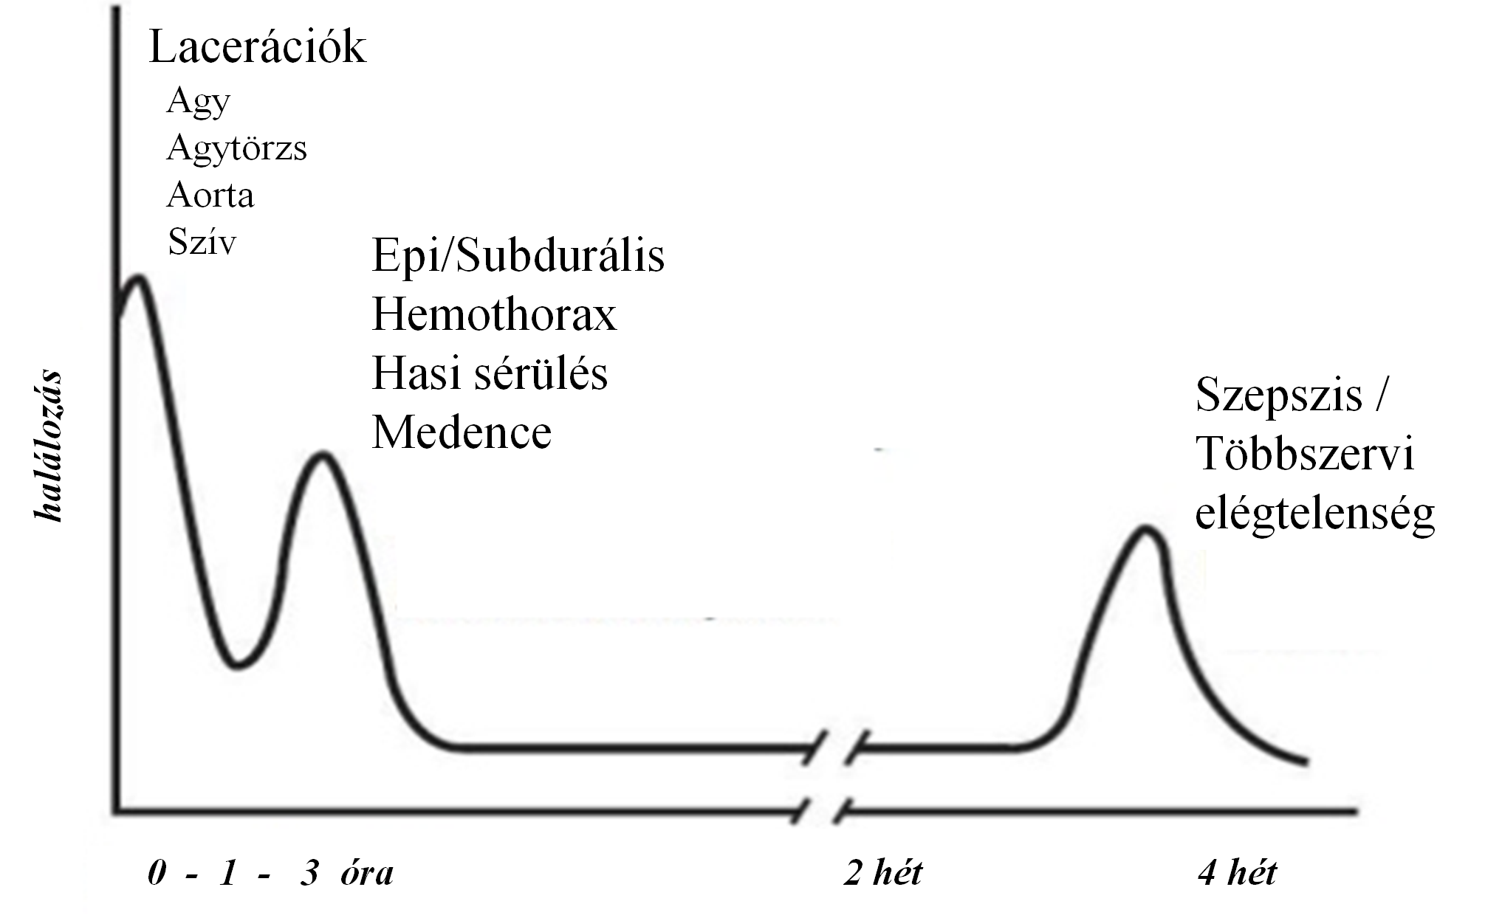
Epidemiológiai adatok
Shere-Wolfe et al. Scand J Trauma, Resuscitation and Em Med 2012; 20:68
A súlyos sérülés (10%) a balesethez köthető halálozás ~ 90 %-a
vezető halálok a 45 év alatti populációban
Trimodális eloszlás a mortalitásban
Vérzéses sokk
Notes:
According to the european trauma registries, true polytrauma using AIS criteria occurs in only 10% of all trauma cases, but causes up to half of all deaths in trauma patients reaching hospital alive, and moreover trauma is the leading cause of death mainly in male children and young adults.
In the civil society road traffic collision and so the blunt trauma is the predominant cause. The extremities and the pelvis are the most frequently injured body areas and most polytrauma deaths occur in the context of head and thoracic trauma.
It is well known that there is a trimodal distribution of mortality in severly injured patients – At the scene of injury lacerations of vital organs lead to immidiate death. In patients reaching the hospital head and thoracic injuries and mostly bleeding are the main causes of death while a few weeks later sepsis caused multiorgan dyfunction become the predominant cause.
In this session we will have presentations about head and chest injuries, and yesterday we had a whole section about the septic patients therefore in this lecture I will talk mainly about the bleeding management.

Slide 4
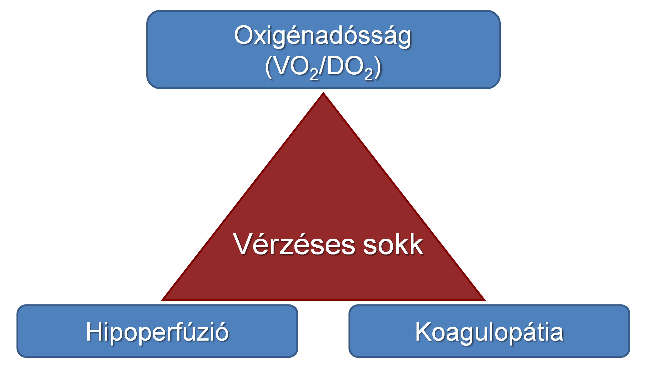
Paradigmaváltás az ellátásban
Tánczos K. et al.: Intensive Care Med 2015;41:712-715
Notes:
Rate of weaning failure after a single SBT is reported to be 26–42%(table 2) [17, 22]. This variation in the rate ofweaning failure among the studies may be due to differences in the definition of weaning failure, especially differences in the subjective indexes used to define failed SBT, or variation in the patients studied. For
instance, chronic obstructive pulmonary disease (COPD) appears as an independent risk factor for increased duration of
weaning and weaning failure [18]. VALLVERDU et al. [17] reported that weaning failure occurred in as many as 61% of COPD patients, in 41% of neurological patients and in 38% of hypoxaemic patients. Contradictory results exist regarding the rate of weaning success among neurological patients [13, 17]. The study by COPLIN et al. [13] of brain-injured patients demonstrated that 80% of patients with a Glasgow coma score ,8 and 91% of patients with a Glasgow coma score ,4 were successfully extubated. Finally, as shown in table 2, in 2,486 patients from six randomised studies, 524 patients failed SBT and 252 failed extubation after passing SBT, leading to a total weaning failure rate of 31.2%

Slide 5
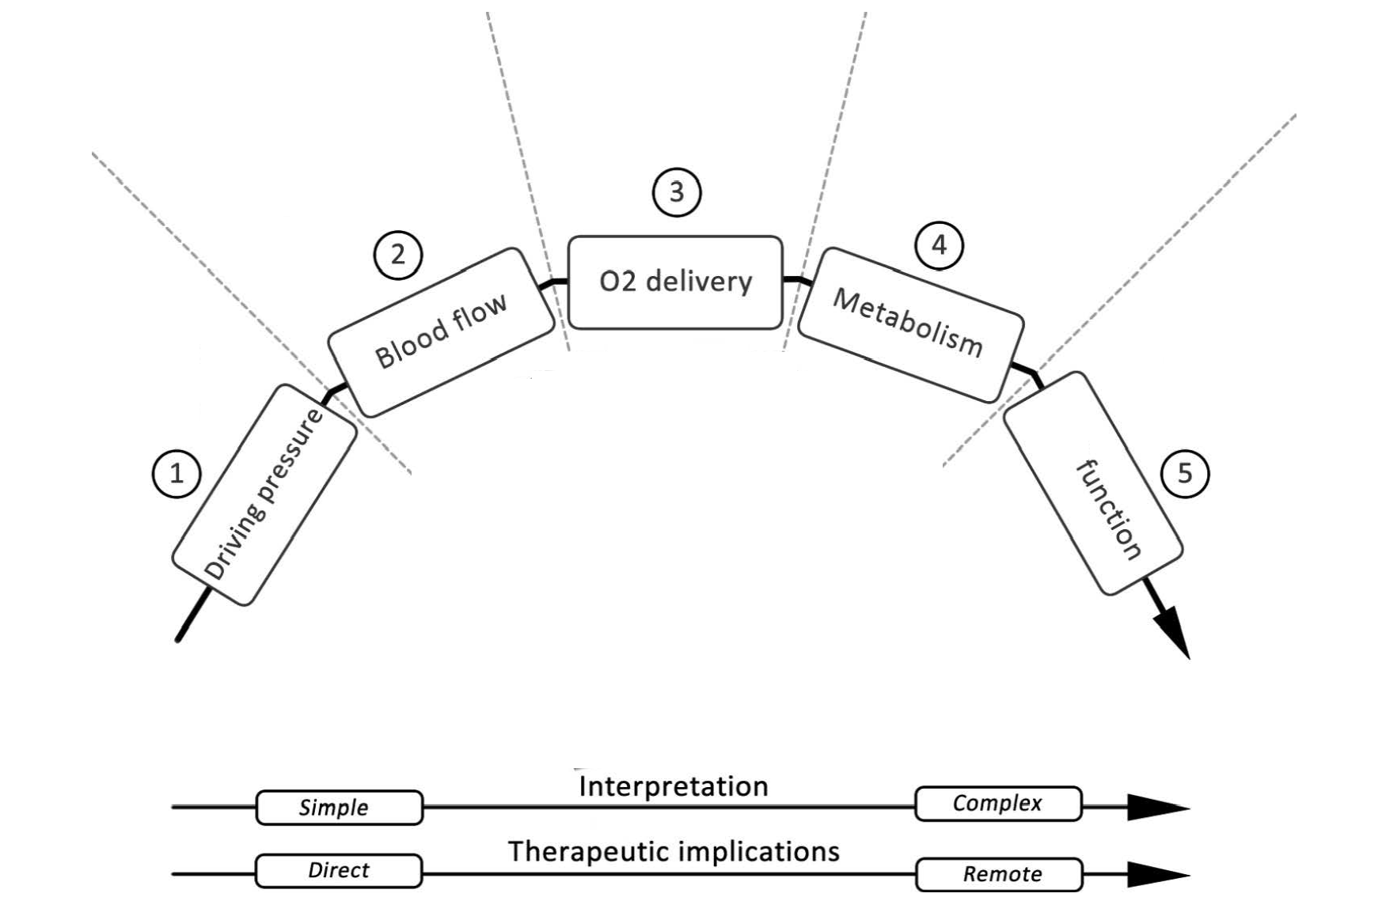
Oxigénháztartás - Élettan
Neuro-hormonális kontroll
Hgb
SaO₂
Aktivitás
Kor
Hőmérséklet
CO
MAP
Tudat, diurézis…
Organ
Oxigénextrakció
ScvO₂
DO₂
VO₂
Dinamikusan változó paraméterek !!!
Squara Critical Care 2014, 18:579
Notes:
5
It is well known that the adequacy of tissue oxygenation is determined by the balance between the rate of oxygen transport to the tissues and the rate at which the oxygen is used by the tissues.
In order to maintain this balance we need to ensure not just an optimal driving pressure but also a sufficient quantity and quality of blood.
Therefor there is no one, single hemodanamically parameter with a set value, which one should treat or follow as a target,
Rather it is necessary to put all these hemodynamic variables and measures of oxigen delivery and consumption into context in a way that once macro-hemodynamic parameters are “normalized,” adequacy of treatment has to be checked by measures of oxygen debt.
However if its hold true for the global hemodynamic optimization why we shuoldnt use this concept in the case of cerebral hemodanymic optimization?
Measuring the ICP and cerebral perfusion pressure give us important information about the driving pressure, we can estimate the cerebral blood flow by using TCD, while oxigen debt of brian tissue may be indicated by different brain tissue oxigenisation parameters.

Slide 6
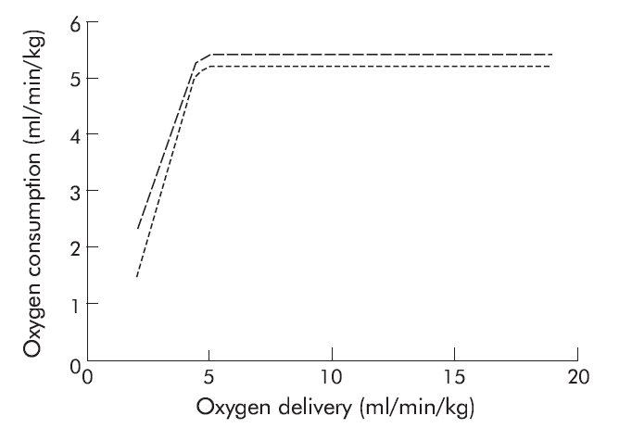
Súlyos vérzés = oxigéndeficit
Vincent JL et al. Int. Care Med 1990; 16:145–148
DO₂ < VO₂
DO₂ = (SVxP) x CaO₂
Hipovolémia
Anémia
Hipoperfúzió
Fájdalom
Stressz
laktát
Oxigén
extrakció
pulzusszám
Notes:
Rate of weaning failure after a single SBT is reported to be 26–42%(table 2) [17, 22]. This variation in the rate ofweaning failure among the studies may be due to differences in the definition of weaning failure, especially differences in the subjective indexes used to define failed SBT, or variation in the patients studied. For
instance, chronic obstructive pulmonary disease (COPD) appears as an independent risk factor for increased duration of
weaning and weaning failure [18]. VALLVERDU et al. [17] reported that weaning failure occurred in as many as 61% of COPD patients, in 41% of neurological patients and in 38% of hypoxaemic patients. Contradictory results exist regarding the rate of weaning success among neurological patients [13, 17]. The study by COPLIN et al. [13] of brain-injured patients demonstrated that 80% of patients with a Glasgow coma score ,8 and 91% of patients with a Glasgow coma score ,4 were successfully extubated. Finally, as shown in table 2, in 2,486 patients from six randomised studies, 524 patients failed SBT and 252 failed extubation after passing SBT, leading to a total weaning failure rate of 31.2%
6

Slide 7
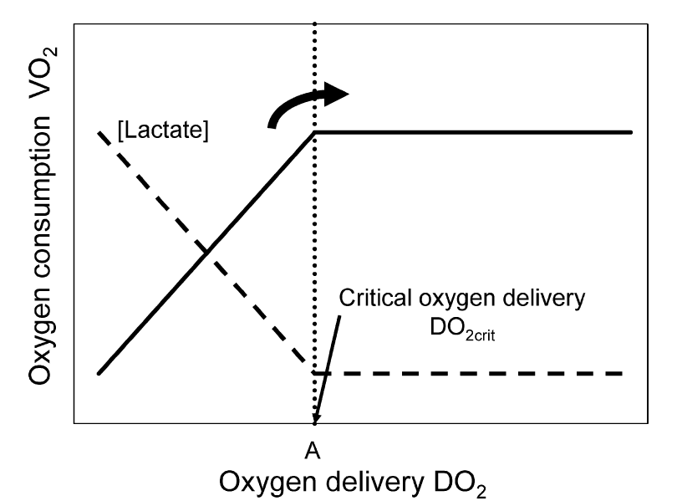
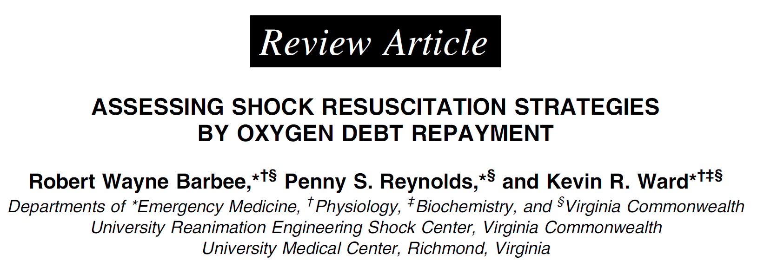
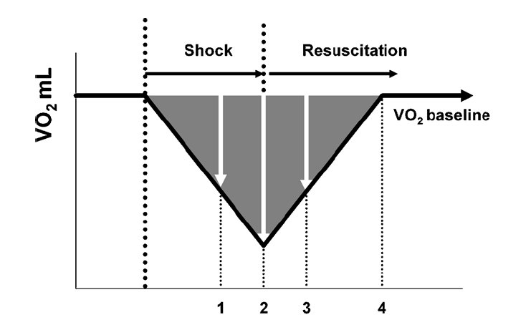
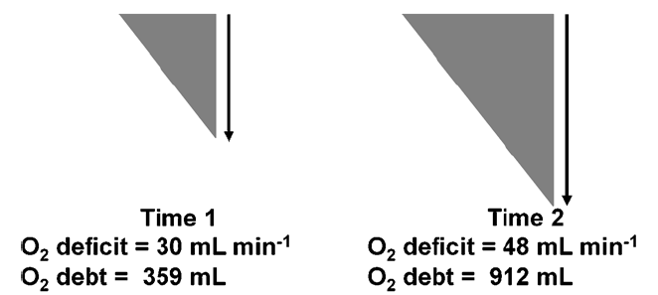
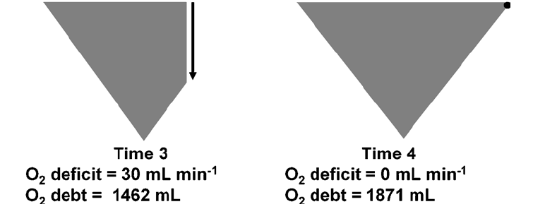

Slide 8
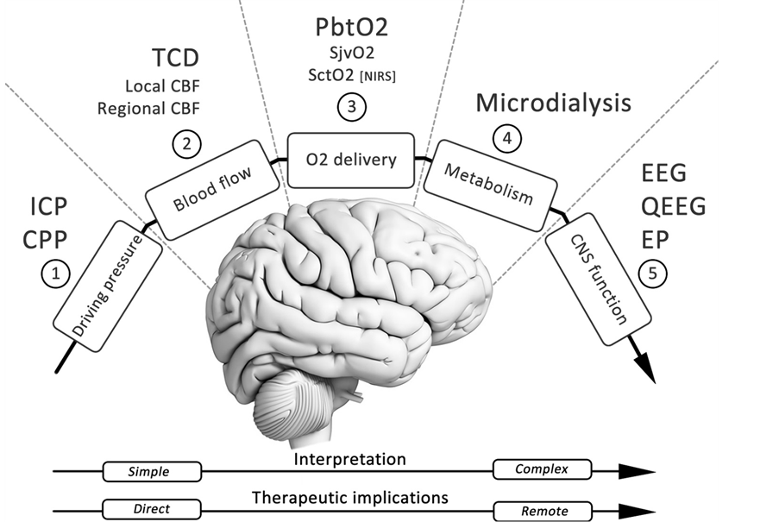
Az oxigéndeficit felismerése
Az oxigéndeficit kezelése
Az oxigéndeficit oka
Tánczos K, Németh M, Molnár Z. Ann. Up. in Int. Care and Em. Med. 2014, pp:355
Pandin P. et al.:Open Journal of Anesthesiology, 2014, 4, 131-152
CI
SVI
GEDVI
CO₂ rés
Transzfúzió
Folyadék
Hgb
SpO₂
Fájdalomcsillapítás
Oxigén
Agitáció
Fájdalom
Láz
Inotróp
Szedáció
Lázcsillapítás
ESZKÖZ
Tudat, diurézis, Periféria
(hő, szín, CRT
MAP
Vazopresszor
Organ
ScvO₂ és laktát
CÉL
DO₂
VO₂
Notes:
8
It is well known that the adequacy of tissue oxygenation is determined by the balance between the rate of oxygen transport to the tissues and the rate at which the oxygen is used by the tissues.
In order to maintain this balance we need to ensure not just an optimal driving pressure but also a sufficient quantity and quality of blood.
Therefor there is no one, single hemodanamically parameter with a set value, which one should treat or follow as a target,
Rather it is necessary to put all these hemodynamic variables and measures of oxigen delivery and consumption into context in a way that once macro-hemodynamic parameters are “normalized,” adequacy of treatment has to be checked by measures of oxygen debt.
However if its hold true for the global hemodynamic optimization why we shuoldnt use this concept in the case of cerebral hemodanymic optimization?
Measuring the ICP and cerebral perfusion pressure give us important information about the driving pressure, we can estimate the cerebral blood flow by using TCD, while oxigen debt of brian tissue may be indicated by different brain tissue oxigenisation parameters.

Slide 9
Az oxigéndeficit felismerése
Az oxigéndeficit kezelése = precíziós medicina
Az oxigéndeficit kezelése
Tánczos K, Németh M, Molnár Z. Ann. Up. in Int. Care and Em. Med. 2014, pp:355
Pandin P. et al.:Open Journal of Anesthesiology, 2014, 4, 131-152
Transzfúzió
Folyadék
Fájdalomcsillapítás
Oxigén
Szedáció
Inotróp
Lázcsillapítás
ESZKÖZ
Tudat, diurézis, Periféria
(hő, szín, CRT
MAP
Vazopresszor
Organ
ScvO₂ és laktát
CÉL
DO₂
VO₂
Notes:
9
It is well known that the adequacy of tissue oxygenation is determined by the balance between the rate of oxygen transport to the tissues and the rate at which the oxygen is used by the tissues.
In order to maintain this balance we need to ensure not just an optimal driving pressure but also a sufficient quantity and quality of blood.
Therefor there is no one, single hemodanamically parameter with a set value, which one should treat or follow as a target,
Rather it is necessary to put all these hemodynamic variables and measures of oxigen delivery and consumption into context in a way that once macro-hemodynamic parameters are “normalized,” adequacy of treatment has to be checked by measures of oxygen debt.
However if its hold true for the global hemodynamic optimization why we shuoldnt use this concept in the case of cerebral hemodanymic optimization?
Measuring the ICP and cerebral perfusion pressure give us important information about the driving pressure, we can estimate the cerebral blood flow by using TCD, while oxigen debt of brian tissue may be indicated by different brain tissue oxigenisation parameters.

Slide 10
Dinamikus szemlélet
- kritikus állapot -
Mérés
Értékelés
IDŐ
Kezelés

Slide 11
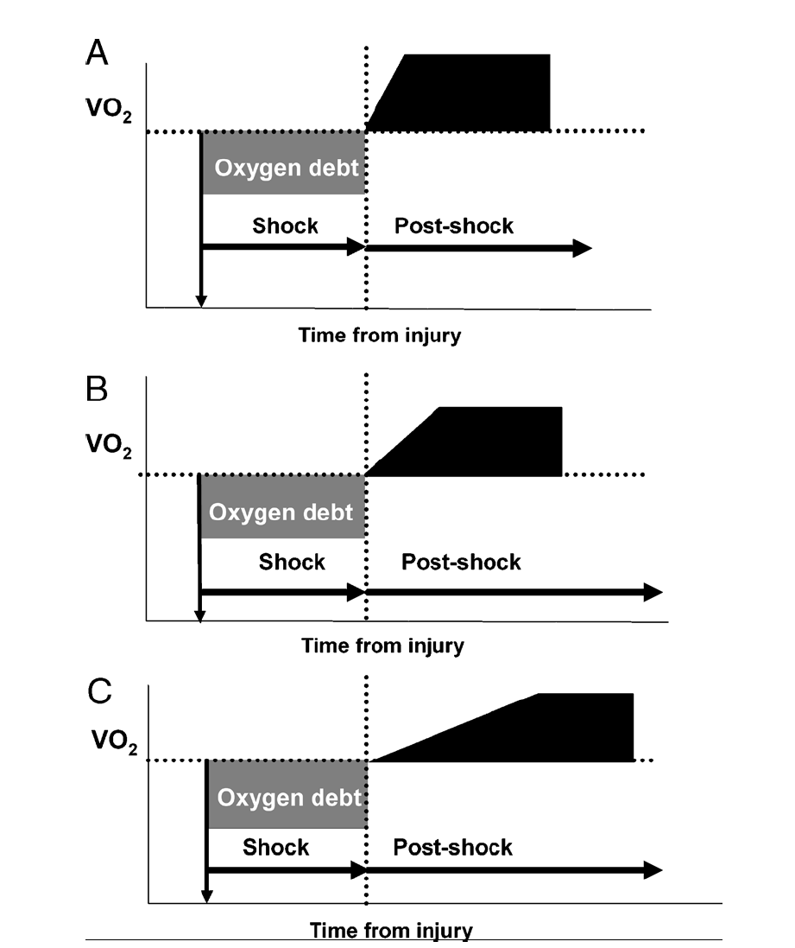
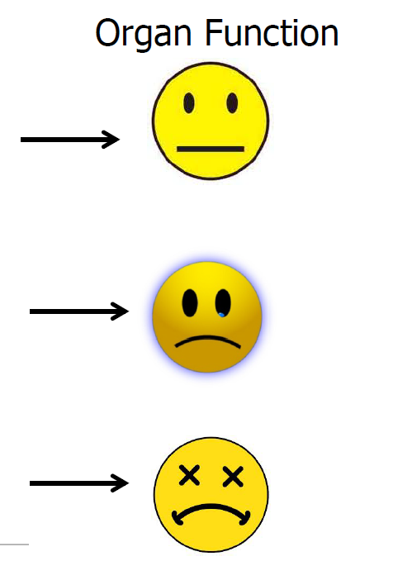

Slide 12
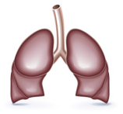
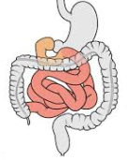
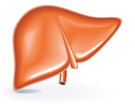
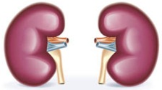
„VÉRELÉGTELENSÉG”
Szervelégtelenség

Slide 13
Endothel károsodás

Slide 14
Hemodinamikai
Makrocirkuláció
Mikrocirkuláció
Koherencia
Oxigénadósság
Endothel károsodás
Endothel aktiválódás
Kapilláris „leak”
Diszregulált
Kapilláris denzitás/flow
Diszregulált immunválasz
Diszregulált alvadás
„VÉR-ELÉGTELENSÉG”

Slide 15
Hemodinamikai
Makrocirkuláció
Mikrocirkuláció
INkoherencia
Oxigénadósság
Endothel károsodás
Kapilláris „leak”
Diszregulált
Kapilláris denzitás/flow
Diszregulált immunválasz
Diszregulált alvadás
„VÉR-ELÉGTELENSÉG”

Slide 16
Paradigmaváltás az ellátásban
Tánczos K. et al.: Intensive Care Med 2015;41:712-715
Notes:
Rate of weaning failure after a single SBT is reported to be 26–42%(table 2) [17, 22]. This variation in the rate ofweaning failure among the studies may be due to differences in the definition of weaning failure, especially differences in the subjective indexes used to define failed SBT, or variation in the patients studied. For
instance, chronic obstructive pulmonary disease (COPD) appears as an independent risk factor for increased duration of
weaning and weaning failure [18]. VALLVERDU et al. [17] reported that weaning failure occurred in as many as 61% of COPD patients, in 41% of neurological patients and in 38% of hypoxaemic patients. Contradictory results exist regarding the rate of weaning success among neurological patients [13, 17]. The study by COPLIN et al. [13] of brain-injured patients demonstrated that 80% of patients with a Glasgow coma score ,8 and 91% of patients with a Glasgow coma score ,4 were successfully extubated. Finally, as shown in table 2, in 2,486 patients from six randomised studies, 524 patients failed SBT and 252 failed extubation after passing SBT, leading to a total weaning failure rate of 31.2%

Slide 17
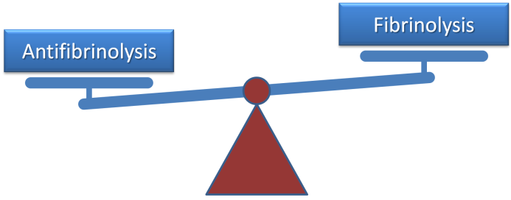
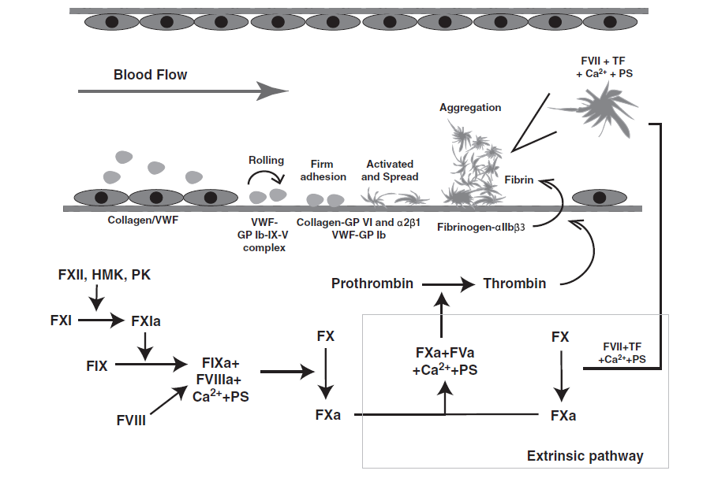
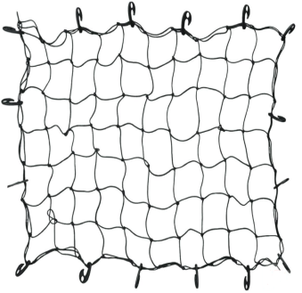
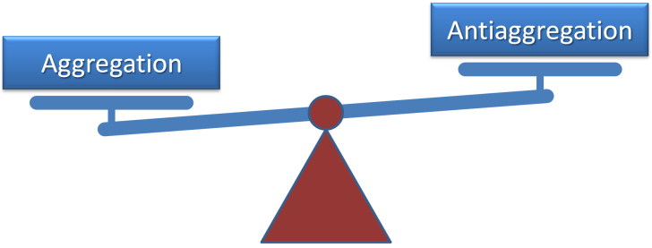
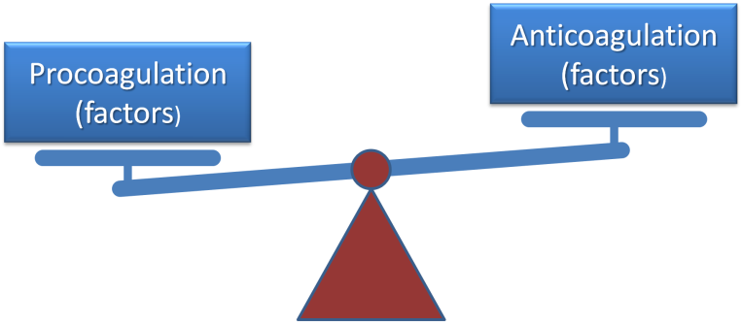
A véralvadás alapjai…
Zhang et al J Neurotrauma 2012; 29:2597–2605
Fibrinolízis
Primer hemosztázis
Vérrög
Trombingeneráció

Slide 18
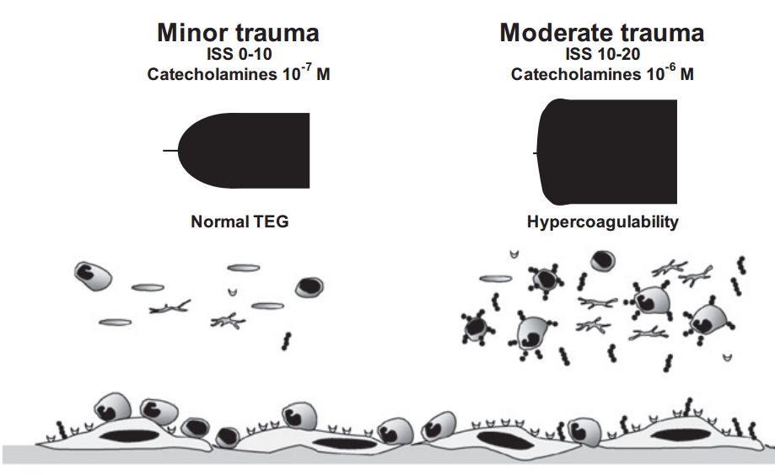
Szöveti sérülés
(Trauma, műtét)
Inflammáció
(fertőzés, égés..)
Katekolamin
Endothél
Endothél aktiváció
Primer hemosztázis
Fibrinolízis
Thrombocita
Plazma
Trombingeneráció

Slide 19
J Trauma Acute Care Surg. 2017;82:6,S41-49
„VÉRELÉGTELENSÉG”
Katekolamin
Oxigénadósság
Inflammáció
Endothél
Endothél károsodás
Primer hemosztázis
Fibrinolízis
Thrombocita
Plazma
Trombingeneráció

Slide 20
J Trauma Acute Care Surg. 2017;82:6,S41-49
„VÉRELÉGTELENSÉG”
Katekolamin
Oxigénadósság
Inflammáció
Endothél
Endothél károsodás
Hiperfibrinolízis / Fibrinolizis „shutdown”
Primer hemosztázis
Thrombocita diszfunkció
Fibrinolízis
Thrombocita
Plazma
Autoantikoaguláció
Trombingeneráció

Slide 21
J Trauma Acute Care Surg. 2017;82:6,S41-49
„VÉRELÉGTELENSÉG”
Katekolamin
Oxigénadósság
Inflammáció
Endothél károsodás
Thrombocita diszfunkció
Hipothermia
Acidózis
Autoantikoaguláció
Hiperfibrinolízis
Dilúció
Sérülés
Reszuszcitáció

Slide 22
Betegágy mellett…
Konvencionális tesztek
Bolliger D et al Transfusion Medicine Reviews 2012; 26: 1-13
Notes:
Regarding the viscoelastic test there are two deviceses which are avaiable on the market. Thromboelastography or TEG is from the United States, while the other one, rotational thromboelasthometry or ROTEM is a german device. Viscoelastic test is a rapid and dynamic POC devices of whole-blood coagulation. In other words the two devices are very similar and during the curve-analysis they provide valueable information about the initiation and kinetics of clot formation, clot firmness and, and clot breakdown. While mesuring primary hemostasis we should also use another test called platlet aggregometry, to be discussed later.

Slide 23
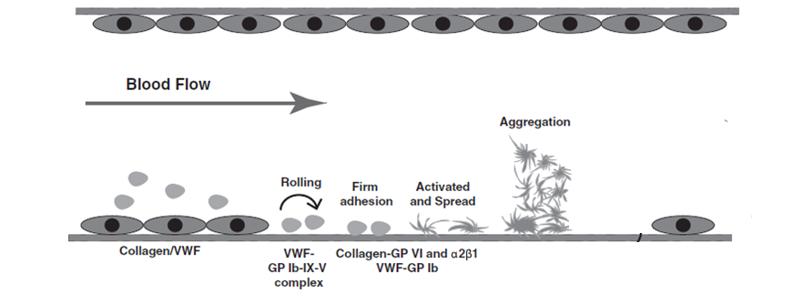
Thrombocitafunkció
Zhang et al J Neurotrauma 2012; 29:2597–2605
Platelet
adhesion
Platelet activation
Platelet aggregation
„Thrombocyta burst”
vWF
Collagen
ADP
TXA₂
Thrombin
Notes:
Beyond the abolute platelet count the function is just as important. During the primary hemostasis the platelets have 3 main function. Adhesion with vWF and collagen to the endothelial cells, then activation by ADP and TXA, and the platelet aggregation, which is potentiated by thrombin. At the same time thrombocytes play a very important role throughout, by providing surface for the whole process.

Slide 24
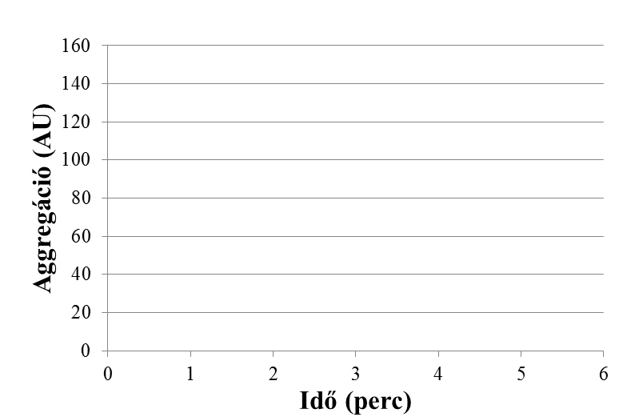
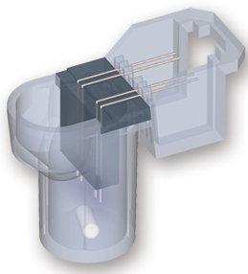
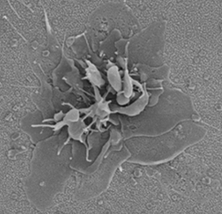
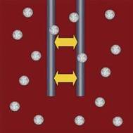
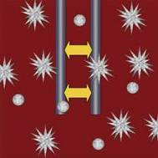
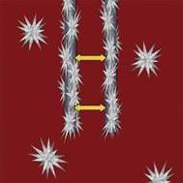
Multiple Electrode Aggregometry (MEA) Multiplate®
Aggregation (AU)
Area under the curve = AUC (AU x min)
α
Time (min)
Notes:
Activating the platelets with different activators will result the activated platelets sticking onto the electrodes, hence increasing their eletrical resistance. During the analysis the area under the curve shows the amount of activated thrombocytes. Consequently, the smaller the AUC, the worse the platelet function.

Slide 25
Aktivátorok…
 | Activation | Sensitive | Insensitive
RISTO test | Ristocetin: vWF dependens platelet activation via GpIb receptor | Bernard-Soulier syndroma, severe vWD, aspirin
COL test | Collagen: platelet activation via GpIV and α2β1 receptor | aspirin, IIb/IIIa antagonists | clopidogrel, vWF
ASPI test | arachidon acid: activation via COX - TXA₂ pathway | aspirin, IIb/IIIa antagonist | clopidogrel, vWF
ADP test | ADP: ligand of platelet’s ADP receptors | clopidogrel, IIb/IIIa antagonist | aspirin, vWF
TRAP test | TRAP-6 :thrombin receptor activating peptide | IIb/IIIa antagonista | vWF, aspirin, clopidogrel

Slide 26
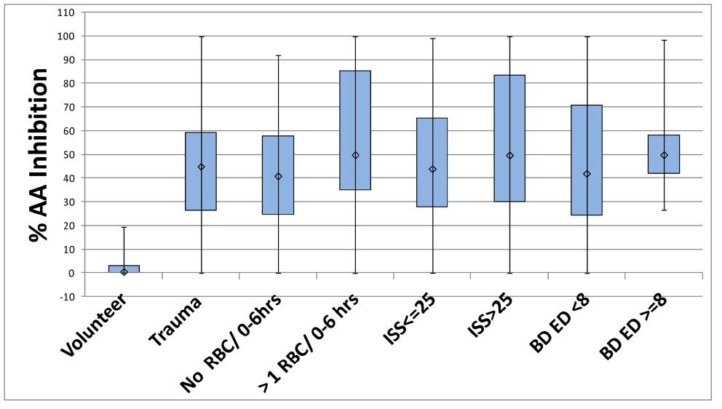
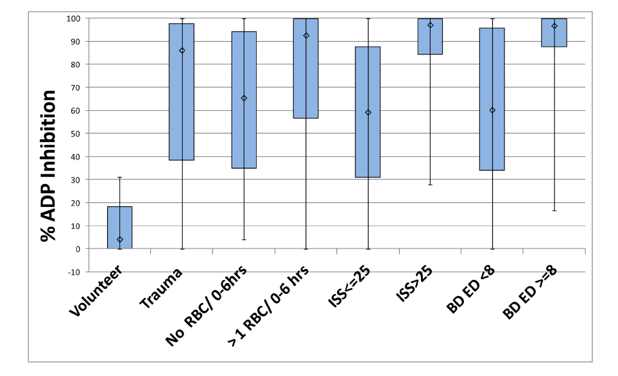
Wohlauer et al. J Am Coll Surg. 2012; 214(5): 739–746

Slide 27
Konvencionális vs. Viszkoelasztikus tesztek
Koagulopátia
Konvencionális tesztek
Bolliger D et al Transfusion Medicine Reviews 2012; 26: 1-13
INR /APTI ATIII
Notes:
Regarding the viscoelastic test there are two deviceses which are avaiable on the market. Thromboelastography or TEG is from the United States, while the other one, rotational thromboelasthometry or ROTEM is a german device. Viscoelastic test is a rapid and dynamic POC devices of whole-blood coagulation. In other words the two devices are very similar and during the curve-analysis they provide valueable information about the initiation and kinetics of clot formation, clot firmness and, and clot breakdown. While mesuring primary hemostasis we should also use another test called platlet aggregometry, to be discussed later.

Slide 28
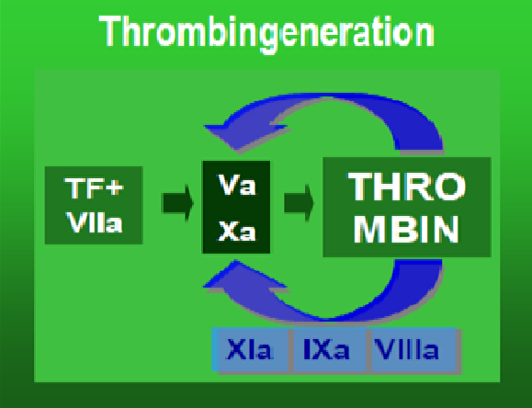
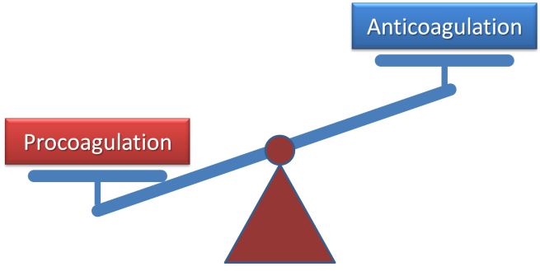
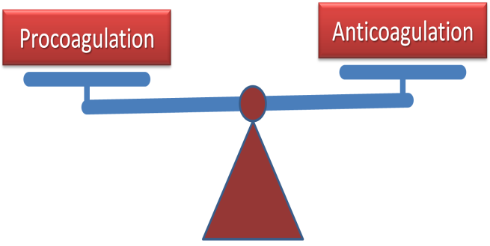
INR = 2.5 ?
Orális antikoagulánst
(warfarint) szedő beteg
Közepesen súlyos
májcirrózisban
szenvedő beteg
Jobban vérzik
Nem vérzik jobban,
DE: nincs tartaléka
PCC terápia (FFP)
(koponyasérült !!)
FFP + PCC terápia

Slide 29
Konvencionális tesztek
Bolliger D et al Transfusion Medicine Reviews 2012; 26: 1-13
INR /APTI ATIII
Fibrinogén
thrombocita
D-dimer
Notes:
Regarding the viscoelastic test there are two deviceses which are avaiable on the market. Thromboelastography or TEG is from the United States, while the other one, rotational thromboelasthometry or ROTEM is a german device. Viscoelastic test is a rapid and dynamic POC devices of whole-blood coagulation. In other words the two devices are very similar and during the curve-analysis they provide valueable information about the initiation and kinetics of clot formation, clot firmness and, and clot breakdown. While mesuring primary hemostasis we should also use another test called platlet aggregometry, to be discussed later.

Slide 30
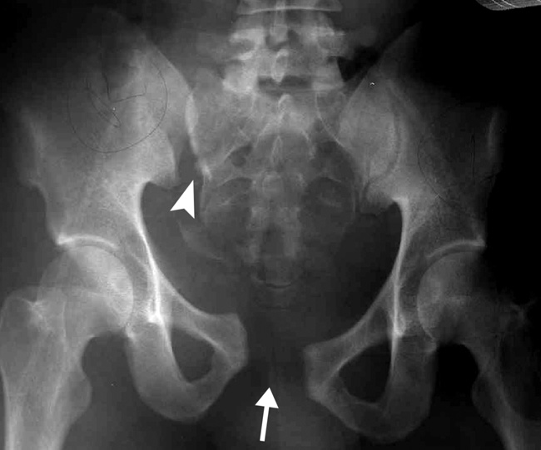
Preoperatív időszak
Intraoperatív időszak
Posztperatív időszak
Folyadékreszponder
(2+2 E vvt)
Nincs szervelégtelenség
Kb. 2 óra (≈ 500-700ml)
Jó tudat és gázcsere
Növekvő
noradrenalin igény
Ballanszírozott folyadékterápia
Labor paraméter | érték
INR | 1.24
APTI | 44.5 s
ATIII | 72 %
TI | 17.2 s
Fibrinogén | 3.44 g/l
D-Dimer | 1.54 ug/ml
Tct | 107 G/l
Konvencionális labor
pH | 7.31
pO2 | 147.5
pCO2 | 29.4
BE | -7.9
Hct | 19 %
Laktát | 4.9
Labor paraméter | érték
INR | 1.38
APTI | 49.5 s
ATIII | 64 %
TI | 19.2 s
Fibrinogén | 1.99 g/l
D-Dimer | 10.54 ug/ml
Tct | 99 G/l
Hasi UH
+
Sebész konz.
Folyadék (1000 ml)
+ Noradrenalin
2 E vvt
+
2 E FFP/1gr fibrinogén
Supportív
terápia
Ébredő, extubálva
Thő: 35.9
Noradrenalin
(5-7 ug/min)
pH | 7.339
pO2 | 125.7
pCO2 | 34.9
BE | -4.5
Hct | 23 %
Laktát | 2.9
FIBRINOGÉN !!
Tranexámsav
Fibrinogén + FFP

Slide 31
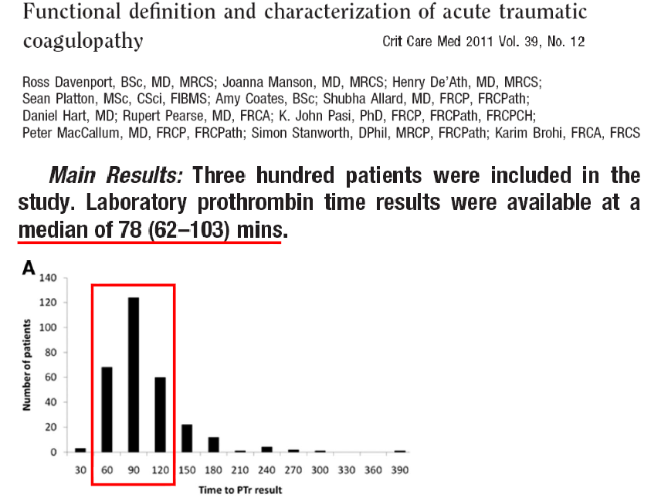
Konvencionális tesztek
PT / INR
aPTT
5 %
Mann KG et al Circulation 2011; 124:225-235
static and late tests
Tanaka KA et al Anesth Analg 2009; 108:1433-1446
Toulon P et al Thromb Haemost 2009;101:394-401
Notes:
Regarding the standard plasma-based laboratory tests, well, we are not very well of. Maybe the most commonly used parameters from these tests are the prothrombin time and the activated thromboplastin time, however, their results from the central laboratory come far too late. According to the results of these two prospective, observational studies the standard coagulation tests were available just after 50 to 80 min, which may be inappropiate in the case of a severly bleeding patients.

Slide 32
Konvencionális tesztek
Bolliger D et al Transfusion Medicine Reviews 2012; 26: 1-13
INR /APTI ATIII
Fibrinogén
thrombocita
D-dimer
Gyors – Dinamikus ?
Notes:
Regarding the viscoelastic test there are two deviceses which are avaiable on the market. Thromboelastography or TEG is from the United States, while the other one, rotational thromboelasthometry or ROTEM is a german device. Viscoelastic test is a rapid and dynamic POC devices of whole-blood coagulation. In other words the two devices are very similar and during the curve-analysis they provide valueable information about the initiation and kinetics of clot formation, clot firmness and, and clot breakdown. While mesuring primary hemostasis we should also use another test called platlet aggregometry, to be discussed later.

Slide 33
Optimális alvadási teszt:
- súlyos vérzés esetén -
Gyors – Teljes vér - Dinamikus
Notes:
Therefore, in complex coagulopathy, an optimal test should rapidly provide information on the individual patient’s coagulation therefore it can be used dynamically in critically bleeding patients. The optimal test should be performed on whole blood and provide a comprehensive overview of the entire coagulation process from the primary hemostasis to the clot stability.

Slide 34
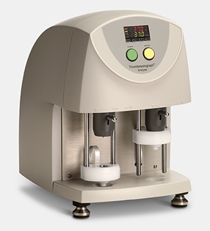
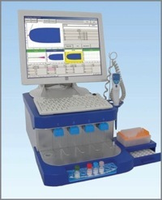
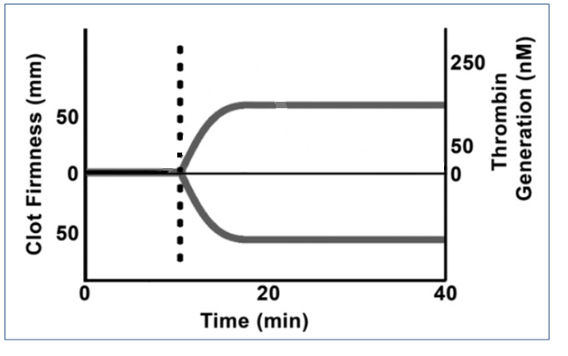
Viszkoelasztikus tesztek (TEG®, ROTEM®)
Bolliger D et al Transfusion Medicine Reviews 2012; 26: 1-13
Fast – Whole Blood - Dynamic
Platelet
aggregometry
Notes:
Regarding the viscoelastic test there are two deviceses which are avaiable on the market. Thromboelastography or TEG is from the United States, while the other one, rotational thromboelasthometry or ROTEM is a german device. Viscoelastic test is a rapid and dynamic POC devices of whole-blood coagulation. In other words the two devices are very similar and during the curve-analysis they provide valueable information about the initiation and kinetics of clot formation, clot firmness and, and clot breakdown. While mesuring primary hemostasis we should also use another test called platlet aggregometry, to be discussed later.

Slide 35
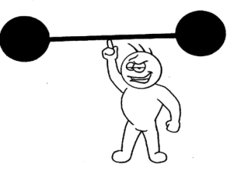
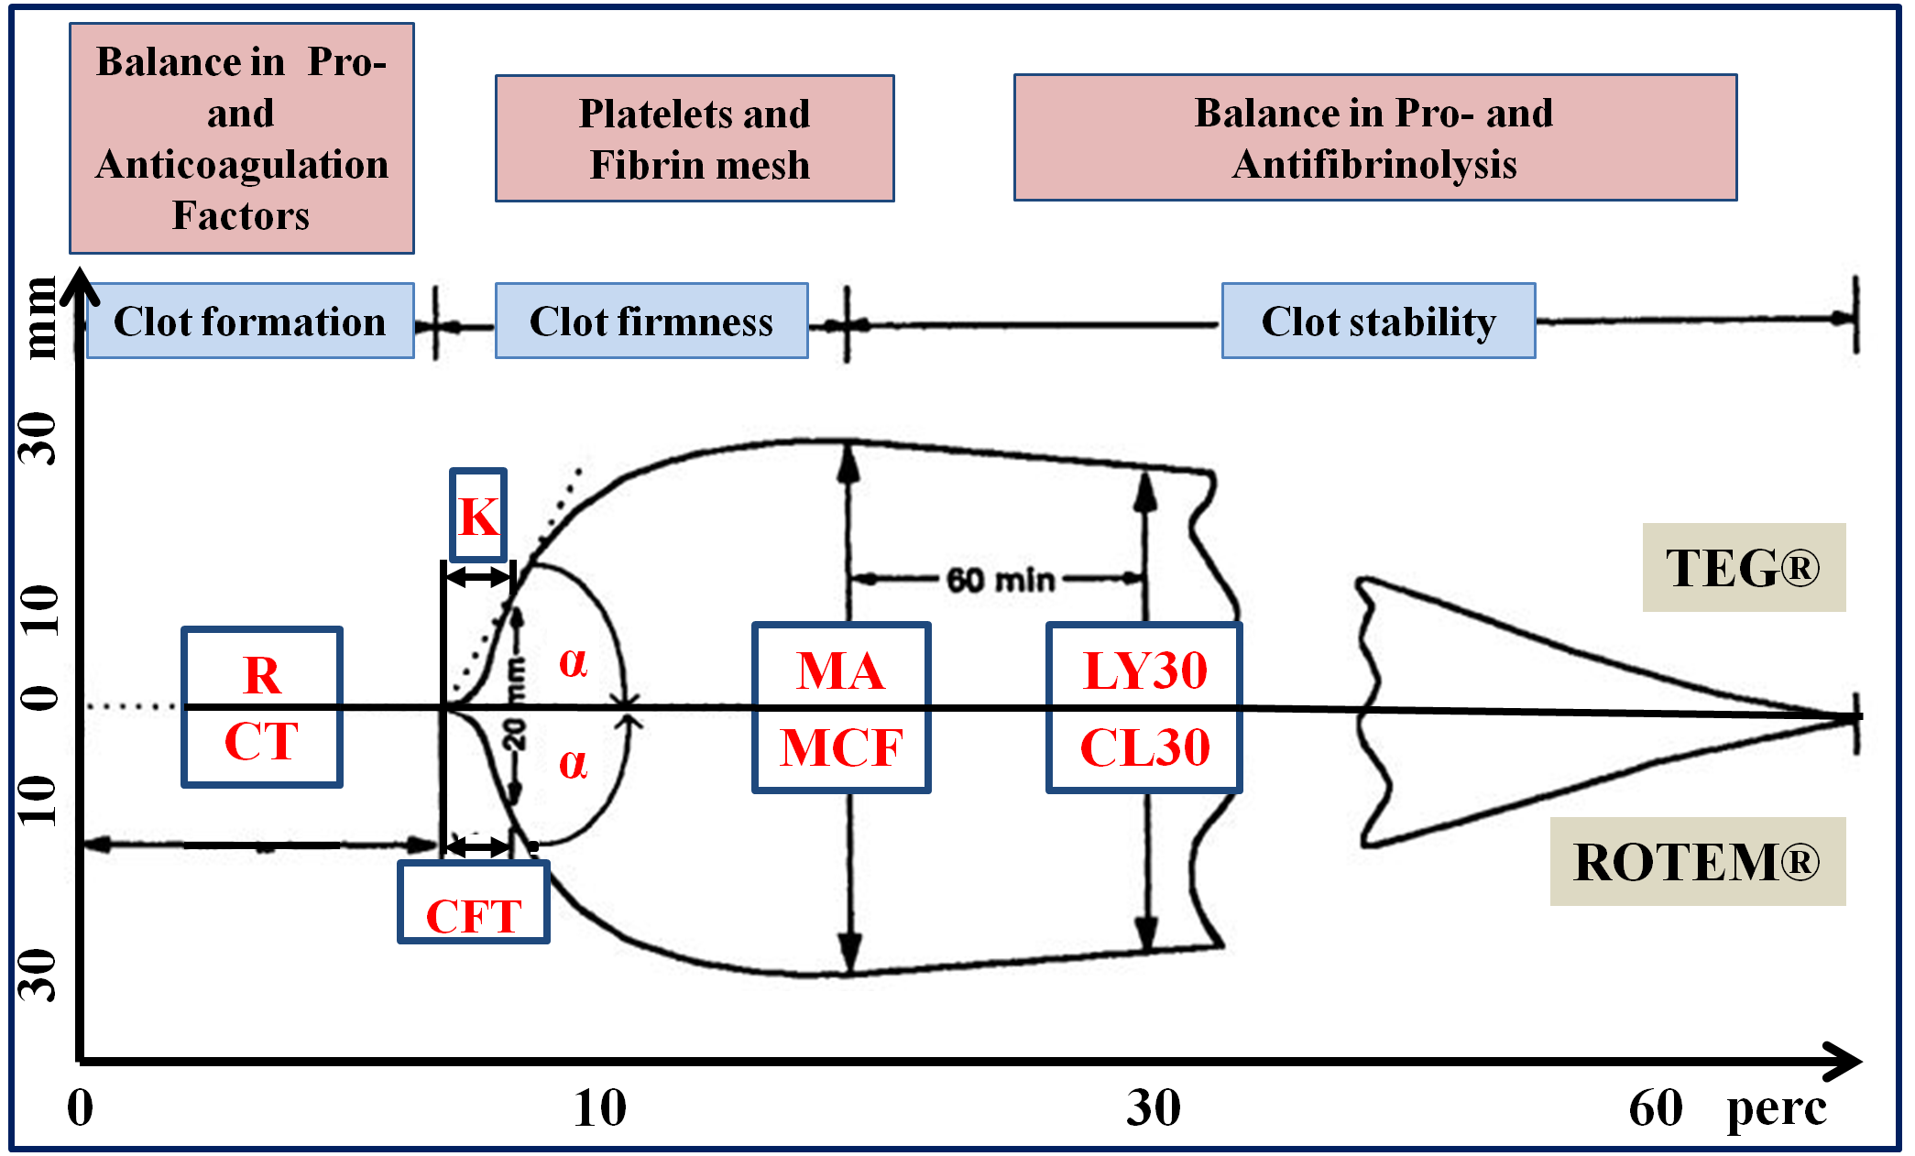
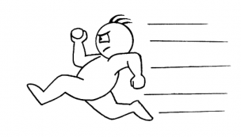
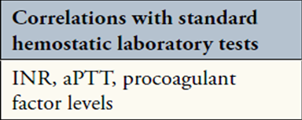
TEG® vs. ROTEM®
Clot strength
PCC +/- FPP Fibrinogén konc, FFP, Tct konc Tranexámsav
Stravicz RT et al Gastroent & Hepat 2012; 8: 513-520
Notes:
This slide summarises the curve analysis: the clotting time is affected by the ballance of the pro and anticoagulation plasmatic factors, the kinetic of the clot formation represenred by k, alpha or cft. The strenght of the clot is affected by the fibrin network and the activated platlets, while the clot stability or the fibrinolysis is shown by these parameters.
It is important to note that VET results cannot be compared directly with SCTs, because TEM analyses are performed on whole blood, whereas most SCTs are measured in plasma. Nonetheless, INR, aPTT and the level of pro and anticoagulant factors may corralete with the clotting time, platlets count and the fibrinogen levels, with MA or MCF, while D.dimer or FDP with the clot stability.

Slide 36
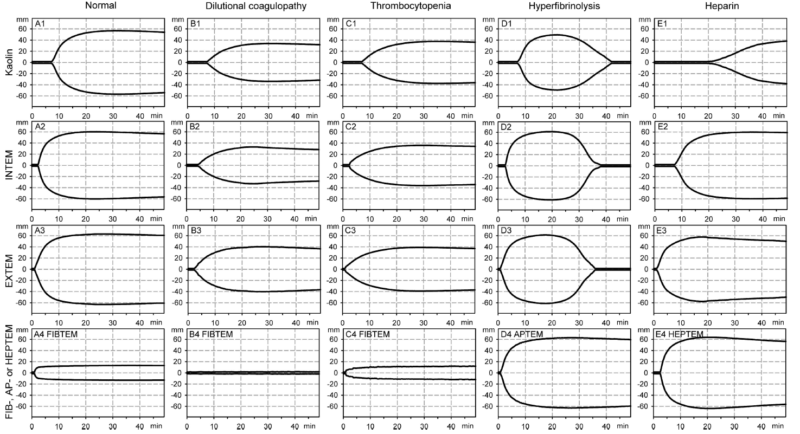
TEG/ROTEM curves…
Notes:
How does it look like on the screen. These are the typical curves of each test under normal conditions.
In case of dilutional coagulopathy, both the clotting time and the clot stregth is impaired due to dilution of the couagulation factors, platelets and fibrinogen.
In trhombocytopenia the clot strength is affected, but the fibrinogen test is normal.
Here you can see a typical curve of hyperfibrinolysis. By adding aprotinin to the sample normalises the curve.
And finally, as the last example, the prolonged intrinsic pathway can be reversed by heparinase if the long clotting time is the result heparin effect and not due to the lack of pro-coagulation factors.

Slide 37
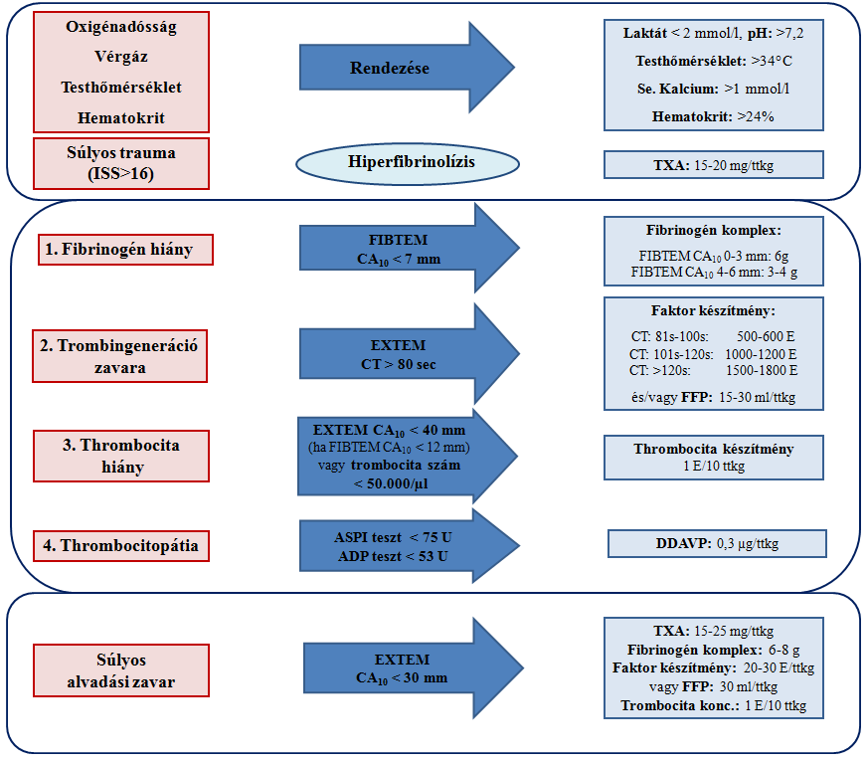
>

Slide 38
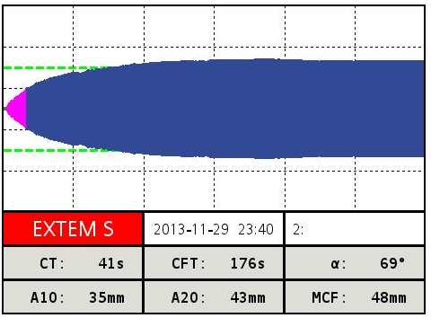
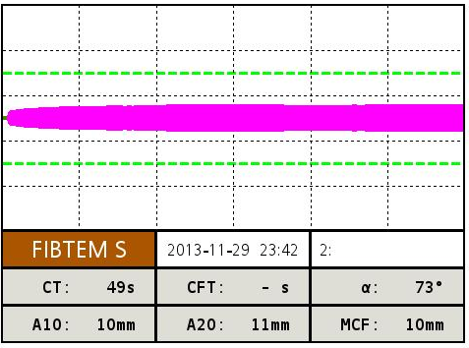
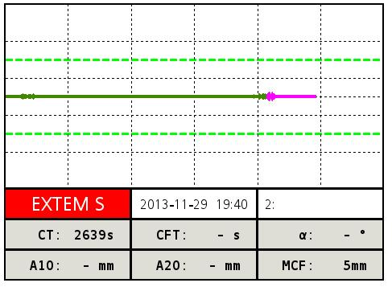
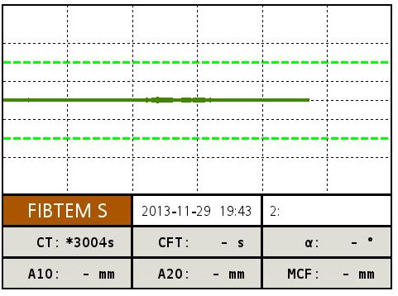
10 E vvt / 10 E FFP
2000 E PPC
3 gr fibrinogén
12 E Tct
7 E vvt / 8 E FFP
500 E PPC
2 gr fibrinogén
2 E vvt
39 éves ffi
„C” tipusú medencetörés
hólyagsérülés

Slide 39
10 E vvt / 10 E FFP
2000 E PPC
3 gr fibrinogén
12 E Tct
7 E vvt / 8 E FFP
500 E PPC
2 gr fibrinogén
2 E vvt
2 E vvt
1 gr fibrinogén
8 E Tct
24 mikrogr DDAVP
39 éves ffi
„C” tipusú medencetörés
hólyagsérülés

Slide 40
Traumás diszfibrinogenémia
Konvencionális teszt
fibrinogén szint: 2.2 g/l
Viszkoelasztikus teszt

Slide 45
„Vérelégtelenség”
White NJ et al, J Trauma Acute Care Surg 2017;82, S41-49
1. Fizesd ki az oxigénadósságot!
2. Javítsd meg a glykocalixot!
3. Állítsd meg a fibrinolízist!
4. Pótold, ami elveszett!

Slide 46
Kezelési stratégia súlyosan vérző betegeknél
Tánczos K et al Intensive Care Med. 2015; DOI 10.1007/s00134-015-3658-8
Dinamikusan működő rendszer !

